Slide 1
Honest estimation of treatment effects in subgroups
PSI 2023 Subgroup SiG Session
June 14th, 2023
Presenter: Yuejia Xu (Early Biometrics & Statistical Innovation, Data Science & Artificial Intelligence, R&D, AstraZeneca)
Joint work with David Svensson (Early Biometrics & Statistical Innovation, Data Science & Artificial Intelligence, R&D, AstraZeneca)

Slide 2
Acknowledgements and disclaimer
Authors would like to thank PSI subgroup Special Interest Group members for valuable inputs and helpful discussions.
Disclaimer: The opinions expressed in this presentation are those of the authors, and do not necessarily reflect the official policy of AstraZeneca.

Slide 3
Presentation outline
Background and a toy example
A review of commonly-seen “bias-adjusted” methods discussed in the literature
  Resampling
  Global modelling
Simulation studies – an empirical comparison of the methods
Discussion and future work

Slide 4
Background
Subgroup analysis:
  Subgroup identification: researchers look for the best subgroup which comes from domain considerations/data-driven methods
  Subgroup inference: provide inference on the promising subgroup and see how good the selected subgroup is
Naïve (unadjusted) estimator: the estimated effect size of the selected subgroup and perform statistical inference conditional on the selected subgroup
It is well-recognised that the naïve estimator will overestimate the true treatment effect in the selected subgroup (Thomas & Bornkamp, 2017)

Slide 5
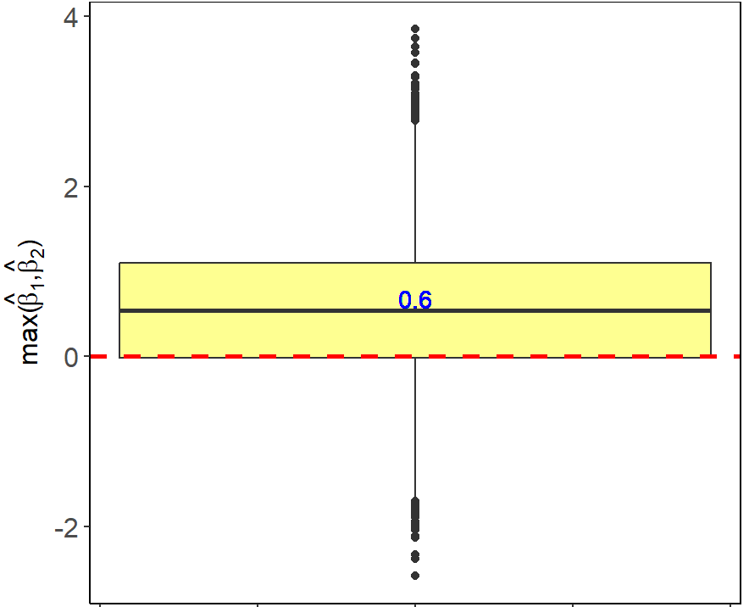


A simulated toy example (Guo & He, 2021)
  Two pre-specified subgroups with true treatment effect sizes $β_{1}$ and $β_{2}$
  Assume no treatment effects in both subgroups, i.e., $β_{1}$ = $β_{2}$ = 0, and estimated effect sizes in these two subgroups, $\hat{β_{1}}$ and $\hat{β_{2}}$, are independent and follow standard normal distribution $N(0,1)$
  Boxplot of max($\hat{β_{1}}$, $\hat{β_{2}}$) based on 10000 simulated samples
max($\hat{β_{1}}$, $\hat{β_{2}}$) is an inflated estimator for max($β_{1}$, $β_{2}$)
Interpretation: in the case where both subgroups have no treatment effects, we still observe the treatment effect in the best subgroup to be 0.6 on average
Notes:
Take home message: the naïve approach is very risky for subgroup pursuit. To make a better informed decision, an appropriate adjustment to the subgroup selection bias is needed.

Slide 6
Method – Resampling
Main idea of resampling methods:
  Use independent samples to adjust for selection bias
Examples of resampling methods:
  Cross-validation estimator
  Bootstrap bias-correction methods (Foster et al., 2011; Thomas & Bornkamp, 2017)
    Bootstrap re-substitution estimator
      Directly estimate the bias introduced by the subgroup selection process
    Bootstrap 0.632 estimator
      Combine unadjusted estimate with the average estimates in the estimation sample

Slide 7
Cross-validation approach
1
Split the data into $k$ folds, use $k−1$ folds for training (identification) and 1 fold for test (estimation)
Original data
(divided into 5 parts)
Fold 1 | Fold 2 | Fold 3 | Fold 4 | Fold 5
Iteration 1
Fold 1 | Fold 2 | Fold 3 | Fold 4 | Fold 5
Iteration 2
Fold 1 | Fold 2 | Fold 3 | Fold 4 | Fold 5
Training (identification) sets
Iteration 3
Fold 1 | Fold 2 | Fold 3 | Fold 4 | Fold 5
Iteration 4
Fold 1 | Fold 2 | Fold 3 | Fold 4 | Fold 5
Test (estimation) sets
Iteration 5
Fold 1 | Fold 2 | Fold 3 | Fold 4 | Fold 5
2
Within each iteration, perform subgroup identification based on the training (identification) set
3
Predict treatment effects for subjects in the test (estimation) set based on the subgroup identification model constructed on the training (identification) set
4
Each subject will have an out-of-sample predicted treatment effect. Adjusted subgroup treatment effect will be estimated by averaging over out-of-sample predictions for subjects in the subgroup.

Slide 8

Bootstrap-based approaches
1
Split the data into training (identification) and test (estimation) sets by bootstrapping (sampling with replacement)
Original data
1 | 2 | 3 | 4 | 5 | 6 | 7 | 8 | 9 | 10
Training (identification) sets
Test (estimation) sets
Bootstrap 1
8 | 6 | 2 | 9 | 5 | 8 | 1 | 4 | 8 | 2
3 | 7 | 10
Bootstrap 2
…
10 | 1 | 3 | 5 | 1 | 7 | 4 | 2 | 1 | 8
6 | 9
Bootstrap $B$
6 | 5 | 4 | 1 | 2 | 4 | 2 | 6 | 9 | 2
3 | 7 | 8 | 10
2
Within each bootstrap sample, perform subgroup identification based on the training (identification) set and obtain subgroup effect in the training (identification) set
3
Predict subgroup treatment effect in the test (estimation) set
4
Compare the treatment effect in the selected subgroup between the training (identification) set and the test (estimation) set
Repeat steps 2-4 for $B$ bootstrap samples, estimate the bias and adjust the original estimates

Slide 9

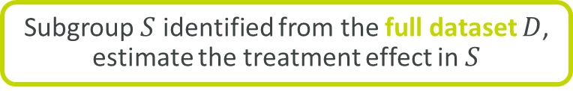
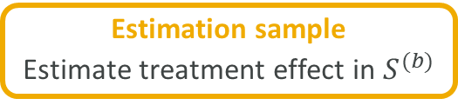
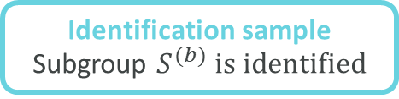
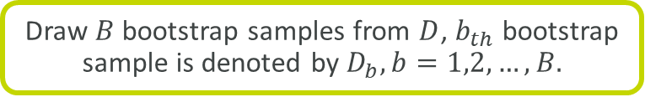
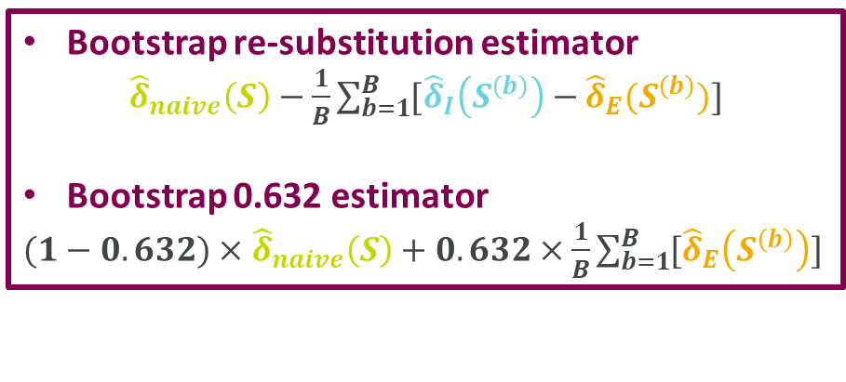


Bootstrap re-substitution and bootstrap 0.632
Subgroup $S$ identified from the full dataset $D$, estimate the treatment effect in $S$
Naïve treatment effect estimate in $S$: ${\hat{δ}}_{naive}(S)$
Bootstrap re-substitution estimator
${\hat{δ}}_{naive}\left(S\right)−\frac{1}{B}\sum_{b=1}^{B}{[{\hat{δ}}_{I}\left(S^{\left(b\right)}\right)−}{\hat{δ}}_{E}(S^{\left(b\right)})]$
Bootstrap 0.632 estimator
$(1−0.632)×$ ${\hat{δ}}_{naive}\left(S\right)+0.632×\frac{1}{B}\sum_{b=1}^{B}{[{\hat{δ}}_{E}\left(S^{\left(b\right)}\right)]}$
Draw $B$ bootstrap samples from $D$, $b_{th}$ bootstrap sample is denoted by $D_{b}, b=1,2,…,B.$
Identification sample Subgroup $S^{(b)} is identified$
Estimation sample
Estimate treatment effect in $S^{(b)}$
$${\hat{δ}}_{I}(S^{(b)})$$
$${\hat{δ}}_{E}(S^{(b)})$$

Slide 10
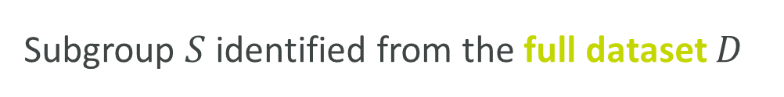
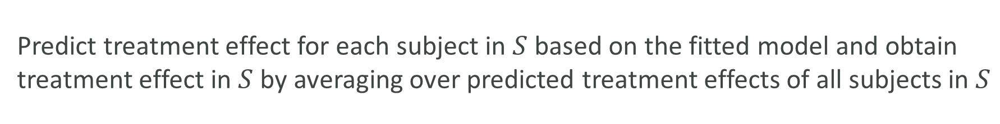
Method – globally fitted LASSO/Causal forest
Main idea of globally fitted models:
Estimate treatment effects in the selected subgroup based on a global model that implicitly induces shrinkage in treatment effect estimation (Thomas & Bornkamp, 2017)
1
Subgroup $S$ identified from the full dataset $D$
2
Fit a global model on $D$, e.g., LASSO (Tibshirani, 1996) or Causal Forest (Wager & Athey, 2018)
Predict treatment effect for each subject in $S$ based on the fitted model and obtain treatment effect in $S$ by averaging over predicted treatment effects of all subjects in $S$
3

Slide 11
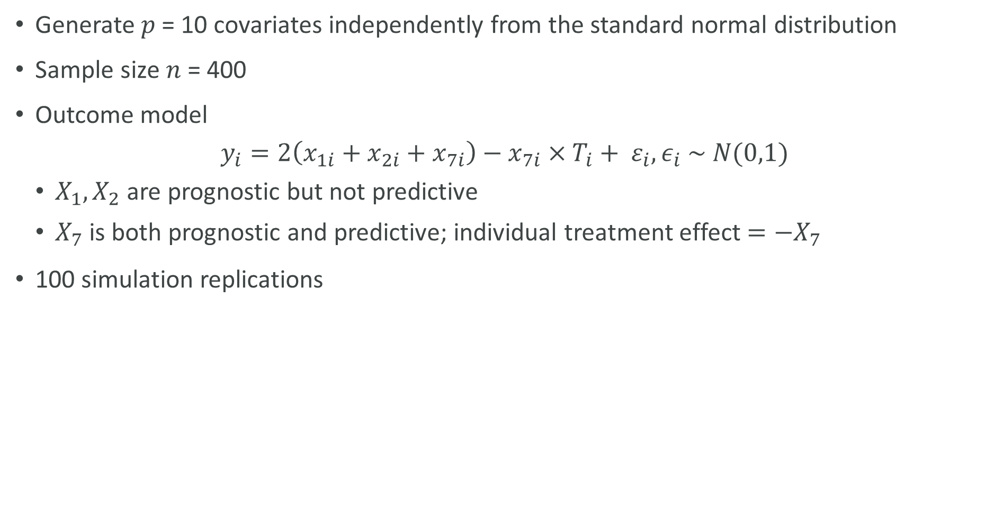
Simulation Set-up
Generate $p$ = 10 covariates independently from the standard normal distribution
Sample size $n$ = 400
Outcome model
$$y_{i}=2\left(x_{1i}+x_{2i}+x_{7i}\right)−x_{7i}×T_{i}+ ε_{i}, ε_{i} \sim N(0,1)$$
  $X_{1},X_{2}$are prognostic but not predictive
  $X_{7}$ is both prognostic and predictive; individual treatment effect ${=−X}_{7}$
100 simulation replications

Slide 12
Methods under comparison in simulation studies
1) Naïve estimator from unstructured and greedy subgroup search approach
2) Naïve estimator from data-driven approaches (model-based recursive partitioning; Seibold et al., 2016)
3) Bias-adjusted methods
  Resampling methods
    Cross-validation (10-fold cross-validation, repeat the splits 50 times)
    Bootstrap re-substitution (50 bootstrap samples)
    Bootstrap 0.632 (50 bootstrap samples)
  Globally fitted model
    LASSO
    Causal forest

Slide 13
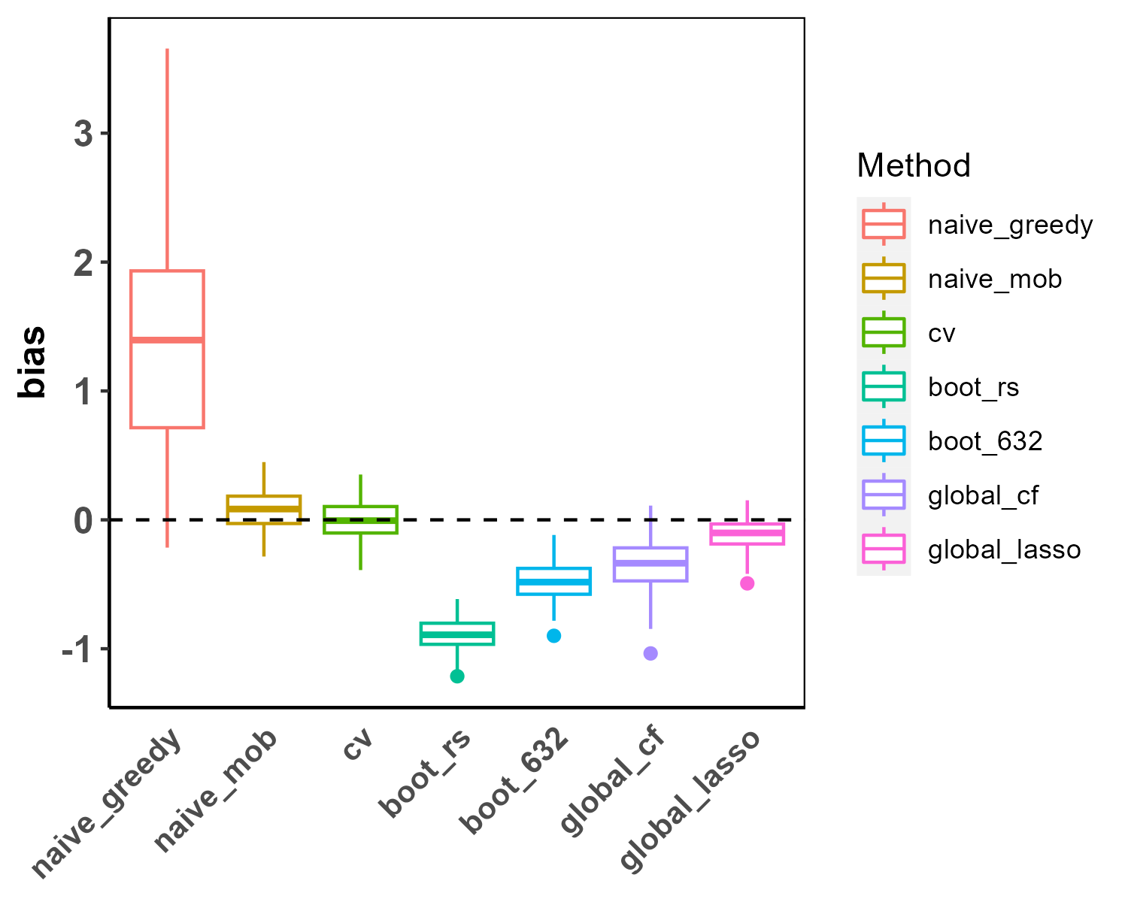
Simulation results
Table 1: Bias for estimating the treatment effect in the selected subgroup using different methods
Method | Mean | SD
Greedy search – naïve (naïve_greedy) | 1.37 | 0.83
MOB – naïve (naïve_mob) | 0.08 | 0.14
Cross-validation (cv) | - 0.01 | 0.16
Bootstrap re-substitution (boot_rs) | - 0.89 | 0.14
Bootstrap 0.632 (boot_632) | - 0.48 | 0.15
Globally fitted causal forest (global_cf) | - 0.35 | 0.21
Globally fitted LASSO (global_lasso) | - 0.11 | 0.12

Slide 14
Conclusion and future work
Honest estimation of treatment effects in the selected subgroup is a challenging problem
Naïve treatment effect estimators suffer from selection bias and are overly-optimistic
  Structured and data-driven approaches (e.g. MOB) lead to less bias compared to unstructured and greedy search subgroup identification approaches
We compare several bias-adjusted subgroup treatment effect estimators via simulations
  Cross-validation-based estimator appears to be closest to the truth
  Most “bias-adjusted” approaches proposed in the literature seem to be overly-conservative and underestimate the true treatment effect in the selected subgroup
Future research
  More simulation scenarios
  Other bias-adjusted methods that worth further investigation
    0.632+ estimator proposed by Efron and Tibshirani (1997)
    Bias-adjusting bootstrap procedure proposed by Guo and He (2021)

Slide 15
Key references
Efron, B., & Tibshirani, R. (1997). Improvements on cross-validation: the 632+ bootstrap method. Journal of the American Statistical Association, 92(438), 548-560.
Foster, J. C., Taylor, J. M., & Ruberg, S. J. (2011). Subgroup identification from randomized clinical trial data. Statistics in medicine, 30(24), 2867-2880.
Guo, X., & He, X. (2021). Inference on selected subgroups in clinical trials. Journal of the American Statistical Association, 116(535), 1498-1506.
Lipkovich, I., Dmitrienko, A., & B D'Agostino Sr, R. (2017). Tutorial in biostatistics: data‐driven subgroup identification and analysis in clinical trials. Statistics in medicine, 36(1), 136-196.
Seibold, H., Zeileis, A., & Hothorn, T. (2016). Model-based recursive partitioning for subgroup analyses. The international journal of biostatistics, 12(1), 45-63.
Thomas, M., & Bornkamp, B. (2017). Comparing approaches to treatment effect estimation for subgroups in clinical trials. Statistics in Biopharmaceutical Research, 9(2), 160-171.
Tibshirani, R. (1996). Regression shrinkage and selection via the lasso. Journal of the Royal Statistical Society: Series B (Methodological), 58(1), 267-288.
Wager, S., & Athey, S. (2018). Estimation and inference of heterogeneous treatment effects using random forests. Journal of the American Statistical Association, 113(523), 1228-1242.

Slide 17
Back-up

Slide 18
Model-based recursive partitioning method (MOB)
Rather than fitting one global model to a dataset, it estimates local models on subsets of data that are learned by recursive partitioning (Seibold et al., 2016)
1
Fit a parametric model to a data set
2
Test parameter instability over a set of partitioning variables. If there is some overall parameter instability, split the model with respect to the variable associated with the highest instability
Compute the split points that locally optimize the objective function
3
Split the node into child nodes and repeat the procedure until some stopping criterion is met
4

