Slide 1

Impact of E9 Addendum to Industry
Chrissie Fletcher
(one of two EFPIA representatives on the ICH E9 Working Group)
PSI/EFSPI 1-day scientific meeting 28-Sept-15
International Conference on Harmonisation of Technical Requirements
for Registration of Pharmaceuticals for Human Use

Slide 2
Disclaimer (Chrissie Fletcher)
The views expressed herein represent those of the presenter and do not necessarily represent the views or practices of Amgen, the views of the other Industry representatives on the ICH E9 working group, or the views of the general Pharmaceutical Industry.

Slide 3
Agenda
Impact of the new E9 addendum to Industry
Feedback from EFSPI Statistics Leaders discussion
High level results from international E9 survey
Key issues debated in E9 WG (thus far!)
How addendum will align with E9
Important questions for you to consider
Q&A

Slide 4
Impact to E9 addendum to Industry
The new framework will
  Improve the way we design and plan clinical trials
    Objectives → Estimand(s) → Primary analyses → Sensitivity analyses
  Optimise the way we conduct clinical trials
    Data collection, patient follow-up
  Perform primary analyses aligned to objectives
    Handling of non-adherence
  Perform sensitivity analyses aligned to primary analyses
    Robustness of estimand(s)

Slide 5
EFSPI Statistics Leaders feedback
Potential bias seems to be underpinning the estimand discussion.
  contextualise in the rationale
Range of examples would be appreciated to better help understanding the differences between estimands (incl. use of graphics)
Defining what the role of sensitivity analyses is would be helpful
The involvement of clinicians is very important as it is understood this is not just a statistical issue

Slide 6
International E9 survey
Conducted May-June 2015
  Thanks to those who completed it!
Collect views of current practice on what:
  Treatment effects are being estimated in clinical trials
  Awareness of relevant guidelines
  Techniques to minimise missing data
  Analysis choices for primary and sensitivity analyses
  Comments (lots of them!)

Slide 7
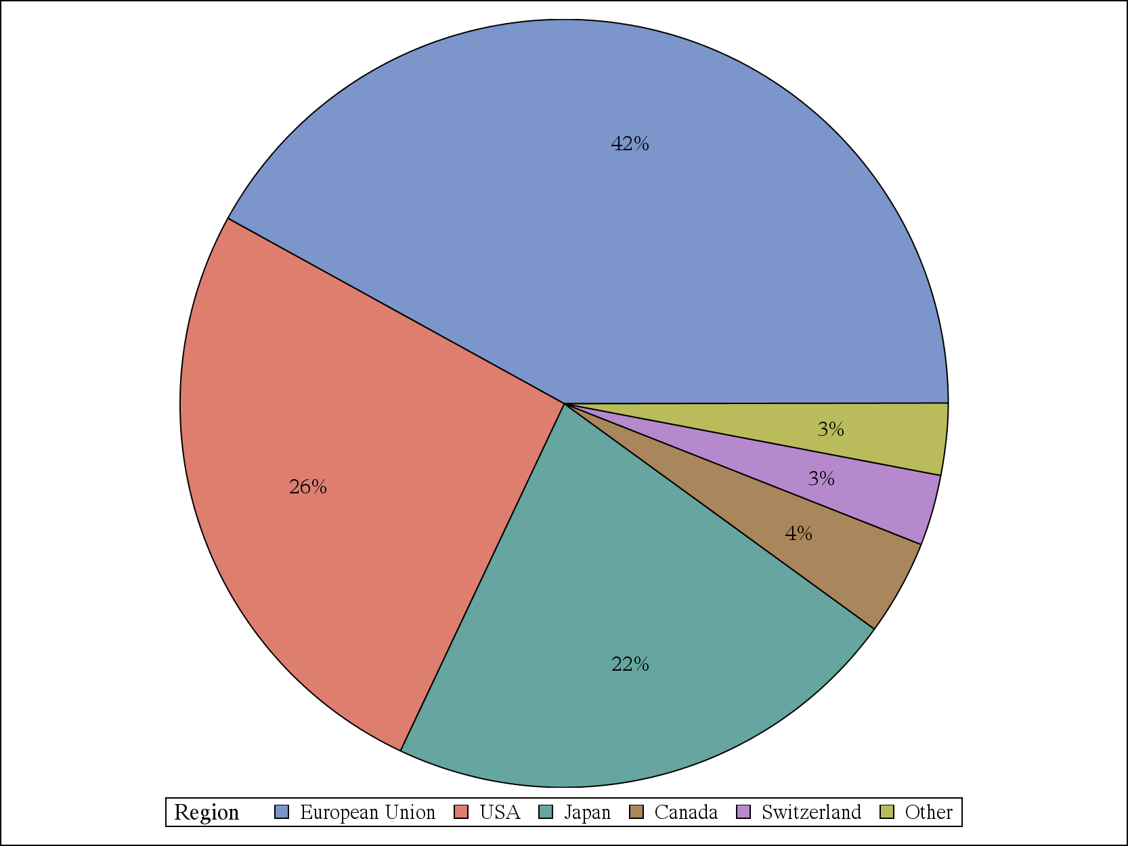
E9 survey – demographics (N=1305)

Slide 8
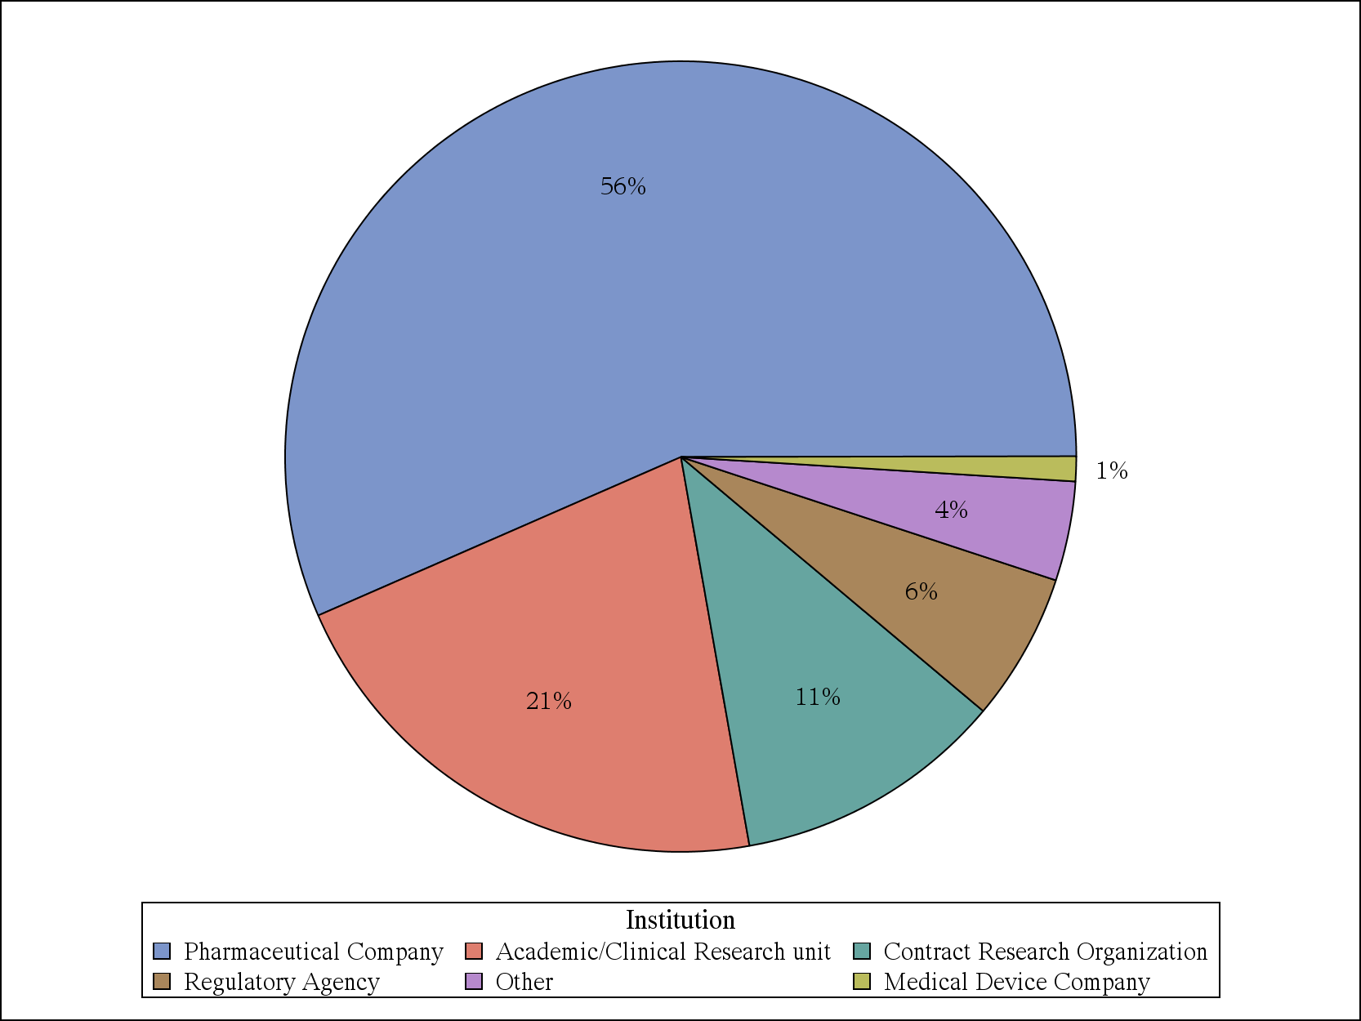
E9 survey - demographics

Slide 9
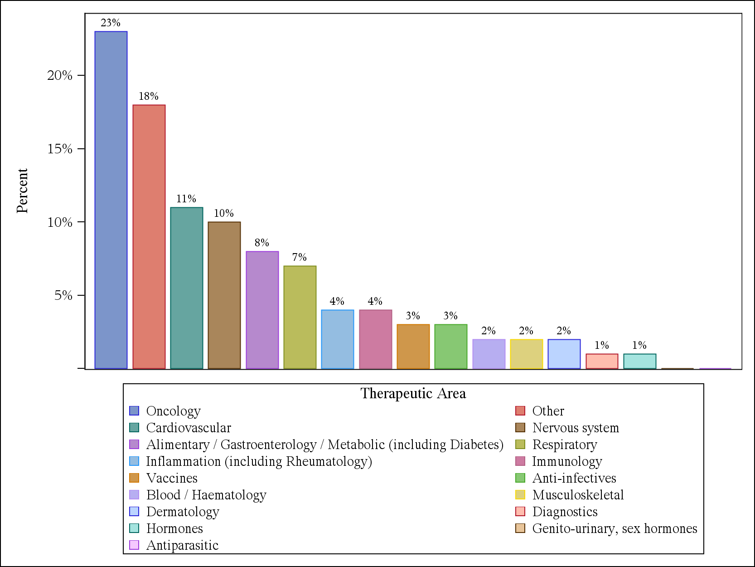
E9 survey - demographics

Slide 10
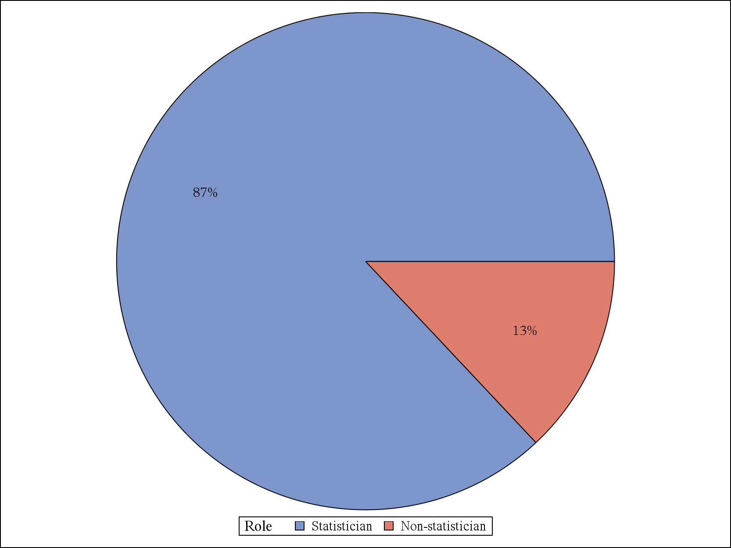
E9 survey - demographics

Slide 11
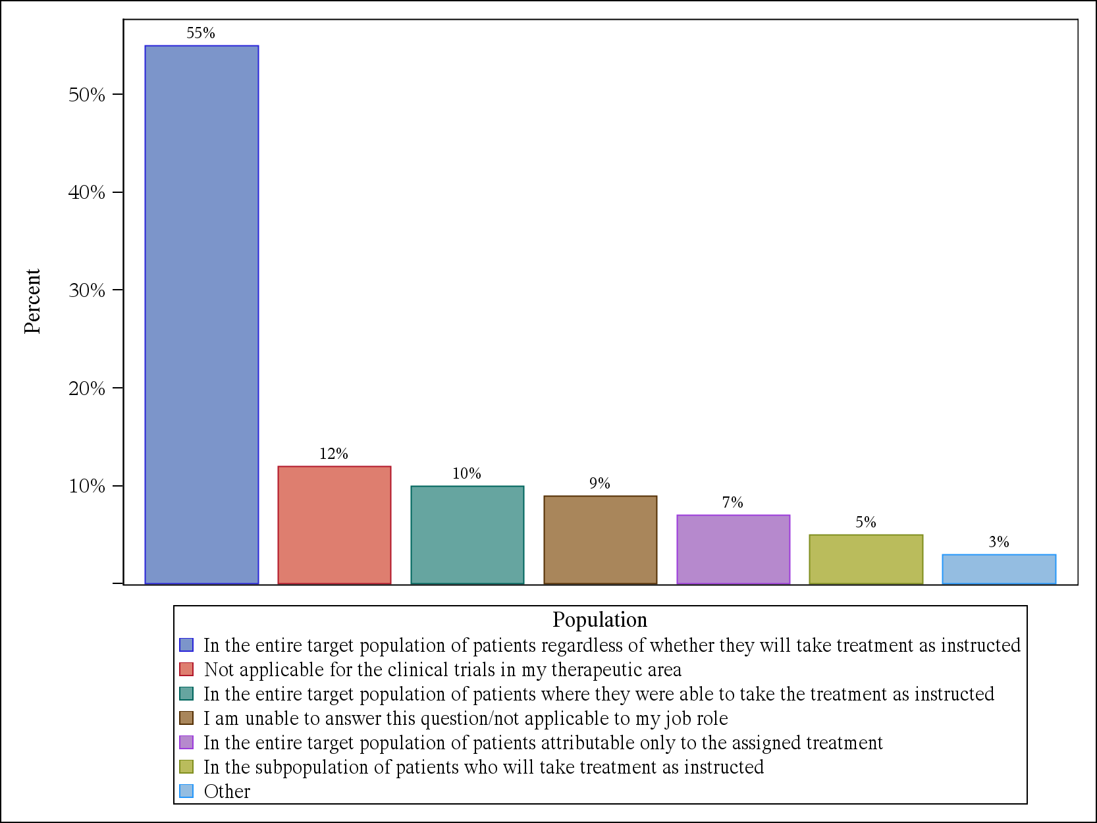
Treatment effect being estimated in a primary analysis – outcome/event trials

Slide 12
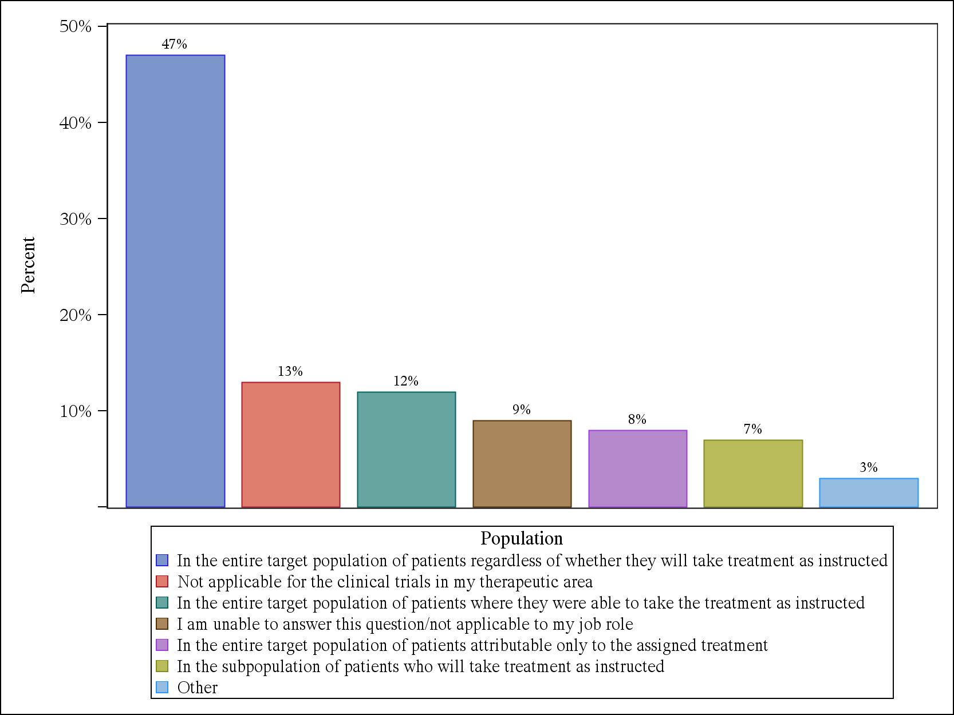
Treatment effect being estimated in a primary analysis – ‘symptom’ trials

Slide 13
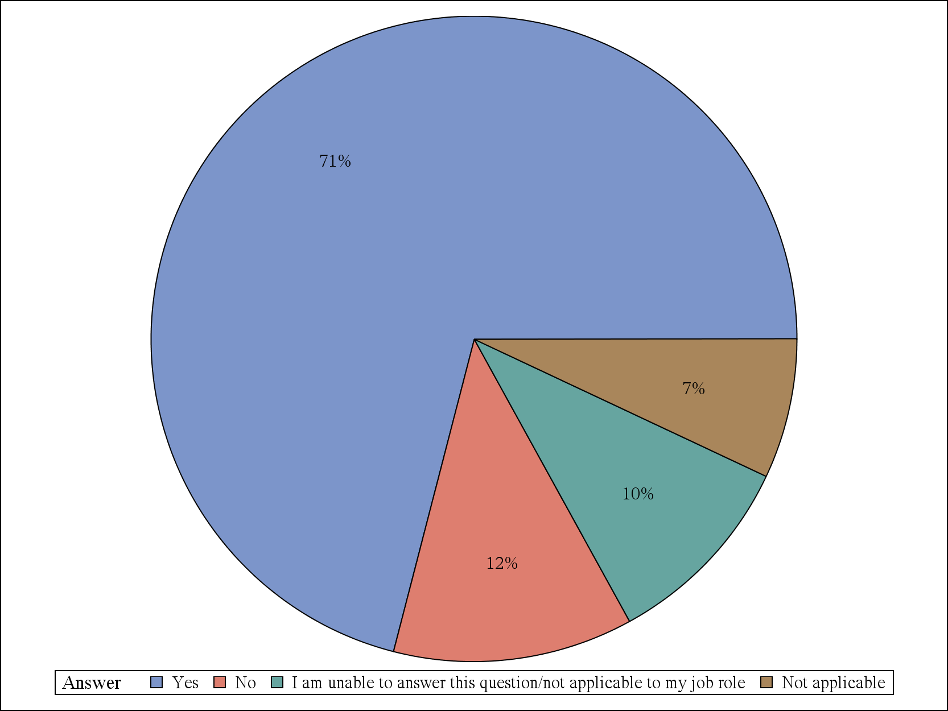
Try to collect data for patients who stop treatment but remain on study

Slide 14
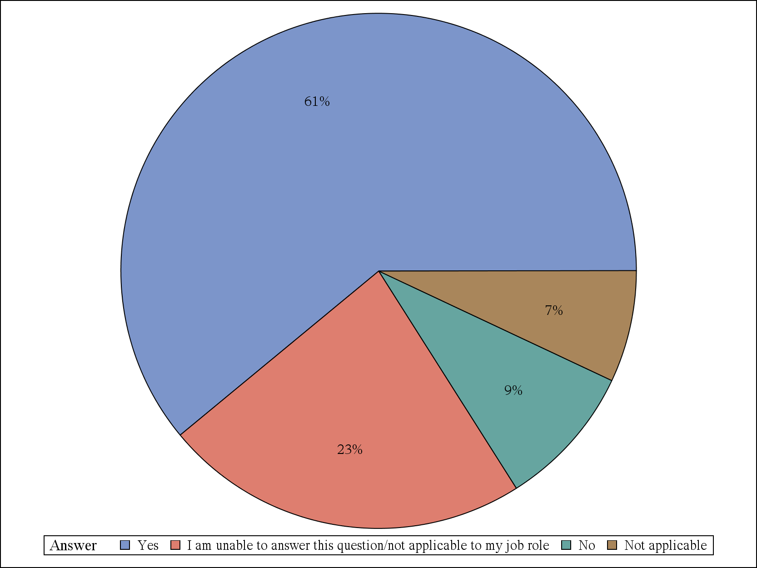
Try to contact patients to prevent lost to follow up

Slide 15
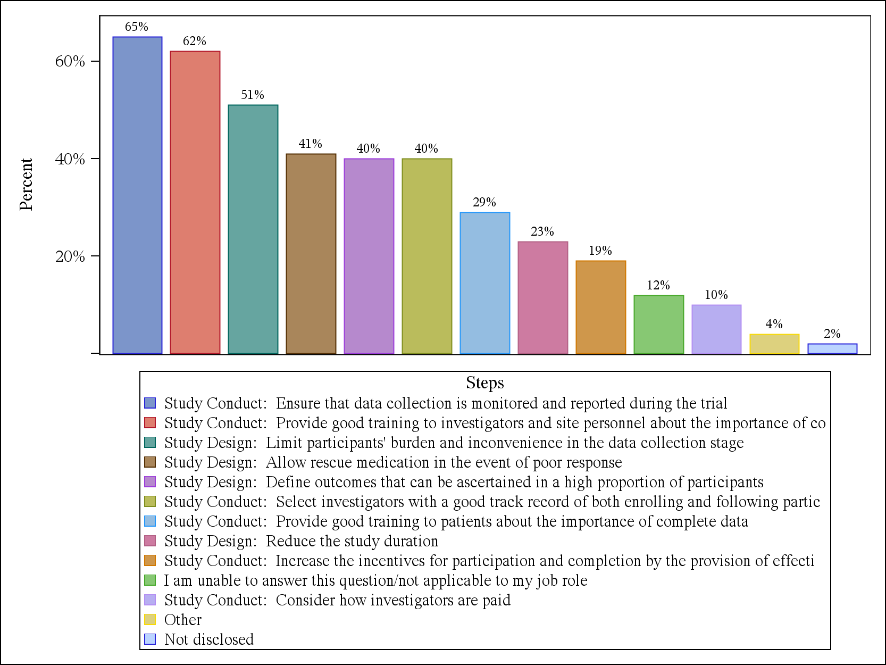
Steps taken to prevent missing data

Slide 16
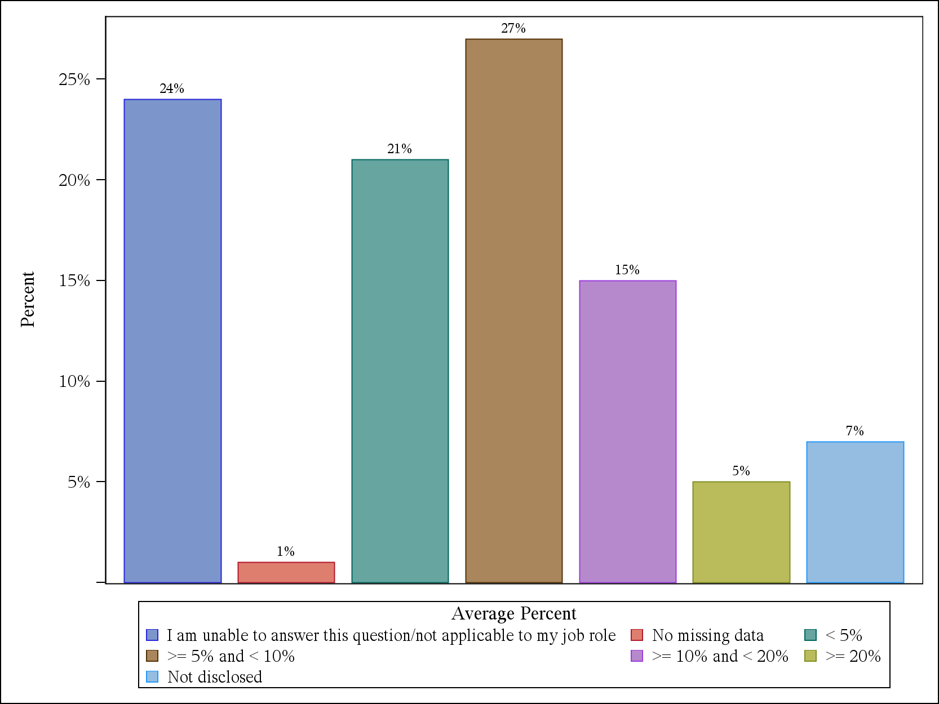
How much primary endpoint data attributed to study dropout

Slide 17
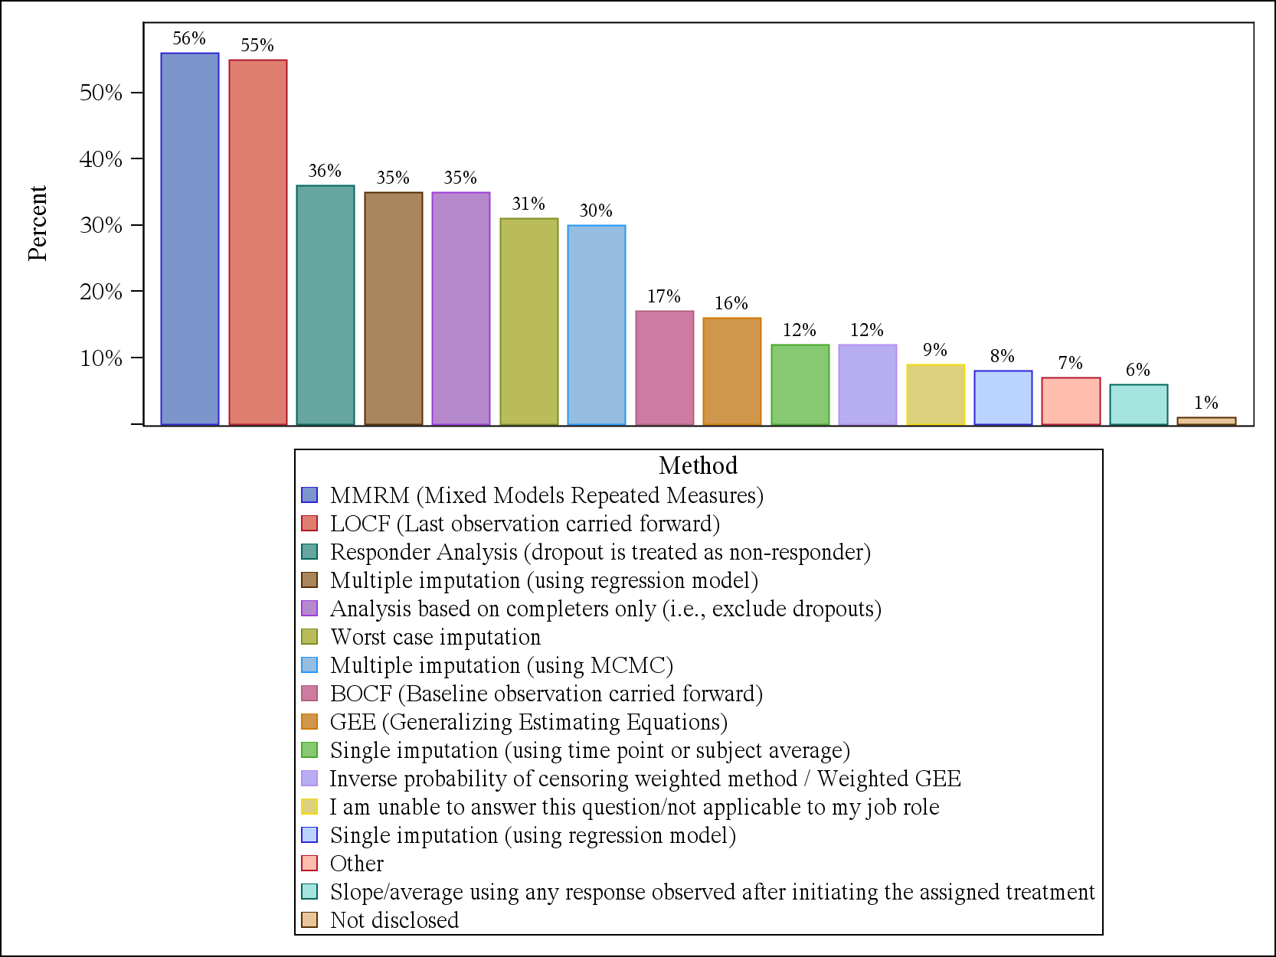
Methods for handling missing data in primary analyses

Slide 18
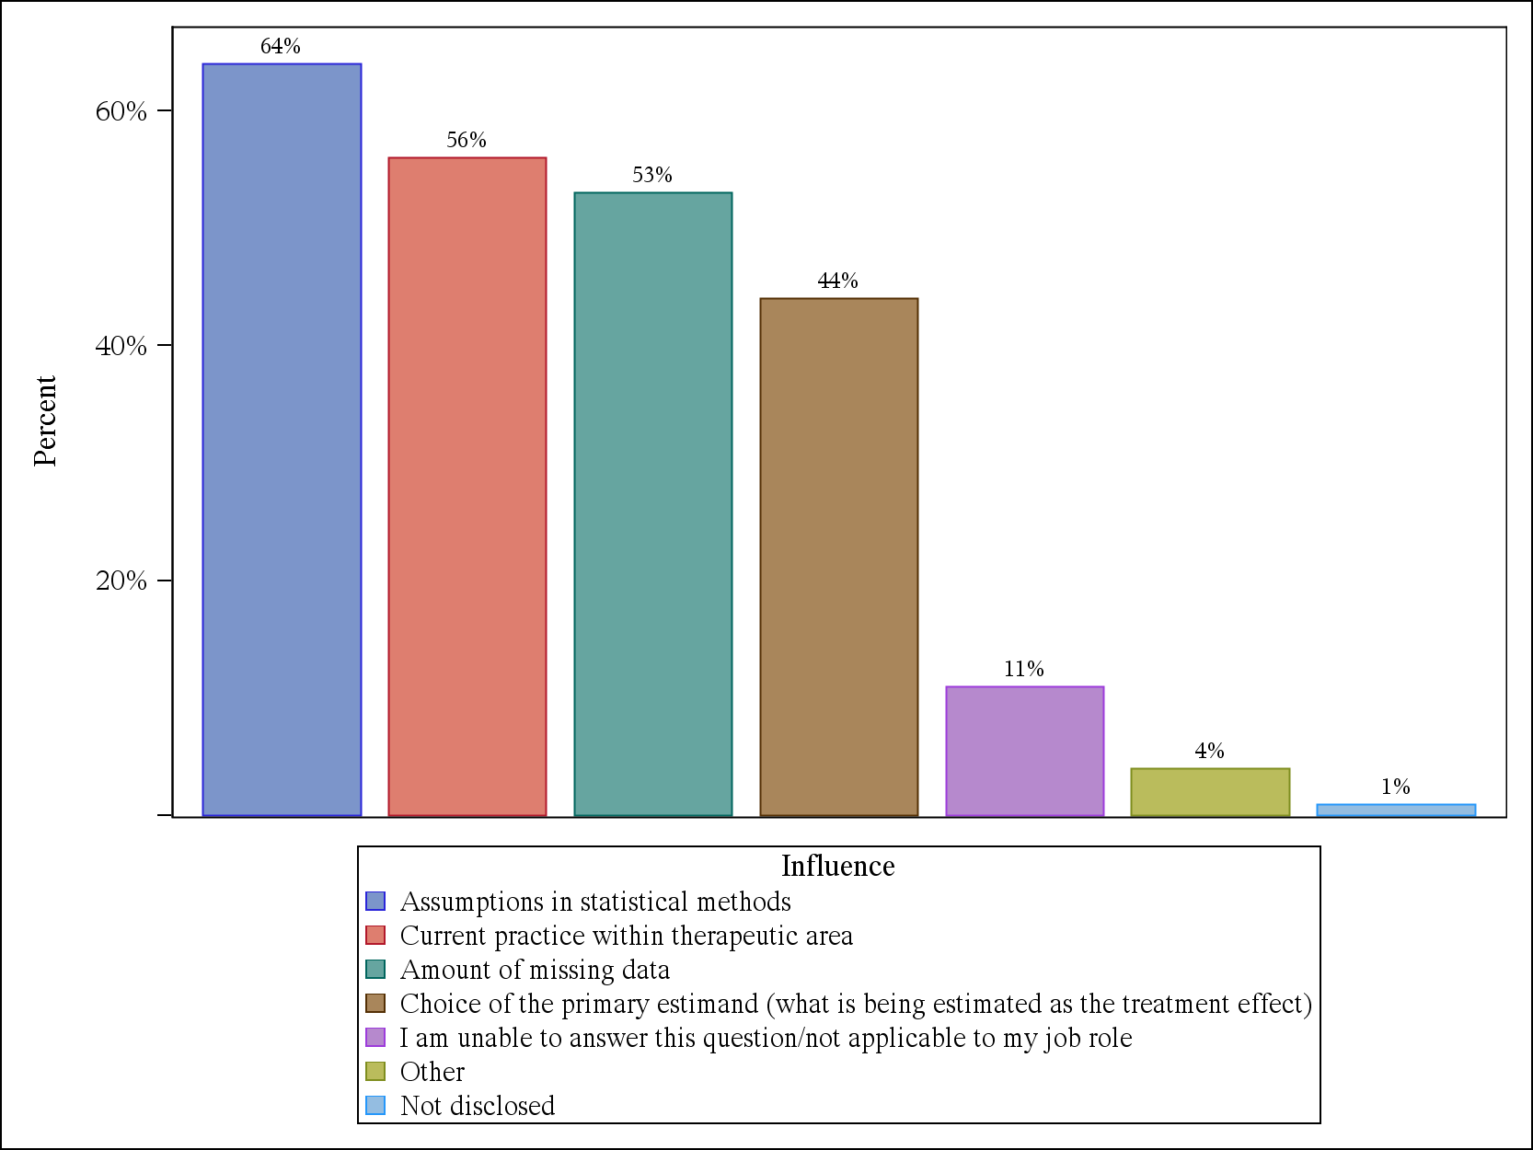
What influences your choice for handling missing data in primary analyses

Slide 19
Key issues debated in E9 WG
Distinguishing between the various estimands
Areas of E9 that would benefit from further clarification
Developing laymans explanations
Sharing case studies from all regions and how the choice of estimand contributed to regulatory decision making
Exploring methodologies that align to each category of estimand → technical appendix

Slide 20
How addendum will align with E9
The addendum cannot conflict with any principles described in E9
The proposed framework may position some of the existing principles in E9 in a different way
There may be areas of E9 that require further clarification to fully align the addendum
In the spirit of E9 the addendum will not be recommending statistical methods

Slide 21
Important questions for you to consider
Does the definition of an estimand make sense?
Does the proposed framework in the E9 addendum make sense?
Do you have any concerns with the framework?
How much of a difference is the proposed framework compared to how you currently design clinical trials?
What do you see as key challenges for introducing the framework?
How do you think clinicians will view estimands and the proposed framework?

Slide 22
References
ICH concept paper (2014) E9(R1): Addendum to Statistical Principles for Clinical Trials on Choosing Appropriate Estimands and Defining Sensitivity Analyses in Clinical Trials
Lewis JA (1999) Statistical principles for clinical trials (ICH E9): An introductory note on an international guideline. Statistics in Medicine, 18: 1903-1904.
ICH Expert Working Group (1999) Statistical principles for clinical trials (ICH E9). Statistics in Medicine, 18: 1905-1942.
National Research Council of the National Academies (2010) The Prevention and Treatment of Missing Data in Clinical Trials. Washington, D.C.: National Academies Press.
EMA (2011), Guideline on Missing Data in Confirmatory Clinical Trials.
O’Neill RT and Temple R (2012) The prevention and treatment of missing data in clinical trials: an FDA perspective on the importance of dealing with it. Clin Pharmacol Ther, 91: 550-554.
Little RJ, D’Agostino R, Cohen M, et al. The prevention and treatment of missing data in clinical trials. N Engl J Med, 367(14): 1355-1360.
A structured approach to choosing estimands and estimators in longitudinal clinical trials. C. H. Mallinckrodt et al. Pharmaceut. Statist. 2012, 11 456–461
Missing Data: Turning Guidance Into Action. C. H. Mallinckrodt et al. Statistics in Biopharmaceutical Research 2013, Vol. 5, No. 4, 369-382
Choosing Appropriate Estimands in Clinical Trials. AK Leuchs et al. DIA Therapeutic Innovation & Regulatory Science. 2015

