Slide 1
Quantitative Decision Making (QDM)
Jacquie Christie
Biostatistics, GlaxoSmithKline
On behalf of Graeme Archer and Jacquie Christie

Slide 2
Agenda
Why we need Quantitative Decision Making
What is Quantitative Decision Making
Targets and Evidence Levels
Risks
Probability of Success
Conditional Probability of Success
Summary and further considerations.
Worked Example

Slide 3
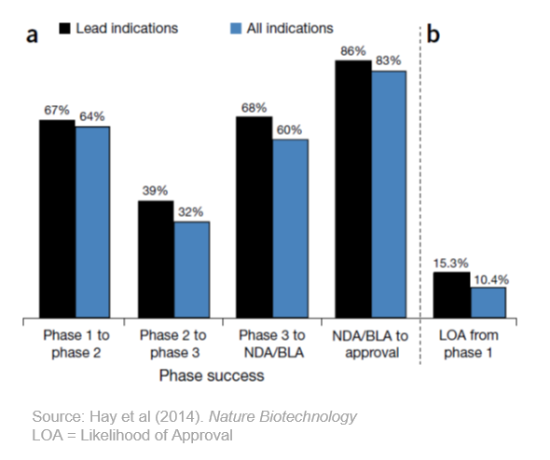
Why Do We Need Quantitative Decision-Making?
The problem - R&D Attrition Rates

Slide 4
What Does QDM Bring?
Quantitative Decision Making enables
Development plans and studies to be designed optimally.
Decision risks can be quantified and minimised.
The utility of studies to be quantified
Bias is minimised.
Confirmation bias

Slide 5
1. Target and Evidence Levels
Set Success Criteria
Set Failure Criteria

Slide 6
Step 1a) Set Targets
For each Decision-Making endpoint
TARGET values of the TRUE drug effect
Minimum Value = MV
the smallest true value that would be of interest
anything less than the MV is unlikely to be a reimbursable medicine
Target Value = TV
The true value we desire
This would enable successful approval and commercialisation of the drug.

Slide 7
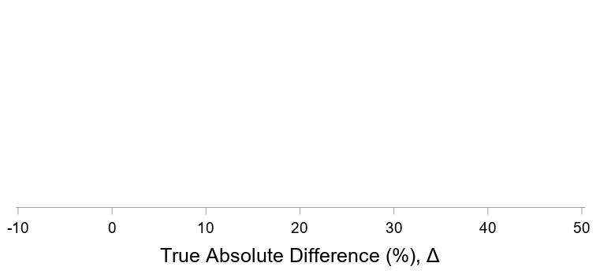
Positive and Negative Outcomes
Anchored against the targets
MV
TV
The more evidence that Δ > MV, the more we want to GO
The more evidence that Δ < TV, the more we want to STOP

Slide 8
Step 1b) Set Evidence Levels
For each Decision-Making endpoint
Probability thresholds to conclude a positive or negative outcome
Positive evidence: against the Minimum Value (MV)
How confident do we want to be that we are better than the MV?
Negative evidence: against the Target Value (TV)
How confident do we want to be that we are below the TV?

Slide 9
Example Rules
Positive ➔ there is at least 80% probably that the true treatment effect is > MV
Negative ➔ there is at least 90% probability that the true treatment effect is < TV
Inconclusive ➔ Neither positive or negative (or both)

Slide 10
Interpreting the Rule
Calculate the Critical Values
Based on the chosen study design (sample size, variability, decision rules), what value do you need to be to make a decision
The minimum critical value of treatment effect which concludes POSITIVE evidence
The maximum critical value of treatment effect which concludes NEGATIVE evidence

Slide 11
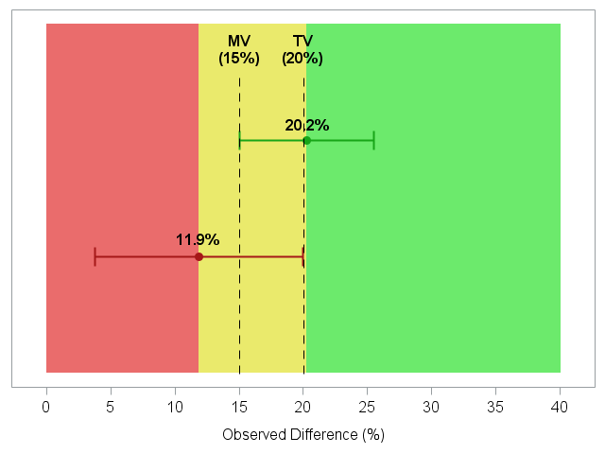
Decision rule in terms of observed values
If 20.2% is observed there is a 80% probability that the true effect is >=15% (MV)
If 11.9% is observed there is a 90% chance the true effect is <=20% (TV)

Slide 12
2.Risks
Quantify the risk of an incorrect conclusion

Slide 13
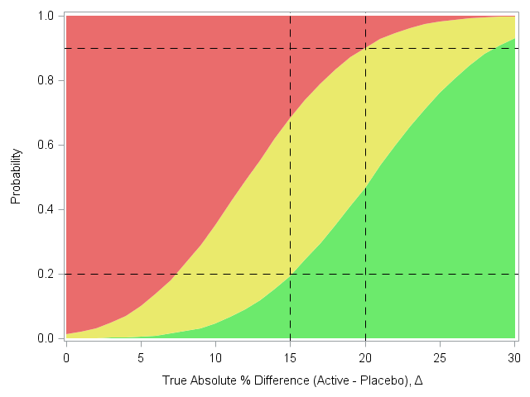
Conditional Decision Operating Characteristics Wave Plot
Quantify Risks
Positive ➔ there is at least 80% probably that the true treatment effect is > MV (15%)
Negative ➔ there is at least 90% probability that the true treatment effect is <TV (20%)
Inconclusive ➔ Neither
positive or negative
If the risk level of your proposed design is too high, or there is a very large consider zone
➔ CHANGE SOMETHING
Notes:
Study design specific. Here N=100

Slide 14
3. Probability of Success

Slide 15
Step 3) Further Evaluation of the study
Probability of Success
The wave plots give the probabilities of go/consider/stop CONDITIONAL (if) on different possible true treatment differences
The true treatment effect remains uncertain
The plot indicates a very high probability of a positive decision when the true treatment effect is > 25%.
But how likely is it that the true effect is > 25?

Slide 16
The prior: a probability distribution to describe the current understanding about the true treatment difference
Previous trial data for this compound
Pre-clinical & Biology Data
Competitor Data
Elicitation

Slide 17
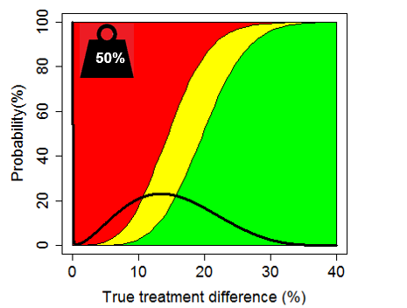
3) Calculate Study PoS
Prior Distribution over Wave Plot
True effect | Probability of making each decision for a given true effect
 | Positive (%) | Inconclusive (%) | Negative (%)
TV=20% | 52% | 38% | 10%
Assurance | 18% | 22% | 70%
Probability of Success
Prior distribution weight on zero

Slide 18
4. Conditional Probability of Success
PoS of the subsequent study, conditioned on a positive outcome of the current study

Slide 19
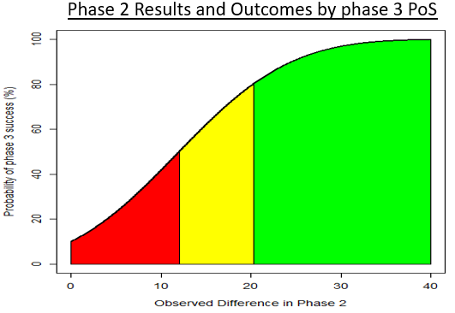
Step 4) Subsequent Study Conditional PoS
Map possible observed Phase 2 results to Phase 3 POS
Minimum Phase 2 data that achieves a go, gives 80% probability of phase 3 success
The tougher we set the Phase 2 rules, the higher the Probability of success in Phase 3.

Slide 20
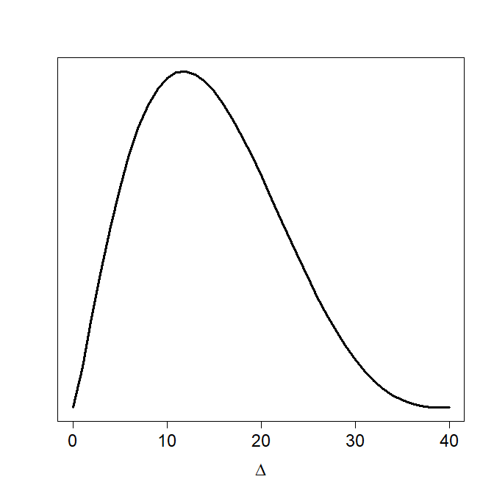
Risk Discharge
Quantify the utility of the study in terms of risk discharge
The “average” Phase 3 POS based on any positive outcome in Phase 2, weighted by the prior.
Before phase 2
Phase 3 PoS : 30%
After phase 2 (assuming positive outcome)
Minimum Conditional Phase 3 PoS: 80%
Expected Conditional Phase 3 PoS: 86%
Prior distribution for Δ
Extrapolating endpoints and other design changes between phases can be difficult, but is necessary
If the study is not able to discharge risk for future development, then why proceed with the study at all?

Slide 21
Further Considerations
Methodology can be extended to
Multi-endpoint decision rules
Interim analysis decision rules
Phase I to phase II
Safety, biomarker, PK endpoints etc.

Slide 22
Conclusions
Decision making frameworks are critical for successful drug development
Pre-defined targets and success evidence levels ensure studies are designed optimally
All important risks are quantified and transparent to decision makers
Studies de-risk the subsequent studies and overall development plan
➔Lower late stage attrition
➔Improved R&D productivity
➔More new medicines to patients.
Email: Jacquie.A.Christie@GSK.com

Slide 23
Example Project
Back-up

Slide 24
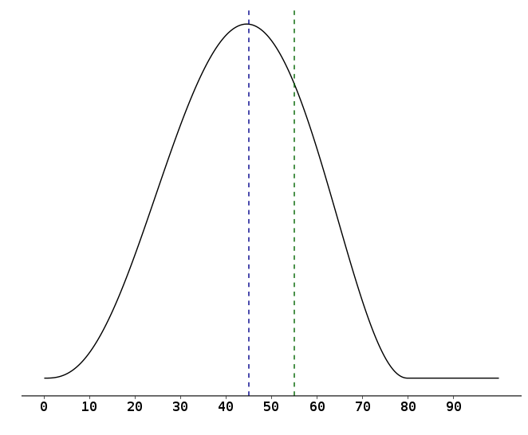
Prior distribution for primary endpoint (response) for GSKXXX
According to the prior, we are
46% sure that the response for GSKXXX is at least 45% (MV) greater than placebo.
22% sure that the response for GSKXXX is at least 55% (TV) greater than placebo.
MV
TV
True Treatment Difference GSKXXX– Placebo
responders

Slide 25
Proposed Design and Definitions of Positive & Negative Outcomes
Design Summary
Randomized, parallel group, placebo controlled, phase IIb.
Proportion of subjects achieving response at week 24 is the decision making endpoint.
Outcomes based on response at week 24
Positive outcome: At least 80% sure that the true differences is ≥45%
This equates to an observed difference of ~ 52% or more.
Negative outcome: At least 90% sure that the true difference is <55%
This equates to an observed difference of ~ 45% or less.
According to the prior and this proposed design, there is a 30% chance of a positive outcome, and a 66% chance of a negative outcome.

Slide 26
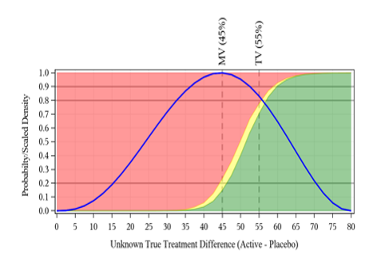
Study Decision Risks and PoS
True effect | Probability of concluding go, stop, or neither
 | Go (%) | Inconclusive (%) | Stop (%)
TV=55% | 67.8% | 7.9% | 24.3%
MV=45% | 14.2% | 7.4% | 78.4%
No effect=0 | 0% | 0% | 100%
Assurance | 30.4% | 3.7% | 66.0%

Slide 27
Efficacy POS evolution by Interim Analysis and at Final Results
Timepoint: | Start of Phase 2 | Futility 1 (N=30) | Futility 2 (N=90) | End of Phase 2
Event: | Study start | Continue at interim | Continue at interim | Go decision at end of Phase 2
Phase 3 POS conditional on Event: | 22% | 45% | 68% | 91%
Prior for difference in Response
where the denotes the probability of an effect >45% (MV)
Probability of stopping |  | 37% | 59%
Cost to stage-gate |  | £XXM | £XXM | £XXM
4%
46%
65%
87%
96%

