Slide 1
The Young Statistician's Guide to regulatory statistics
Inês Reis – Statistical assessor MHRA
PSI Career Young Statistician Webinar Session – 9 June 2020

Slide 2
Disclaimer
The views expressed in this presentation are my own and should not be understood or quoted as being made on behalf of the Medicines and Healthcare products Regulatory Agency (MHRA) or any other entity.
Acknowledgements
Thank you to Julia Saperia and my colleagues in the Licensing Division’s Statistics team at the MHRA who have contributed to this presentation

Slide 3
About the MHRA
The Medicines and Healthcare products Regulatory Agency regulates medicines, medical devices and blood components for transfusion in the UK.
“The mission of the Medicines and Healthcare products Regulatory Agency is to enhance and improve the health of millions of people every day through the effective regulation of medicines and medical devices, underpinned by science and research.”
Photo: Jules Lister

Slide 4
About the MHRA
Clinical Practice Research Datalink (CPRD) – leading provider of integrated real-world research services using anonymised NHS clinical data to improve public health
National Institute for Biological Standards and Control (NIBSC) – plays a leading national and international role in assuring the quality of biological medicines
MHRA regulatory centre (MHRA) – the UK’s regulator of medicines, medical devices and blood components for transfusion, responsible for ensuring their safety, quality and effectiveness

Slide 5
The regulatory network… … up until 31 Jan 2020
ICH
CHMP
MHRA
CHM
SAWP
Other World Regulators
EAGs
BSWP
Other EU regulators
PRAC

Slide 6
The regulatory network… … Now
ICH
CHMP
MHRA
CHM
SAWP
Other World Regulators
EAGs
BSWP
Other EU regulators
PRAC

Slide 7
The medicines regulatory system in a nutshell
HOSPITAL
REGULATOR
Regulatory Agencies
Prescribers & Public
Industry
Scientific
advice
Assessment of MAA
Medicine is used in clinical practice
Research & Development
Medicine is authorised
Marketing Authorisation Application
New medicine
Pharmacovigilance

Slide 8
Statisticians at the MHRA
Licensing of medicines
Biostatisticians
Vigilance and Risk Management
Epidemiologists
Data analysts
Devices
Biostatisticians
Inspectorate
Inspectors with statistical expertise
Biostatisticians
Data managers
Research analysts
Real-world and clinical study planners
Epidemiologists

Slide 9
Statisticians in Research and Development
Molecule discovery
Pre-clinical studies
Phase 1
Phase 2
Phase 3
MAA
δΣα
Statisticians
δΣα

Slide 10
Communication is essential!
INDUSTRY
Clinicians
REGULATORS
Clinical trial design & conduct
Supported by guidelines
δΣα
Other disciplines
Statisticians
Between statisticians and other disciplines (both at the industry and regulatory sides)
Between industry and regulators

Slide 11
What do we do?
Statisticians in the MHRA Licensing Division:
Provide scientific advice
Assess marketing authorisation applications
Contribute to guidelines
Advise on risk management plans
Assess post-authorisation safety studies
Inspect sites
Assess clinical trial applications for medical devices
Respond to internal statistics queries of varied nature and promote statistical knowledge
Collaborate with other centres/divisions
REGULATOR
δΣα

Slide 12
Scientific advice
National
Face-to-face meeting at MHRA offices (currently via video conference)
MHRA statistician attends if questions relate to trial methodology or statistical issues (~ 45-50% of SA meetings)
Open discussion followed by official written advice reviewed by a review group
Common questions:
Is the proposed clinical trial design acceptable?
Is the sample size adequate?
Are the statistical methods acceptable?
Does the agency agree with the plan for interim analysis and design adaptations?
Does the MHRA agree with the proposed estimand?
Etc…

Slide 13
Scientific advice
European
Written advice provided by two countries and later combined in a consolidated advice letter
Discussed at SAWP meeting
Face-to-face discussion meeting if issues are complex, not well elucidated or it is felt the company would benefit
Official final advice letter issued by CHMP

Slide 14
Assess MAAs – Clinical Study Reports
Study integrity (e.g. blinding & randomisation, interim analysis, protocol amendments,…)
Patient accountability
Analysis sets
Analysis methods
Adjustment for covariates
Multiplicity
Chosen estimand*
Handling of missing data
Subgroup analysis
Choice of non-inferiority margin
…
Look for risk of bias
in study design and conduct
in estimates of treatment effect
* Use of the estimand framework is not yet mandatory, however it’s encouraged especially in confirmatory trials

Slide 15
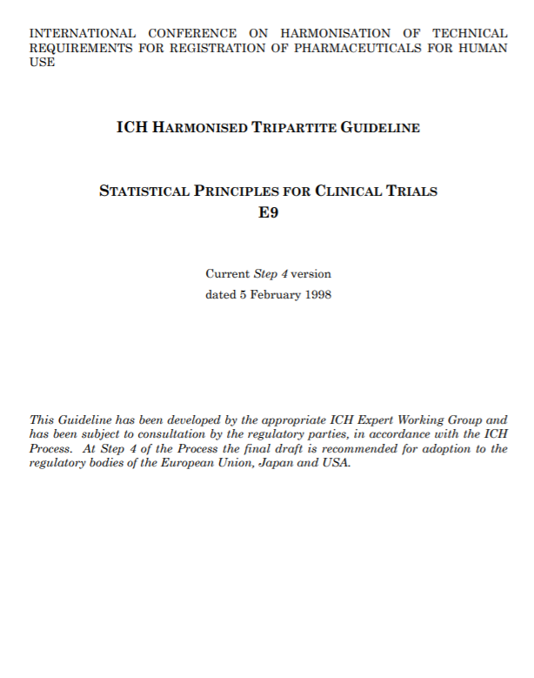
Guidelines
ICH, EMA, FDA
Beware of some differences between European and American guidance (e.g. censoring rules for time-to-event analysis in oncology trials)!
Cornerstone of our work – provide instructions and usual requirements for the purpose of MAAs
Deviations to the guidelines usually need appropriate and detailed justification
Scientific advice can be useful!
My advice: read them and re-read them!

Slide 16
Guidelines - examples
EMA website
Guidelines
ICH E9 Statistical principles for clinical trials
ICH E9(R1) Addendum on estimands and sensitivity analysis in clinical trials
ICH E10 Choice of control group in clinical trials
Adjustment for baseline covariates in clinical trials
Choice of a non-inferiority margin
Clinical trials in small populations
Data monitoring committees
Investigation of subgroups in confirmatory clinical trials
Missing data in confirmatory clinical trials
Guideline on Investigation of Bioequivalence
Points to consider
Application with 1. Meta-analyses; 2. One pivotal study
Multiplicity issues in clinical trials
Switching between superiority and non-inferiority
Reflection papers
Extrapolation of efficacy and safety in medicine development
Methodological issues in confirmatory clinical trials planned with an adaptive design
Need for active control in therapeutic areas where use of placebo is deemed ethical and one or more established medicines are available
Statistical methodology for the comparative assessment of quality attributes in drug development
Questions & Answers
Adjustment for cross-over in estimating effects in oncology trials
Data Monitoring Committees issues
The adequacy of the Mahalanobis distance to assess the comparability of drug dissolution profiles
Clinical pharmacology and pharmacokinetics: questions and answers

Slide 17
Keeping up with new developments in statistics
Constantly evolving methodology (e.g. complex trial designs, new analysis methods, use of alternative sources of data, etc.) – we need to keep up with new developments and determine if they are appropriate to be used in clinical trials for MAAs.
Examples of emerging topics in regulatory statistics:
Adaptive/ Complex trial designs
Master protocols
Estimands
Real World Data
Bayesian Statistics
…

Slide 18
Pharmacovigilance
Risk management plans agreed at marketing authorisation
Studies (usually observational) assessed
Continuous monitoring of drug-event combinations (adverse drug reactions)
React to signals
ask company to investigate
do in-house research using CPRD

Slide 19
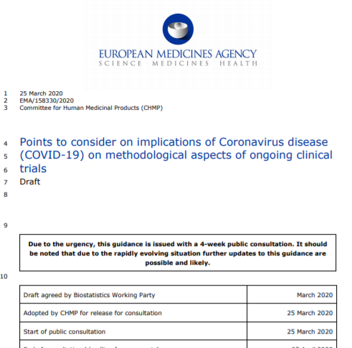
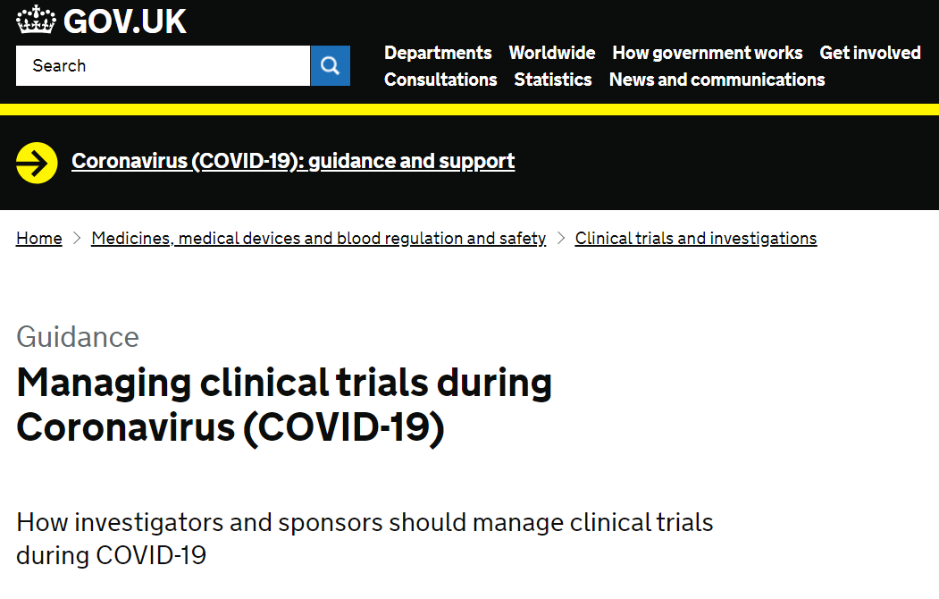
COVID-19 and regulatory statistics
Disruption of ongoing clinical trials
COVID-19 pandemic is likely to seriously disrupt the conduct, data collection and analysis of ongoing clinical trials
Difficulties for patients accessing trial sites for visits, dispensing study treatments, lower availability of trial staff, etc. can lead to many protocol deviations
MHRA and EMA provided guidance on how to deal with disruptions, in particular, a BSWP PtC on implications on methodological aspects has been recently published
Key word is: document everything!

Slide 20
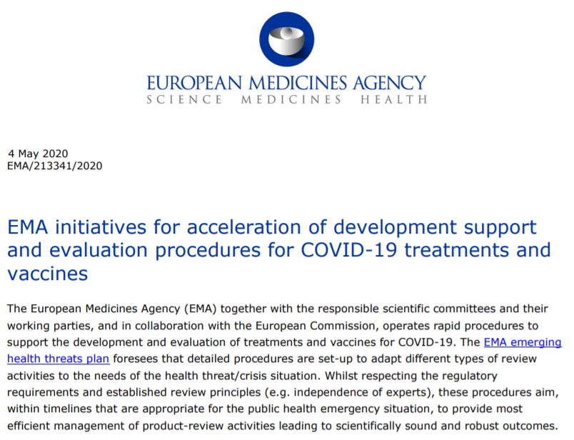
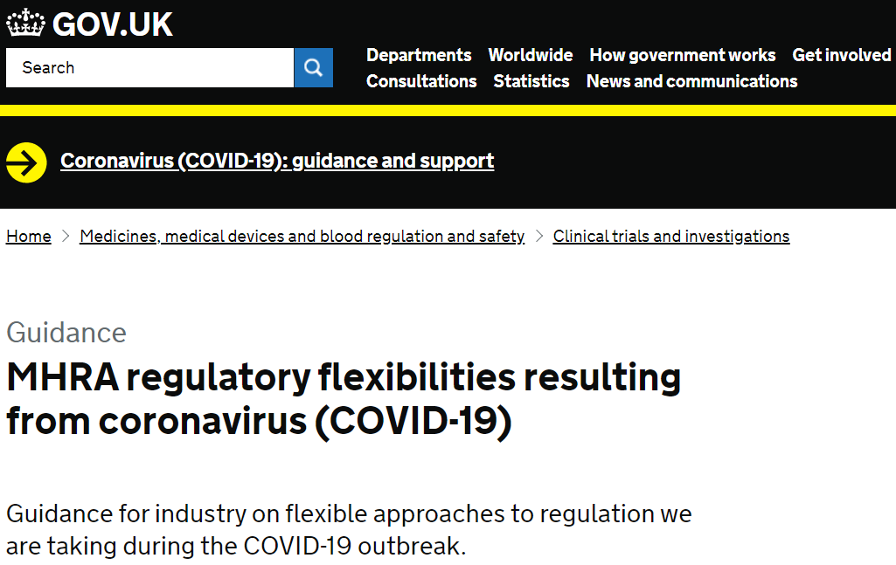
COVID-19 and regulatory statistics
Facilitating research on COVID-19 treatments
Both the MHRA and EMA have published guidance on regulatory flexibilities to ease clinical research and supply of medicines to treat COVID-19
E.g. accelerated clinical trial applications, free and prioritised scientific advice, accelerated MAA assessments, …
Trials design and conduct features can be optimised to accelerate investigation of new treatments
E.g. large scale multi-centre multi-arm trials, adaptive designs, master protocols, virtual trials, considerations on estimands, etc.

Slide 21
COVID-19 and regulatory statistics
Useful links
https://www.gov.uk/guidance/managing-clinical-trials-during-coronavirus-covid-19
https://www.gov.uk/guidance/clinical-trials-applications-for-coronavirus-covid-19
https://www.gov.uk/government/collections/mhra-guidance-on-coronavirus-covid-19
https://www.ema.europa.eu/en/implications-coronavirus-disease-covid-19-methodological-aspects-ongoing-clinical-trials
https://www.ema.europa.eu/en/human-regulatory/overview/public-health-threats/coronavirus-disease-covid-19
https://www.ema.europa.eu/en/documents/other/ema-initiatives-acceleration-development-support-evaluation-procedures-covid-19-treatments-vaccines_en.pdf

Slide 22
Abbreviations
BSWP: Biostatistics Working Party (European)
CHMP: Committee for medicinal products for human use (European)
CPRD: Clinical Practice Research Datalink
EMA: European Medicines Agency
FDA: Food and Drug Administration
ICH: International Council for Harmonisation of Technical Requirements for Pharmaceuticals for Human Use
MAA: Marketing Authorisation Application
MHRA: Medicines and Healthcare products Regulatory Agency
NIBSC: National Institute for Biological Standards and Control
PRAC: Pharmacovigilance and Risk Assessment Committee (European)
PtC: Points to Consider
SAWP: Scientific Advice Working Party (European)

Slide 23
Thank you! Any questions?

