Slide 1
Methods to Evaluate the Benefit-Risk Trade-Off in Individual Patients
Ruth Owen¹, John Gregson¹, Shahrul Mt-Isa², Richard Baumgartner³, Philip Urban⁴, Stuart Pocock¹
PSI Webinar Series June 2020
¹ London School of Hygiene and Tropical Medicine, United Kingdom, ² MSD, United Kingdom, ³ Merck & Co., Inc., Kenilworth, NJ, United States, ⁴ Hôpital de la Tour, Geneva, Switzerland

Slide 2
Introduction
New treatments may be accompanied by safety concerns
While overall results may demonstrate a favourable benefit-risk trade-off there may be individuals where the harm outweighs the benefit
Useful to develop a statistical algorithm to aid decision-making by identifying such individuals

Slide 3
Example 1: TRA 2⁰P-TIMI 50 trial
17,729 patients with a history of MI received vorapaxar vs placebo
Primary outcome: CV death, MI, stroke
Suspected possibility of increase in bleeding complications
We assess GUSTO moderate or severe bleeding

Slide 4
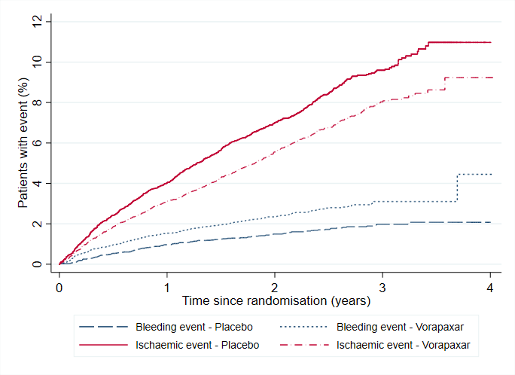
TRA 2⁰P-TIMI 50 trial results
Ischaemic* events:
HR: 0.79 (0.71 to 0.88), p<0.0001
742 (8.4%) vs. 597 (6.7%)
Approximately 145 events prevented
Bleeding events:
HR: 1.61 (1.31 to 1.97), p<0.0001
241 (2.7%) vs. 151 (1.7%)
Approximately 90 events caused
*Primary outcome less hemorrhagic stroke
which is considered a bleeding events:

Slide 5
Applying trial results to aid clinical decisions: traditional framework
Decreased risk of ischaemia
in trial population
Increased risk of bleeding
in trial population
Treatment effects are averaged across patients, ignoring individual differences which may have an important impact on the likelihood of benefit/harm

Slide 6
Applying results to the individual patient
Patient characteristic | Patient 1 | Patient 2
Age | 55 | 77
Sex | Male | Female
Haemoglobin | 140 g/L | 97 g/L
Non-HDL cholesterol, mmol/L | 4.2 mmol/L | 2.5 mmol/L
Thienopyridine use | No | Yes
Is patient likely to benefit from Vorapaxar? | Probably | ?

Slide 7
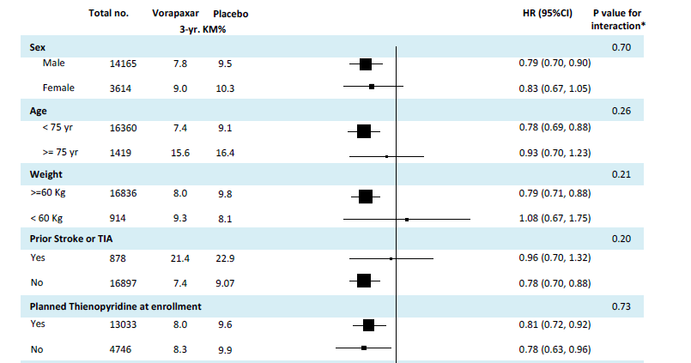
Subgroup Analyses: Traditional framework
Scirica et al. Lancet. 2012;380(9850):1317-24.

Slide 8
Subgroup Analyses: Traditional framework
Limitations:
Only one characteristic can be investigated at a time
Subgroups are often more similar than different in terms of other characteristics
Usually underpowered

Slide 9
Applying trial results: proposed individualised approach
Individualised
assessment of
ischaemic risk
Individualised
assessment of
bleeding risk
Hazard ratio for
ischaemia
Hazard ratio for
bleeding
Individualised assessment of
increased ischaemic risk
Individualised assessment of
increased bleeding risk
Individual assessment of ischemia and bleeding risk achieved using multivariable Poisson regression models for each event

Slide 10
Multivariable predictive model for ischaemic events
 | N | HR (95% CI) | P-value
Treated with vorapaxar | 8880 | 0.80 (0.72, 0.89) | <0.0001
History of heart failure | 1554 | 1.93 (1.68, 2.22) | <0.0001
History of PAD | 1599 | 1.43 (1.23, 1.64) | <0.0001
History of hypertension | 11094 | 1.44 (1.26, 1.64) | <0.0001
History of unstable angina | 4529 | 1.39 (1.23, 1.56) | <0.0001
Prior cerebrovascular event | 872 | 1.61 (1.35, 1.92) | <0.0001
Age, years (Ref <64): 65-74 | 3928 | 1.29 (1.13, 1.47) | <0.0001
75-84 | 1313 | 1.67 (1.38, 2.03)
≥85 | 101 | 1.73 (1.01, 2.95)
Non-HDL cholesterol, mmol/L (Ref <2): 2-3 | 8287 | 1.35 (1.12, 1.63) | <0.0001
3-4 | 4732 | 1.48 (1.21, 1.80)
≥4 | 2202 | 2.17 (1.75, 2.68)
Non-insulin-treated diabetes | 623 | 1.16 (0.89, 1.51) | <0.0001
Insulin-treated diabetes | 3300 | 1.44 (1.26, 1.63)
Haemoglobin, g/L (Ref ≥130): 120-129 | 1782 | 1.31 (1.11, 1.55) | <0.0001
110-119 | 676 | 1.42 (1.12, 1.78)
<110 | 271 | 1.67 (1.24, 2.25)
Smoking status: Ex-smoker | 9100 | 1.07 (0.94, 1.22) | <0.0001
Current smoker | 3480 | 1.47 (1.25, 1.72)
Drug-eluting stent implanted | 6056 | 1.20 (1.07, 1.34) | 0.002
History of CABG | 2408 | 1.21 (1.05, 1.39) | 0.007
Baseline creatinine clearance<60ml/min | 1721 | 1.33 (1.12, 1.58) | 0.001
Female | 3595 | 0.81 (0.71, 0.94) | 0.004
BMI, per 10kg/m² |  | 1.15 (1.03, 1.28) | 0.02

Slide 11
Multivariable predictive model for bleeding events
 | N | HR (95% CI) | P-value
Treated with vorapaxar | 8880 | 1.58 (1.28, 1.93) | <0.0001
Haemoglobin (g/L): ≥130 | 15000 | Reference group | <0.0001
120-129 | 1782 | 1.64 (1.23, 2.19)
110-119 | 676 | 2.58 (1.82, 3.65)
<110 | 271 | 5.05 (3.38, 7.53)
Age (years): <65 | 12387 | Reference group | <0.0001
64-74 | 3928 | 1.87 (1.48, 2.36)
75-84 | 1313 | 1.81 (1.28, 2.57)
≥85 | 101 | 2.63 (1.18, 5.86)
History of PAD | 1599 | 1.50 (1.14, 1.97) | 0.004
History of hypertension | 11094 | 1.45 (1.15, 1.83) | 0.002
Smoking status: Never | 5149 | Reference group | 0.01
Ex-smoker | 9100 | 1.45 (1.14, 1.84)
Current smoker | 3480 | 1.44 (1.04, 1.98)
Baseline creatinine clearance <60ml/min | 1721 | 1.47 (1.10, 1.95) | 0.009
Thienopyridine use at baseline | 13855 | 1.51 (1.16, 1.96) | 0.002

Slide 12
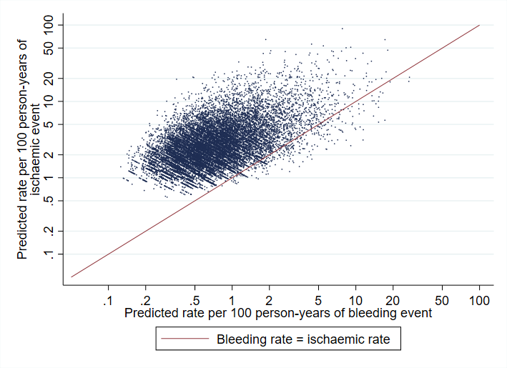
Comparison of bleeding and ischaemic risks
Overlap in predictors means patients at high risk of ischaemia tend to be high risk of bleeding
But still substantial variation
Need to understand how vorapaxar alters risk of each event

Slide 13
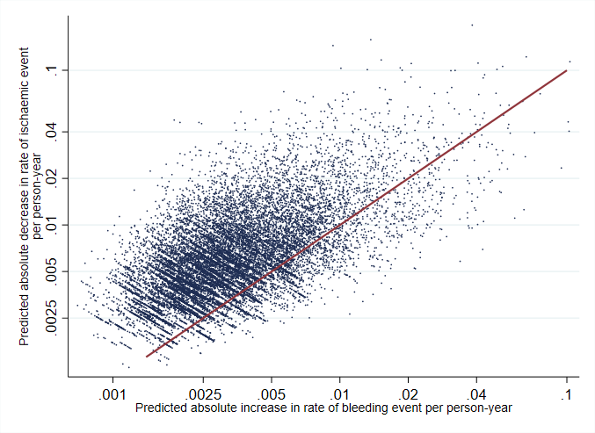
Predicted impact of Vorapaxar on bleeding / ischaemia
Predicted decrease in ischaemic risk more than predicted increase in bleeding risk
15460 (87% of patients)
Predicted decrease in ischaemic risk less than predicted increase in bleeding risk
2269 (13% of patients)

Slide 14
Applying results to the individual patient
Patient characteristic | Patient 1 | Patient 2
Age | 55 | 77
Sex | Male | Female
Haemoglobin | 140 g/L | 97 g/L
Non-HDL cholesterol, mmol/L | 4.2 mmol/L | 2.5 mmol/L
Thienopyridine use | No | Yes
Other important characteristics
Predicted bleeding risk / predicted increase with Vorapaxar | 0.18 | 3.64
Predicted ischaemic risk / predicted decrease with Vorapaxar | 1.06 | 1.63
Is patient likely to benefit from Vorapaxar? | Yes | No

Slide 15
Assessing individual benefit and harm
Have a method for assessing increased risk/benefit trade-off
But:
Are bleeding/ischemic events of equal importance?
How certain are we in our predictions of benefit/harm?

Slide 16
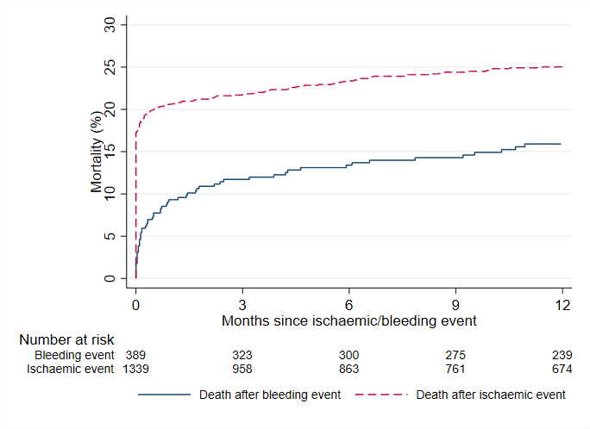
Assessing severity of bleeding/ischaemic events
Risk of death following ischaemic events higher
Ischaemic events should be considered more severe

Slide 17
Assessing severity of bleeding/ischemic events
 | Bleeding event N=389 | Ischemic event N=1339
No. deaths within 1-year post event | 59 | 326
Risk of death 1-year post event¹ | 0.159 | 0.250
Expected 1-year risk of death in absence of event² | 0.023 | 0.009
Risk of death after event – Risk of death in absence of event=
Excess risk of death attributed to event | 0.136 | 0.241
Relative importance of ischemic event compared to bleeding event | 1.77
¹ Kaplan-Meier estimate
² Based on adjusted rate in absence of event

Slide 18
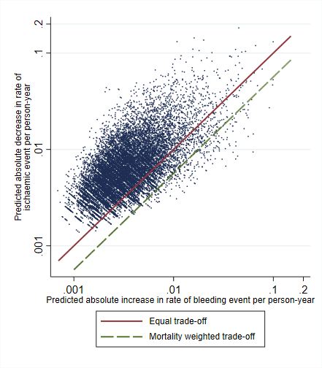
Assessing severity of bleeding/ischaemic events
Predicted decrease in ischemic risk more than predicted increase in bleeding risk after accounting for different mortality risk
Predicted decrease in ischemic risk less than predicted increase in bleeding risk after accounting for different mortality risk
Equal importance: 87% patients more likely to benefit from treatment
Accounting for different mortality risk: 98% more likely to benefit from treatment

Slide 19
Applying results to the individual patient
Patient characteristic | Patient 1 | Patient 2
Age | 55 | 77
Sex | Male | Female
Haemoglobin | 140 g/L | 97 g/L
Non-HDL cholesterol, mmol/L | 4.2 mmol/L | 2.5 mmol/L
Thienopyridine use | No | Yes
Other important characteristics
Predicted bleeding risk / predicted increase with Vorapaxar | 0.18 | 3.64
Predicted ischemic risk / predicted decrease with Vorapaxar | 1.06 | 1.63
No. bleeding events caused per ischaemic events prevented (95% CI) | 0.17 (0.06, 0.43) | 2.23 (0.75, 5.96)

Slide 20
Example 1 Summary
Identified a set of patient characteristics which predict individual trade-off between ischaemic benefit and bleeding risk
Majority of patients ischaemic benefit appears to outweigh harm
Can also capture:
Varying impact of each event on patient’s mortality risk
uncertainty surrounding individualised predictions

Slide 21
Example 2: High Bleeding Risk Trade-off
DAPT after PCI reduces risk of coronary thrombotic events at the expense of increasing risk of major bleeding
Combines data from 6 studies
6,641 high bleeding risk patients* treated with PCI
Trade-off between thrombotic and bleeding events, defined as MI/stent thrombosis and BARC grade 3-5 major bleed
* According to the Academic Research Consortium for High Bleeding Risk (ARC-HBR) criteria
DAPT- Dual Anti-Platelet Therapy, PCI – Percutaneous Coronary Intervention, BARC – Bleeding Academic Research Consortium

Slide 22
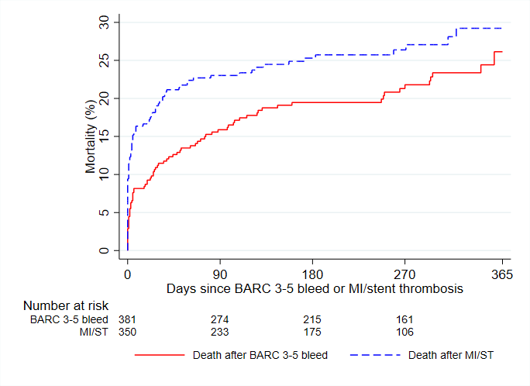
Mortality after Bleeding & Thrombotic Events
Adjusted HR = 6.07
Adjusted HR = 3.69
*From multivariable Cox proportional hazards model which included bleeding and thrombotic events as time-varying covariates and adjusted for predictors of death

Slide 23
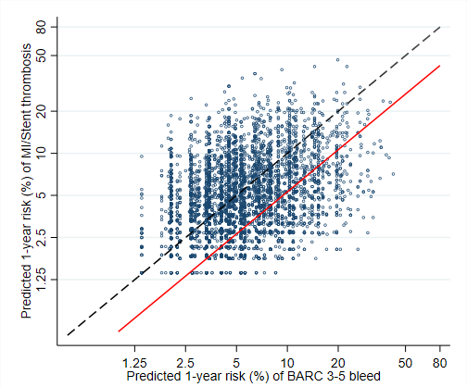
Predicted 1-year risk of BARC 3-5 vs MI/ST
Thrombotic risk = bleeding risk
Equal mortality weighted trade-off
44% patient with bleeding risk > thrombotic risk
23% patients with bleeding risk > thrombotic risk taking mortality into account
Assuming equal effect of DAPT on MI/ST vs BARC 3-5 bleed

Slide 24
Example 3: SPRINT trial
9361 patients with high SBP were randomised to receive intensive vs standard blood pressure control
Lower rate of the primary efficacy composite (MI, other acute coronary syndromes, stroke, acute decompensated heart failure, or death from cardiovascular causes) vs increased rate of SAEs*
1-year mortality risk around 3 times higher after efficacy outcome than after safety outcome
* Including hypotension, syncope, bradycardia, electrolyte abnormality and acute kidney injury or failure

Slide 25
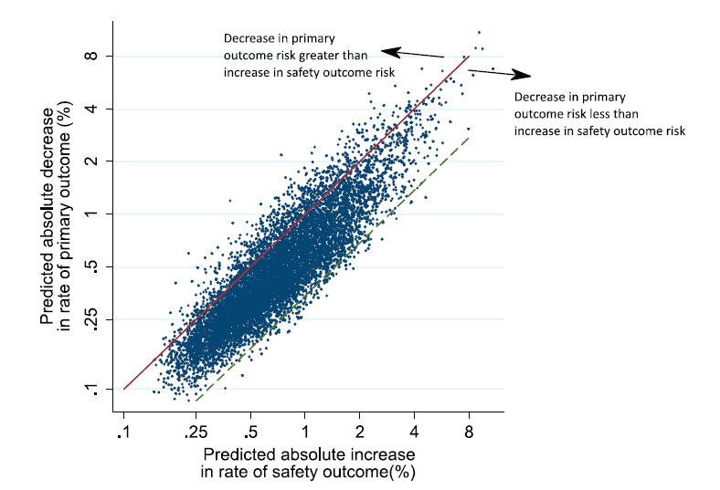
Applying results to the individual patient
Efficacy and safety outcomes considered of equal importance:
➔ Few patients with net benefit (11%)
Decrease in primary outcome risk greater than increase in safety outcome risk accounting for different mortality risk
Decrease in primary outcome risk less than increase in safety outcome risk accounting for different mortality risk
Accounting for different risk in 1-year mortality:
➔ Net benefit for majority of patients (98%)

Slide 26
Conclusions
When making individualised treatment decisions, it is important to weigh the potential benefits against the potential risk.
To assist with this, a statistical tool can be constructed:
identify key patient characteristics which are predictive of efficacy and safety outcomes
quantify the relative importance of each event (in terms of mortality risk, alternatives?)
document the predicted benefit-risk trade-off for individual patients, allowing for the uncertainty in the process

