Slide 1
A Bayesian Approach in Design and Analysis of Pediatric Cancer Clinical Trials
Jingjing Ye, PhD
BeiGene
PSI Journal Club: Bayesian Methods
Nov. 17, 2020
Notes:
Talk length=25mins

Slide 2
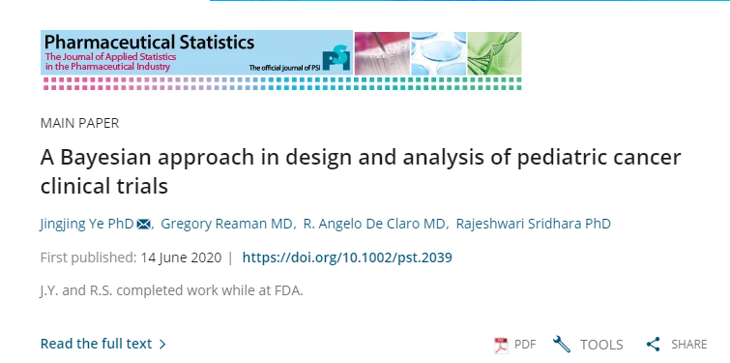
Outline
Background
Using a case study to illustrate potential useful Bayesian analysis
Analysis and monitoring
Design study
Conclusions

Slide 3
Cancer Drug Development for Children and Adolescents
Well recognized, long-standing challenges-biologic, societal, economic
Widely leverages adult drug discovery and development
Many targeted agents likely applicable to cancers in children
Notes:
https://www.fda.gov/downloads/AdvisoryCommittees/CommitteesMeetingMaterials/Drugs/OncologicDrugsAdvisoryCommittee/UCM612244.pdf

Slide 4
RACE for Children Act:
Incorporated as Title V of the FDA Reauthorization Act (FDARA), enacted Aug. 18, 2017
Requires evaluation of new molecularly targeted drugs and biologics “intended for … adult cancers… at a molecular target substantially relevant to the growth or progression of a pediatric cancer”
Molecularly targeted pediatric cancer investigation: clinically meaningful study data
Elimination of orphan exemption for pediatric studies for cancer drugs directed at relevant molecular targets
RACE for Children Act: Research to Accelerate Cures and Equity Act; come into force, 8/18/2020
Notes:
Projected to go into effect in 2020; It intends to
Focus on accelerating appropriate initial pediatric evaluations not increasing number of pediatric phase 1 studies
https://www.fda.gov/AboutFDA/CentersOffices/OfficeofMedicalProductsandTobacco/OCE/ucm544641.htm

Slide 5
Bayesian Analysis
Account uncertainty in prior knowledge
Decision making and interpretation with probability thinking
Use relevant prior information
If not sure of relevance, incorporate P(relevance)
If very sure of relevance, be skeptical about potential efficacy unless you trust ‘experts’

Slide 6
Bayesian on Pediatric Cancers
Pediatric Specific Indication
Bayesian analysis
Older age group
Control
Partial Extrapolation
Bayesian analysis
Adult
Older age group
Discount priors
Sensitivity on the priors
Interpretation on efficacy in posterior probability

Slide 7
Case Study: NDA22068 Nilotinib
 | Adult | Pediatric
Indication | Newly diagnosed Ph+ CML in chronic phase | Newly diagnosed Ph+ CML in chronic phase
Endpoint | MMR at 12 month | MMR at 12 month
Design | Randomized | Single-arm
Sample Size | Nilotinib N=282 versus imatinib N=283 | N=25
Age | 18+ | 2-18
Results* | 44% (38.4, 50.3) | 60% (38.7, 78.9)
Philadelphia chromosome positive chronic myeloid leukemia (Ph+CML)
MMR: major molecular response (MMR; BCRABL/ABL ≤0.1% IS);
* Results are for MMR, for other information refer to USPI
https://www.accessdata.fda.gov/drugsatfda_docs/label/2018/022068s027lbl.pdf

Slide 8
Pediatric Cancer Case Study
Bayesian analysis and sequential monitoring
Bayesian study design with sequential monitoring

Slide 9
Bayesian Analysis and Sequential monitoring

Slide 10
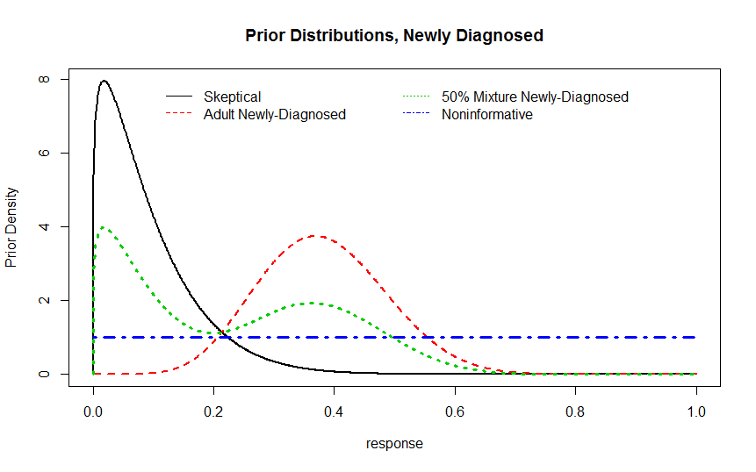
Prior Distributions
Probability of applicability:
Prior=(1-a)*f(D) + a*g(D)
f(D): skeptical prior, g(D): adult study
a=P(applicability of adult results)
Adult | N=282 | 44% (38.4, 50.3)

Slide 11
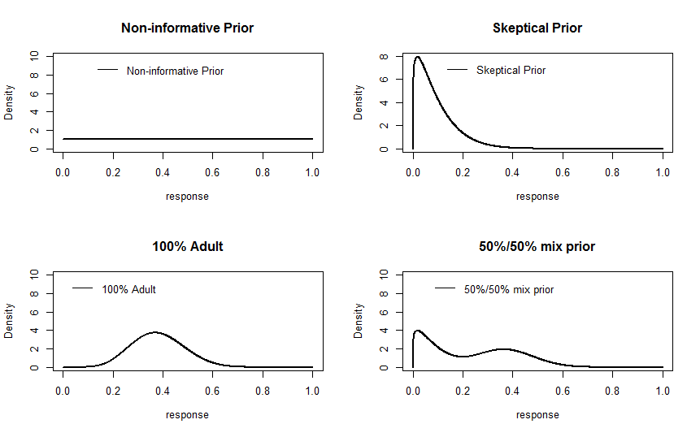
Prior Distribution

Slide 12
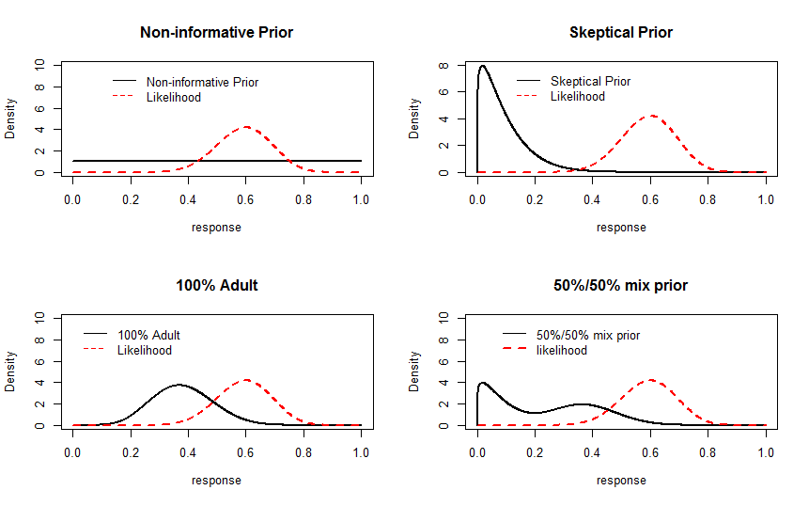
Prior + Likelihood

Slide 13
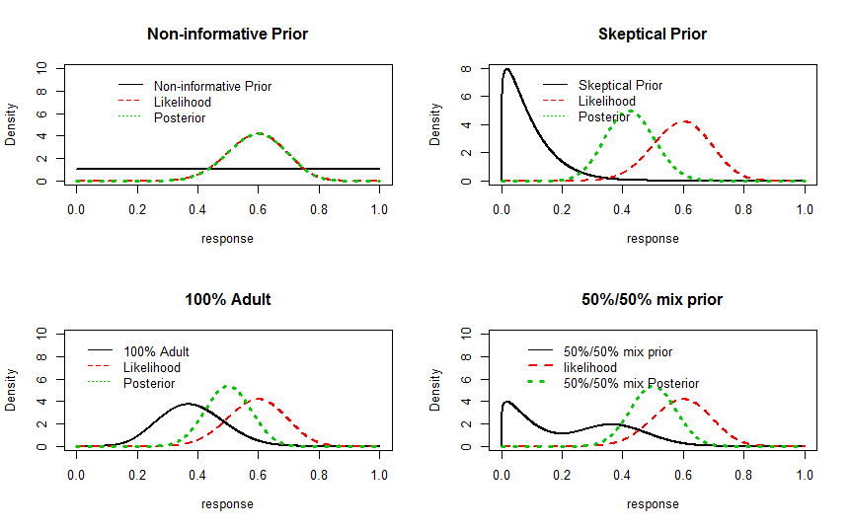
Posterior Distribution

Slide 14
Posterior Probability of Efficacy
 | Bayesian Estimate (95% Cred. Int.) | Posterior Prob. of Efficacy Pr(Response>30%)
Prior
Skeptical | 42.3 (27.4, 58.2) | 94.5%
100% adult | 50 (35.8, 64.2) | 99.8%
50% mixture | 50 (35.6, 64.2) | 99.7%
Non-informative | 59.5 (40.6, 76.6) | 100%
Even given skeptical prior, the posterior probability is 94%+

Slide 15
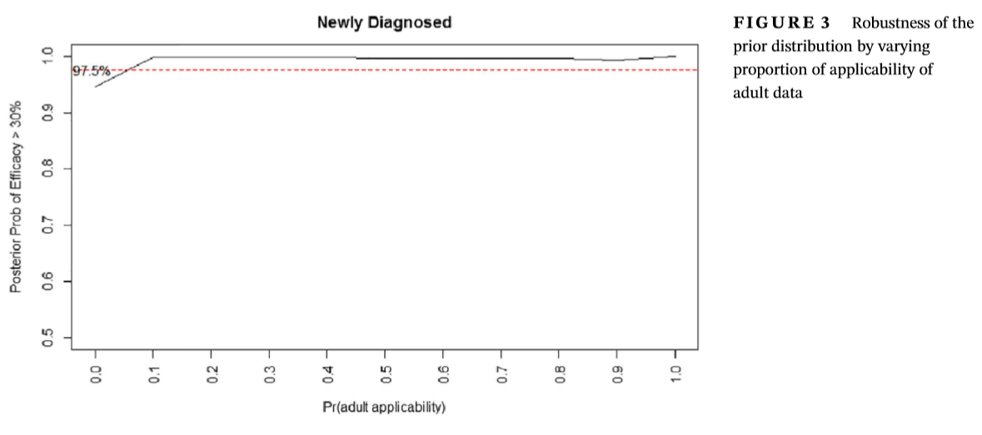
Sensitivity of Priors

Slide 16
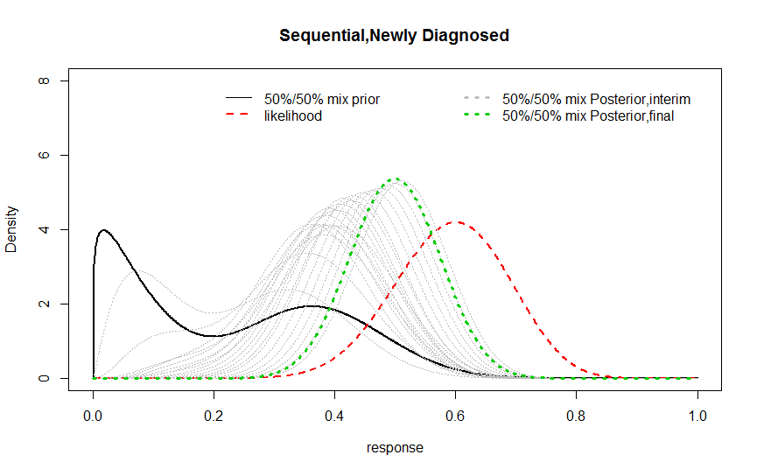
Sequential Monitoring
First evaluation when N=5 patients results available
Evaluate as data accumulate

Slide 17
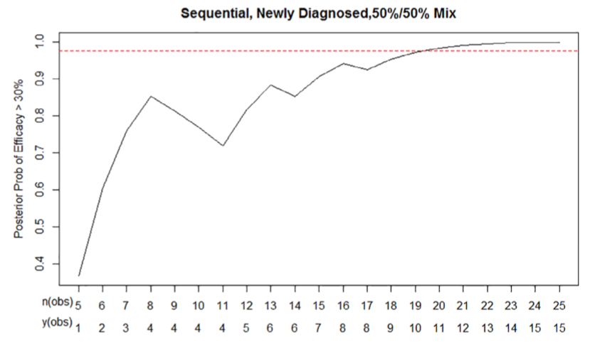
Sequential Monitoring
Posterior prob > 97.5% when 10 responders observed out of 19 enrolled

Slide 18
Bayesian Study Design with Sequential Monitoring

Slide 19
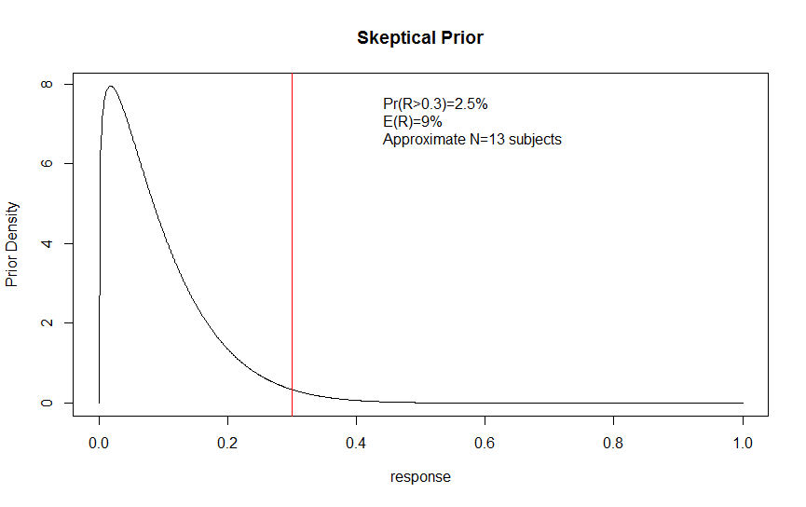
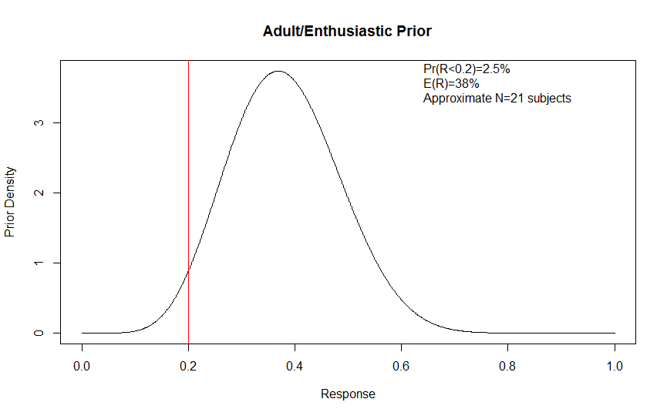
Bayesian Characteristics
Skeptical prior: centered at no clinically-meaningful response and low probability of observing higher response
Adult/Enthusiastic prior: centered at adult efficacy and low probability of observing low response

Slide 20
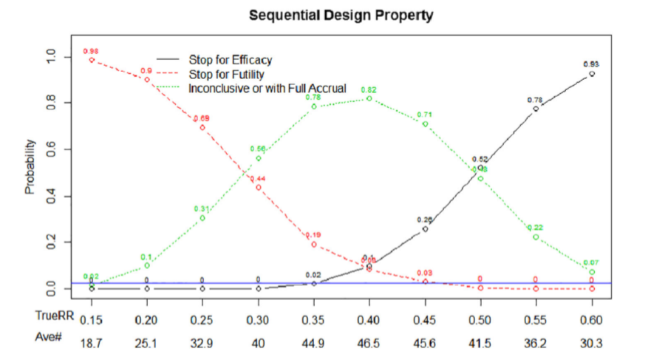
Sequential Design Property
Accrual up to 50 patients
Stop for efficacy if Posterior Pr(R>0.3|Data, Skeptical) >= 0.975
Stop for futility if Posterior Pr(R<0.35|Data, Enthusiastic)>=0.85

Slide 21
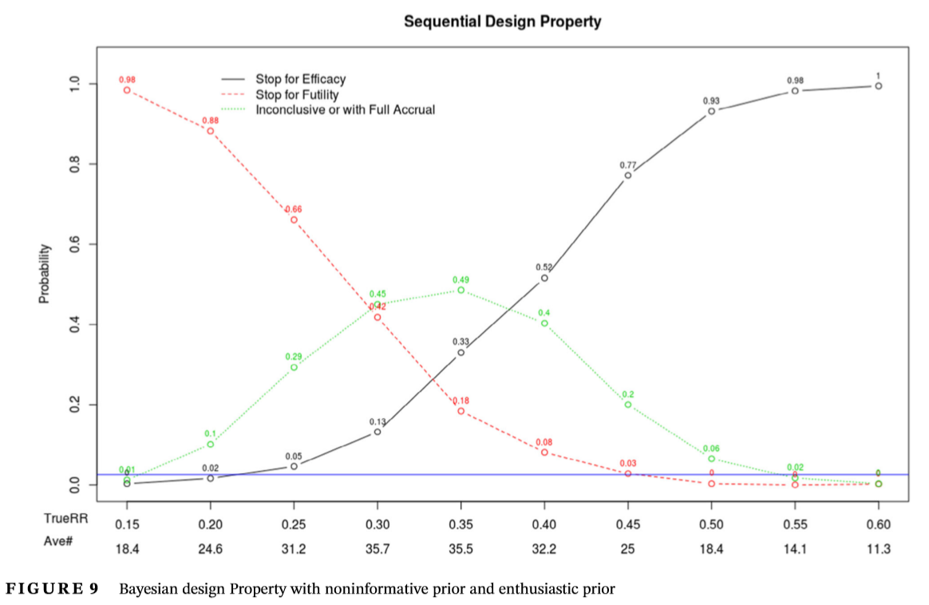
Sequential Design Property - Non-informative + Enthusiastic priors
Accrual up to 50 patients
Stop for efficacy if Posterior Pr(R>0.3|Data, NI) >= 0.975
Stop for futility if Posterior Pr(R<0.35|Data, Enthusiastic)>=0.85

Slide 22
Approaches on Addressing Challenges
International collaboration in pediatric cancer trials when possible, avoid duplication and competition
Bayesian designs and analysis
formally incorporate prior knowledge into the trials
quantify uncertainty
intuitive interpretation based on probability thinking

Slide 23
Addressing Challenges (Cont’d)
Bayesian sequential monitoring offers flexible monitoring of pediatric trial results as data accumulates
Combined with Skeptical and enthusiastic priors, the plan offers good trial design properties, including frequentist-equivalent controlled false-positive rate and sufficient power
Offers options to stop for trial early for both efficacy and futility, advantage of requiring fewer patients

Slide 24
A Bayesian is one who asks you what you think before a clinical trial in order to tell you what you think afterwards.
- Senn, 1997b

Slide 25
References
https://www.fda.gov/AboutFDA/CentersOffices/OfficeofMedicalProductsandTobacco/OCE/ucm544641.htm
https://www.fda.gov/AdvisoryCommittees/CommitteesMeetingMaterials/Drugs/OncologicDrugsAdvisoryCommittee/ucm612242.htm
https://www.fda.gov/downloads/drugs/guidances/ucm425885.pdf
https://www.fda.gov/downloads/Drugs/GuidanceComplianceRegulatoryInformation/Guidances/UCM609513.pdf
https://www.fdanews.com/ext/resources/files/2019/03-14-19-Trials.pdf?1552594371
https://www.fda.gov/downloads/Drugs/GuidanceComplianceRegulatoryInformation/Guidances/UCM633138.pdf

Slide 26
References
https://www.fda.gov/downloads/AdvisoryCommittees/CommitteesMeetingMaterials/Drugs/OncologicDrugsAdvisoryCommittee/UCM612244.pdf
https://www.fda.gov/downloads/drugs/guidances/ucm201790.pdf
Woodcock, J., LaVange, L.M., 2017, Master Protocols to Study Multiple Therapies, Multiple Diseases, or Both., NEJM, 2017; 377:62-70 https://www.ncbi.nlm.nih.gov/pubmed/28679092
Harrell, F., 2017, Why is Bayes relevant to CDER? FDA seminar
Fayers at al. Tutorial in Biostatistics: Bayesian Data Monitoring in Clinical Trials, Stat in Medicine, 1997
Psioda, 2018, An Introduction to Bayesian Sequential Monitoring of Clinical Trials, FDA Seminar

