Slide 1
Effective visualization of uncertainty
Where we are and where to go
Paolo Eusebi
Lovemore Gakava
Alexander Schacht
PSI Webinar - September, 3rd 2020

Slide 2
“What is not surrounded by uncertainty cannot be the truth”
Richard Feynman
Notes:
As statisticians, we are often asked to provide advice on communicating results of clinical studies, including plots. Although I have always tried to do my best with the production of high-quality figures, I have considered the use of confidence bands as good enough for displaying the uncertainty in our estimates. It was just recently, that I discovered that we can and probably should do better in communicating uncertainty.
Replace with a quote/image/story

Slide 3
Why
Cognition
Emotion
Trust
Behavior and decision-making
van der Bles, Anne Marthe, et al. "Communicating uncertainty about facts, numbers and science." Royal Society open science 6.5 (2019): 181870.

Slide 4
Outside clinical data
Examples
Notes:
I should say that if you are more and more interested in data visualizations, you will find some really good examples in uncertainty display in politics, economy, wheter forecasting.

Slide 5
New York Times' 2016 election-predicting needle
Downloaded August 17th, 2020 from https://qz.com/831944/the-new-york-times-election-result-projections-are-mostly-random-jitters/
Notes:
Here the famous needle plot from NYT. NYT live results election page, featuring the needle, received more than 13 million page views, making it among the most-read pieces published that year. The needle inspired a hashtag and several memes. NYT developed the tool as a cutting-edge means of “visualizing uncertainty,” Graphic displays like the needle, are meant to give a more visceral understanding of the real-world error of electoral predictions. The presidential election night in 2016, the needle put Hillary Clinton’s chances of winning at about 80 percent, a prediction that went unrealized. Afterward, the needle received sharp criticism.
Even so, today’s NYT needle is not substantively different in form or function from 2016 one. “There are ongoing efforts to make the model as precise as possible, but essentially it’s the same needle. It’s all just about using what we know, and that hasn’t changed.”
More about the needle

Slide 6
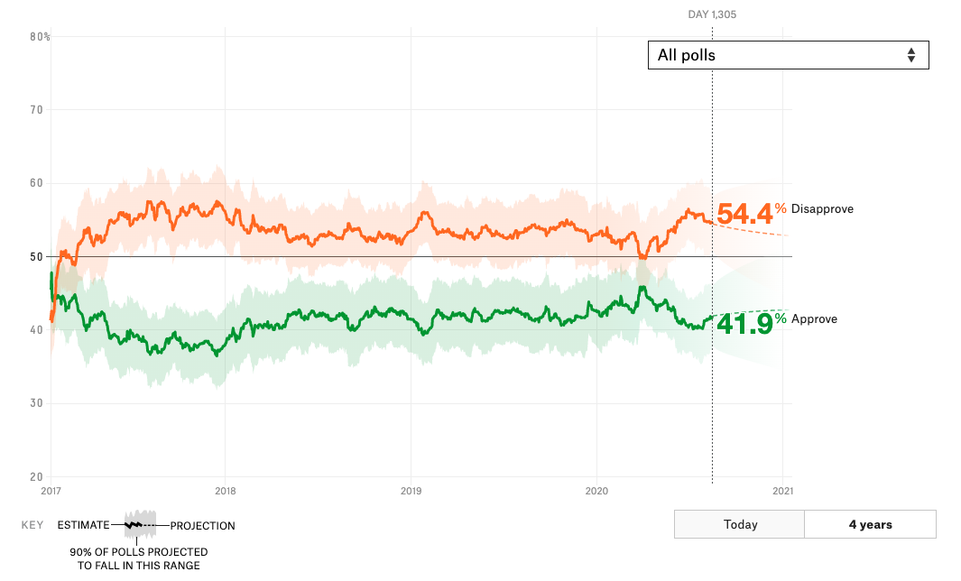
Trump’s approval tracker
Screenshot August 17th, 2020 from www.FiveThirdyEight.com
Notes:
Here the Trump’s approval tracker from FiveThirdyEight. The tool is an updating calculation of the president's approval rating, accounting for each poll's quality, recency, sample size. What makes this tool different from the ones from Real Clear Politics and Huffington Post Pollster? This tracker uses almost all polls but weights them based on their methodological standards and historical accuracy. The polls are adjusted for house effects if they consistently show different results from the polling consensus.
And, most important, uncertainty is taken into account, estimating the fairly wide range within which Trump’s approval ratings could vary over the next 100 days. (This is what’s indicated by the green and orange bands on the chart.)

Slide 7
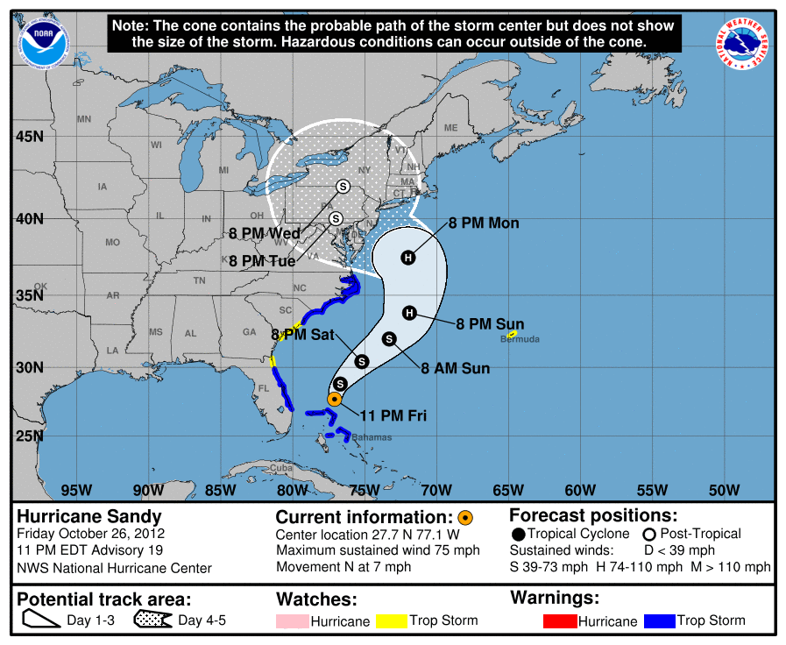
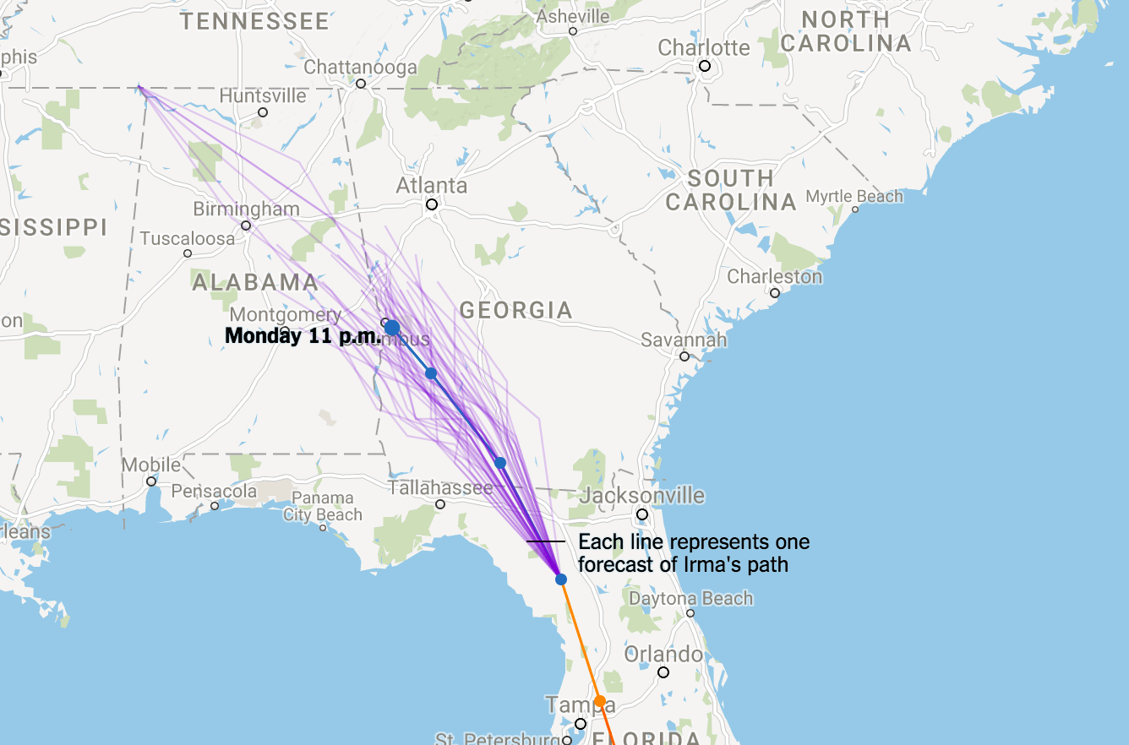
Visualizations for Hurricanes forecasting
Cone of uncertainty
Spaghetti plot
Screenshot July 3rd 2020 from www.datacamp.com
Notes:
There are two common ways of creating visualizations for predicted hurricane paths.
The Cone of Uncertainty and the Spaghetti Plot.
Cone: this tool, used by the National Hurricane Center and communicated by many news outlets, shows us the most likely path of the hurricane over the next five days
Spaghetti: these plots show many, say 50, different realizations of any given model.
Despite the advantage of displaying uncertainty, there are drawbacks in each chart.
Cone: the widening of the cone over time suggests that the storm will grow; the plot contains no information about the size of the storm
Spaghetti: these plots show many, say 50, different realizations of any given model; the plot contains no information about the size of the storm
Day 13 to day 5 (dashed)
Lines blue line (natural gradient)
Area vs lines in patients
Linkin with medical (hypothetical outcome plots)
Solid area missconception

Slide 8
Where we are
A systematic review

Slide 9
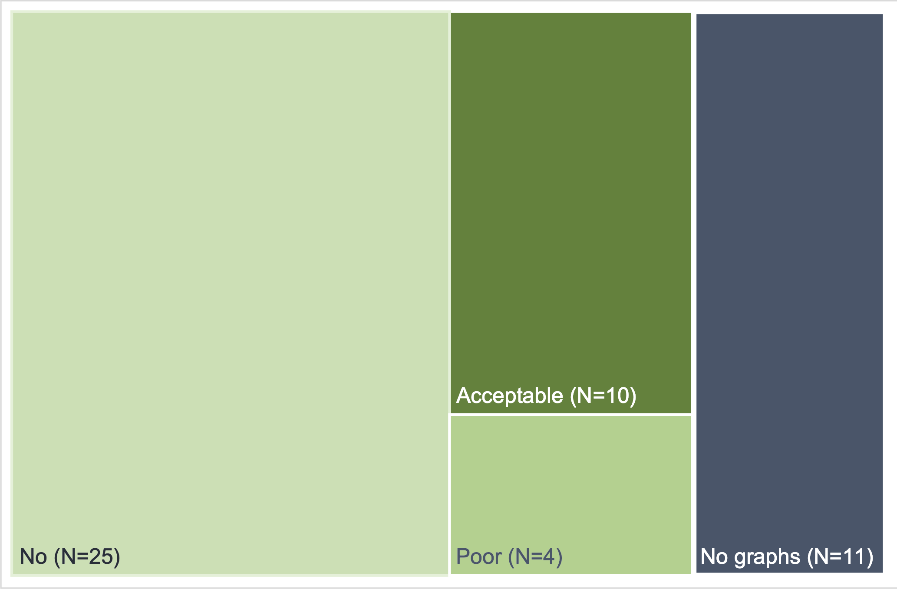
Uncertainty display from 50 papers from top medical journals
39/50
With plots
14/50
With uncertainty display

Slide 10
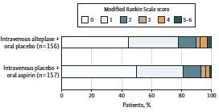
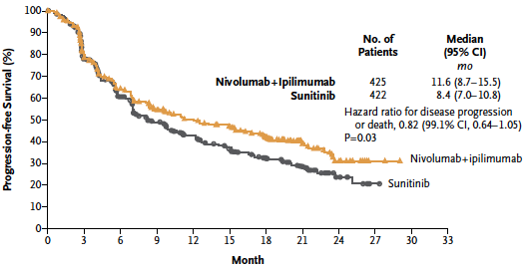
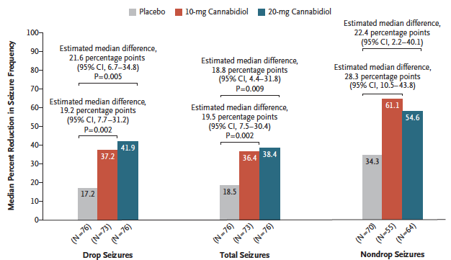
Common plots
10.1001/jama.2018.8496
10.1056/NEJMoa1712126
10.1056/NEJMoa1714631

Slide 11
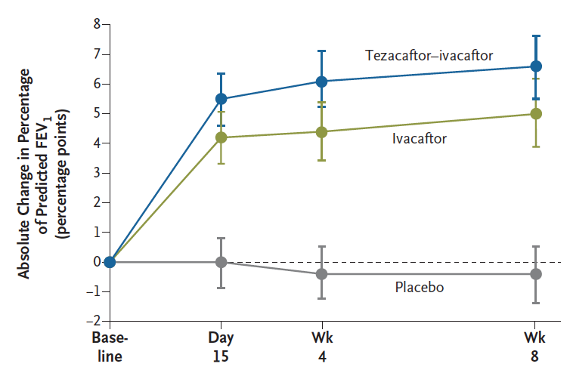
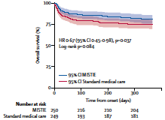
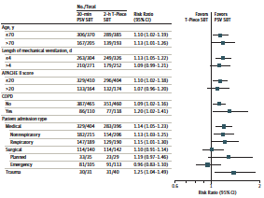
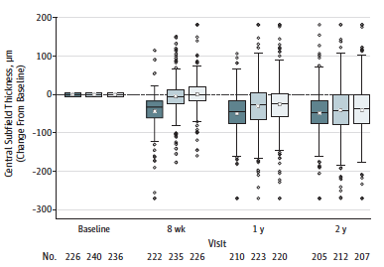
Uncertainty displays
10.1056/NEJMoa1709847
10.1016/S0140-6736(19)30195-3
10.1001/jama.2019.5790
10.1001/jama.2019.7234
Notes:
We can contrast variability uncertainty
We can learn from other areas
Even the leading journals don't get it right

Slide 12
Where to go
Examples

Slide 13
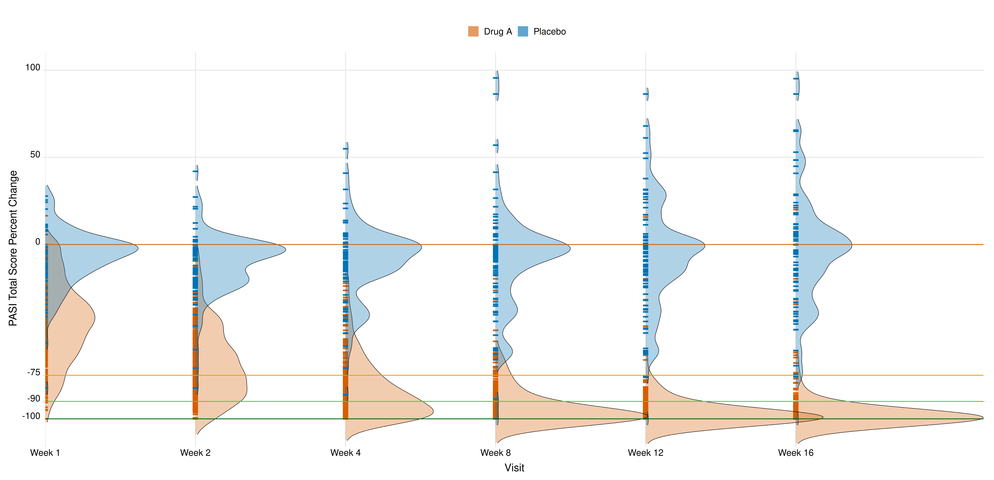
PASI Change from Baseline from Week 0 to Week 16
Notes:
Here some examples related to uncertainty display of on psoriasis. PASI is widely used in clinical trials of therapies to treat psoriasis. Although absolute PASI score is often used to define entry into a trial, it is response to treatment that is important to measure efficacy. This is usually presented as a percentage response rate; e.g., PASI 50, PASI 75, PASI 90, PASI 100. PASI 75, for example, represents the percentage (or number) of patients who have achieved a 75% or more reduction in their PASI score from baseline. PASI 100 indicates patients who have achieved a complete resolution of all disease. By definition a patient who has achieved PASI 75 has also achieved PASI 50. There is a gradual tendency, as therapies become more effective to report higher efficacy rates in clinical trials.
One option is to display the whole distribution of the patients across all the weeks with ridge plot.

Slide 14
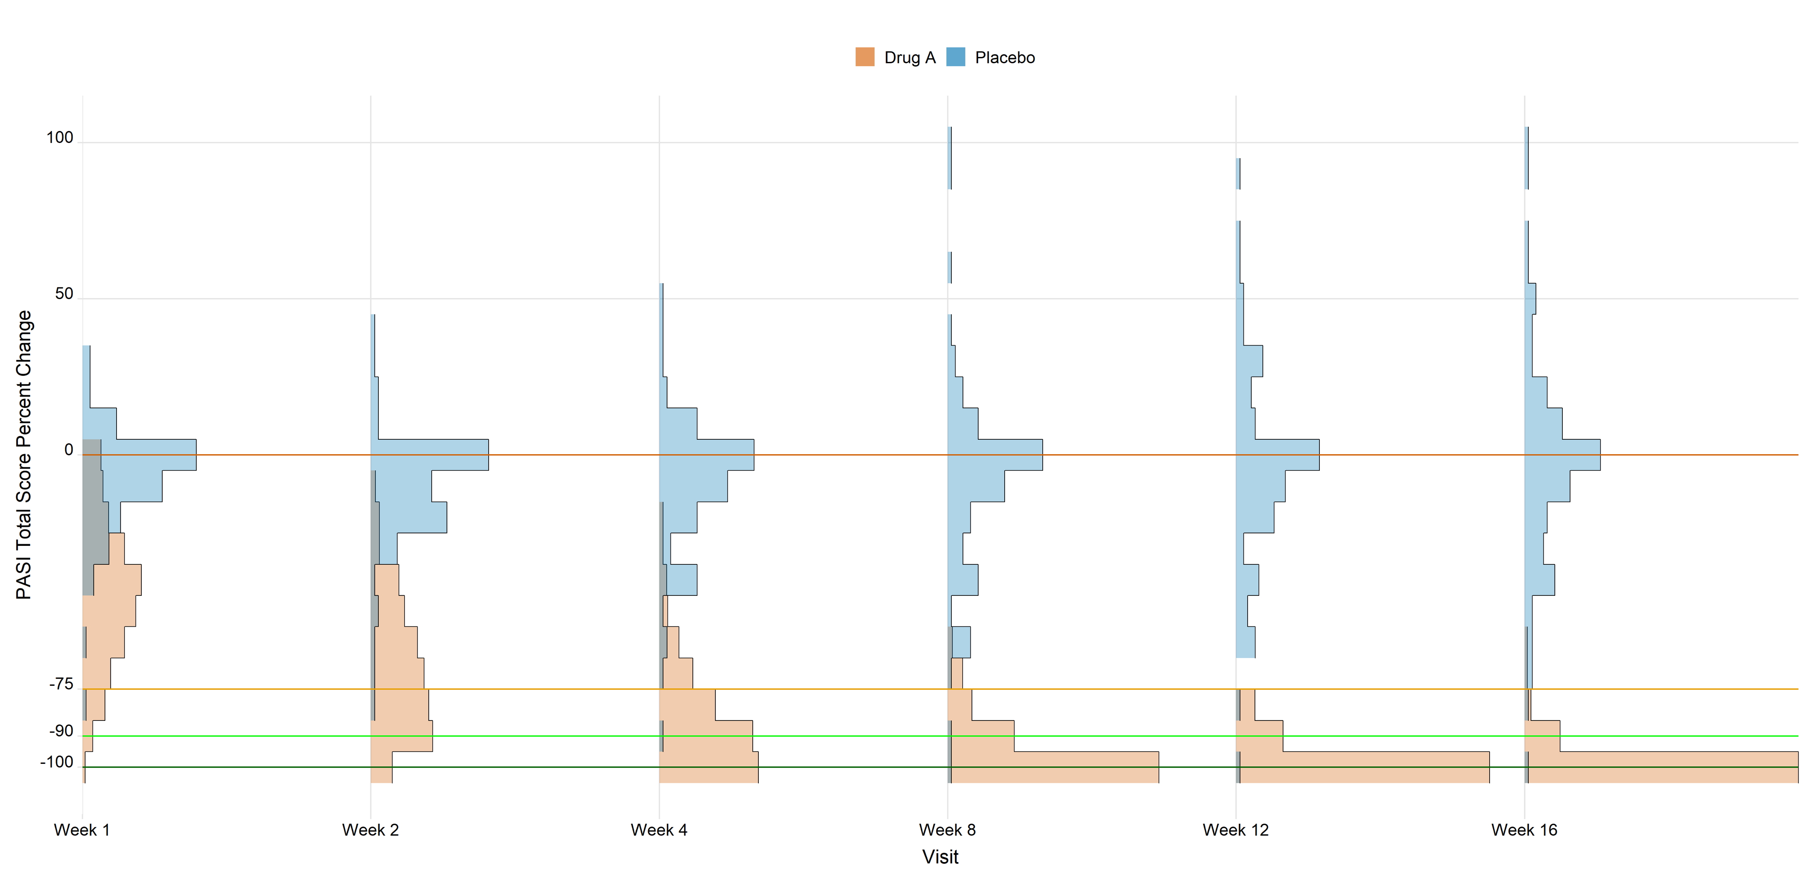
PASI Change from Baseline from Week 0 to Week 16
Notes:
Here some examples related to uncertainty display of on psoriasis. PASI is widely used in clinical trials of therapies to treat psoriasis. Although absolute PASI score is often used to define entry into a trial, it is response to treatment that is important to measure efficacy. This is usually presented as a percentage response rate; e.g., PASI 50, PASI 75, PASI 90, PASI 100. PASI 75, for example, represents the percentage (or number) of patients who have achieved a 75% or more reduction in their PASI score from baseline. PASI 100 indicates patients who have achieved a complete resolution of all disease. By definition a patient who has achieved PASI 75 has also achieved PASI 50. There is a gradual tendency, as therapies become more effective to report higher efficacy rates in clinical trials.
One option is to display the whole distribution of the patients across all the weeks with ridge plot.

Slide 15
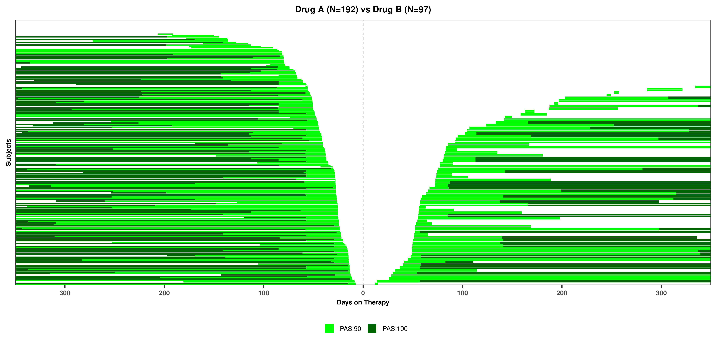
Waterfall Plot of First PASI90 Response Onset and Maintenance
Drug A
Placebo
Notes:
One option is to display each patient in a waterfall plot, showing the cumulative distribution of the patients achieving and maintaining PASI90 response (ligh green). Dark green is used to show PASI100 response.
More time in explain it

Slide 16
Animation of PASI Change from Baseline from Week 0 to Week 16
Drug A
Placebo
Notes:
One option is to display each patient in animated scatter plots, with each patient fluctuating from Week 0 to Week16 according to PASI Total Score Percent Change. Each bubble change its colour according to the different key thresholds (e.g. dark green for 100%). One scatter plot per treatment, stacked barcharts on top for displaying the overall distribution.

Slide 17
Call to action
A manifesto for uncertainty visualization in the pharmaceutical industry
Learning data visualization principles (VIS SIG)
Visualizing uncertainty as reporting standard (CONSORT)
More software in the toolkit

Slide 18
Resources
Cairo, Alberto. The truthful art: Data, charts, and maps for communication. New Riders, 2016.
Novartis checklist
https://sgfin.github.io/files/cheatsheets/graphic_design.pdf
The MU Collective directed by Jessica Hullman and Matt Kay https://mucollective.northwestern.edu
Wilke, Claus O. Fundamentals of data visualization. O'Reilly Media, 2019. https://serialmentor.com/dataviz
PSI Visualisation Special Interest Group (VIS SIG) https://www.psiweb.org/sigs-special-interest-groups/visualisation
van der Bles et al. "Communicating uncertainty about facts, numbers and science" Royal Society open science 6.5 (2019): 181870.
Bonneau et al. "Overview and state-of-the-art of uncertainty visualization." Scientific Visualization. Springer, London, 2014. 3-27.
Spaghetti Plots and Hurricanes' Paths https://www.datacamp.com/community/blog/how-not-to-plot-hurricane-predictions

Slide 19
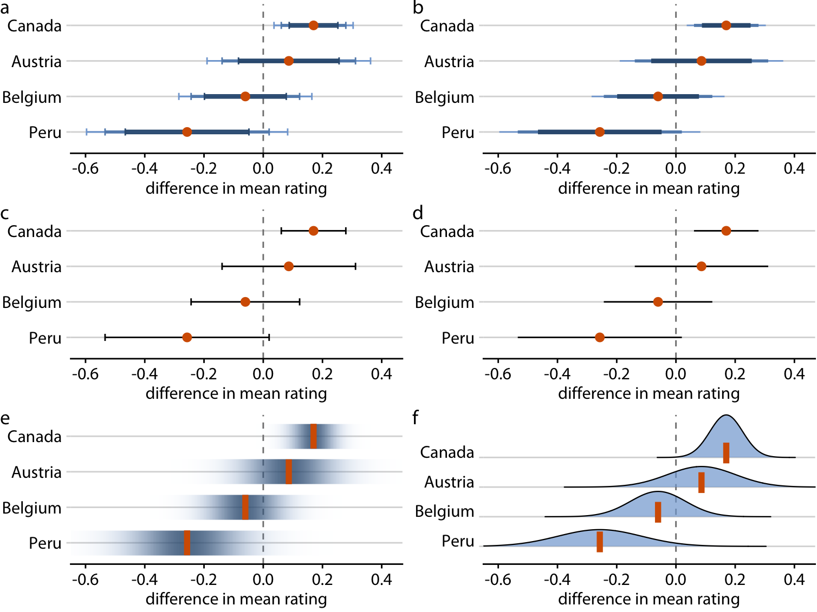
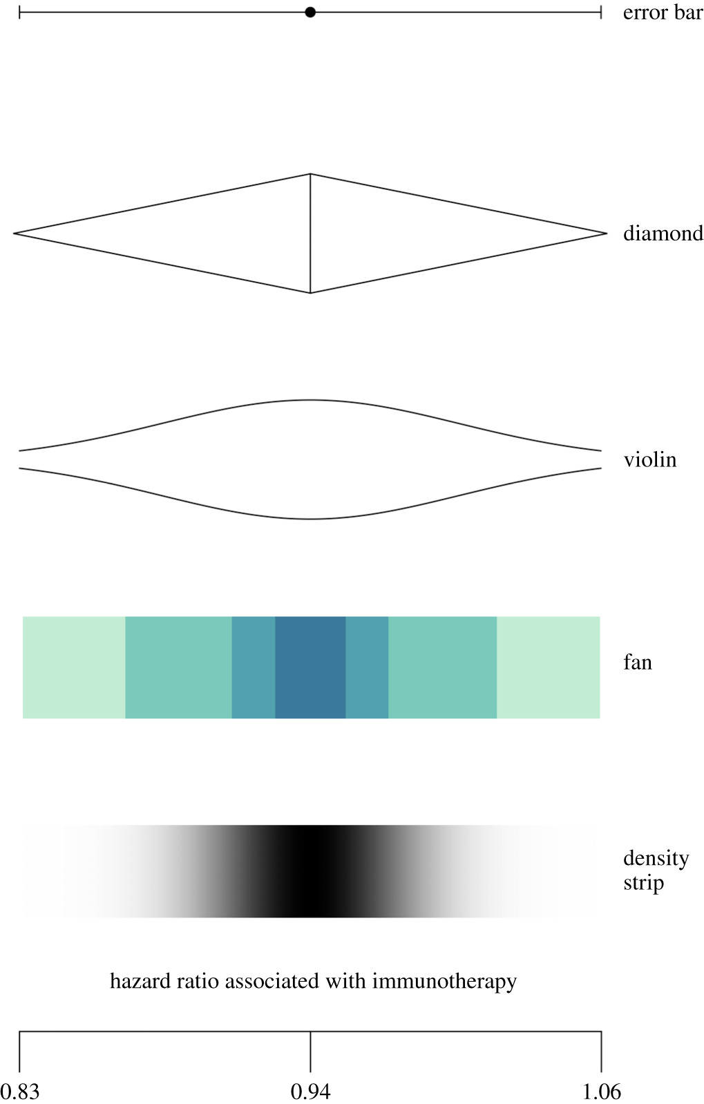
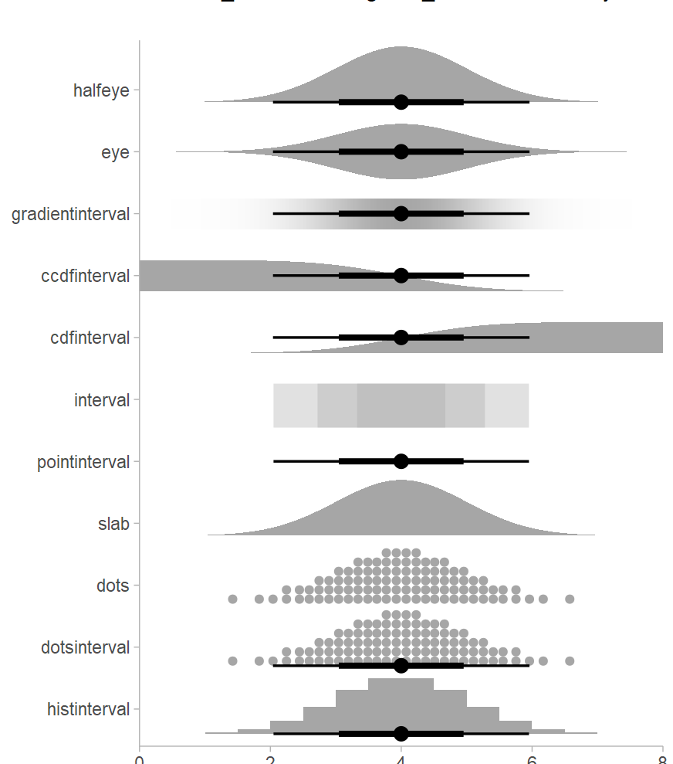
Resources
Claus O. Wilke book "Fundamentals of Data Visualization"
van der Bles et al. (2019)
tidybayes R package
Bonneau et al. (2014)
Notes:
As resources

