Slide 1
Real-World Evidence Submission - a Case Study in Lung Transplantation
PSI RWD SIG Webinar
22 March 2022

Slide 2
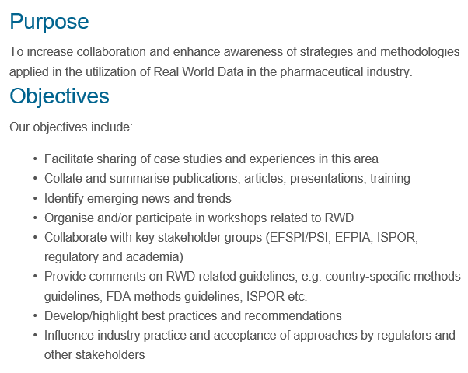
Real World Data SIG
SIG Session at conference 14th June
https://www.psiweb.org/sigs-special-interest-groups/rwd-sig

Slide 3
Overview
The FDA Real-World Evidence (RWE) Framework was published in Dec. 2018, shedding some light on how Real-World Data (RWD) can be used to support regulatory decision making. This guidance was greatly welcomed in an environment that focuses on efficiency and innovative trial designs. Yet, three years out, there are not many examples of RWE in practice, especially of situations where RWE is the exclusive source of evidence supporting new drug indications. Recently, tacrolimus was approved for Lung transplantation based solely on RWE and we would like to share our experience with statisticians in the pharmaceutical community.
Three stakeholders – the sponsor, RWD vendor and FDA - will share their experiences of the submission and approval process. Topics to be covered include relevant project background & context, identification/selection of RWD, study design & key analysis methods, operational considerations related to study conduct & quality, submission content and labeling.

Slide 4
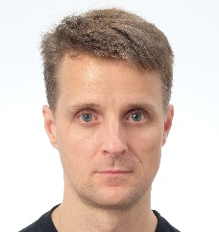
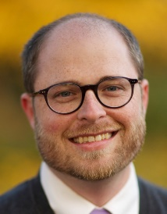
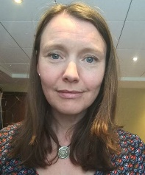
Speakers | Biographies | Abstract
Rick Croy David Nimke Josie Wolfram | Rick has been working in clinical development as a statistician in the pharmaceutical industry for over 20 years. For more than 10 of those years, he has been a global statistical lead on various projects, including tacrolimus for transplantation. David is the Real World Evidence-US Lead at Astellas Advanced Informatics and Analytics. His team of observational researchers and analysts conduct research using secondary use databases. Previously, he worked in epidemiology and RWE groups at Astellas, AbbVie, and Abbott Laboratories. David holds a Doctor of Public Health from University of North Carolina. Josie joined the pharmaceutical industry 25 years ago. Following a few years at GSK, she joined Fujisawa in Munich then Astellas in the Netherlands in various statistical roles. She currently leads a small team focused on leveraging real world data to support development projects. | Richard Croy, David Nimke and Josephine Wolfram will share the background and rationale to pursue this submission, the approach, and key discussion points with the FDA leading up to the submission and during review. Considerations for the choice of RWE and Real-World Data (RWD) used in the pivotal RWD study will be discussed along with the study design elements, key results and challenges. Operational considerations for study conduct and submission will also be addressed
Tim Weaver | Tim Weaver works as a biostatistician in the area of organ transplantation with the Chronic Disease Research Group. In that role he has conducted research using the SRTR database as well as simulation analysis of the organ allocation system. | Tim Weaver will discuss the source of the RWD, the Scientific Registry of Transplant Recipients database, and the observational nature of the data with its implications for the study design and considerations for analysis. Technical aspects of the data-processing code development, data transfer, and results submission will also be discussed.
Tae Hyun (Ryan) Jung | Tae Hyun Jung, Ph.D., is a Senior Statistical Reviewer in FDA/CDER/OTS/OB/DBVII. He has comprehensive NDA/BLA/PMR review experience from phase III/phase IV safety focused reviews, and phase III efficacy reviews including RWE efficacy. He is also leading multiple RWE/RWD research projects using machine learning/artificial intelligence, evidence synthesis, data quality, and synthetic data. Tae Hyun completed his PhD degree in Biostatistics at Yale University. | Tae Hyun Jung will share FDA review perspectives and challenges during the review process. Also, the importance of getting quality patient-level data in RWE submission will be addressed.

Slide 5
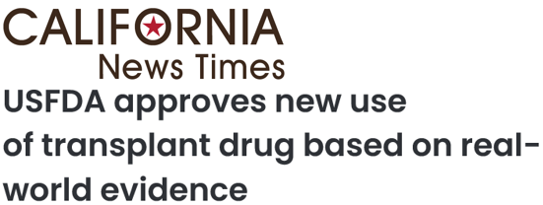
The Real Reason We Are Here
exclusively
exclusively
exclusively
exclusively
exclusively
exclusively
exclusively

Slide 6
Speakers & Agenda
Speaker: | Richard Croy, Global Statistical Lead (Astellas Development)
Topic: | Introduction: Disease Area, Timeline, Context via FDA RWE framework. Regulatory interactions & submission contents
Speaker: | David Nimke, RWE-US Lead (Astellas AIA RWD & RWE)
Topic: | How appropriate RWD source was identified & selected. Potential & actual complications. The study design and planned analysis methods.
Speaker: | Josie Wolfram, Clinical Development Applications Lead (Astellas AIA RWD & RWE)
Topic: | Study analysis & reporting, and the journey to the agreed label. Operational considerations related to study conduct and quality.
Speaker: | Tim Weaver, Statistician (CDRG)
Topic: | Vendor perspective
Speaker: | Tae Hyun (Ryan) Jung, Biostatistics Reviewer (FDA)
Topic: | Regulatory perspective

Slide 7
Speakers & Agenda
Speaker: | Richard Croy, Global Statistical Lead (Astellas Development)
Topic: | Introduction: Disease Area, Timeline, Context via FDA RWE framework. Regulatory interactions & submission contents
Speaker: | David Nimke, RWE-US Lead (Astellas AIA RWD & RWE)
Topic: | How appropriate RWD source was identified & selected. Potential & actual complications. The study design and planned analysis methods.
Speaker: | Josie Wolfram, Clinical Development Applications Lead (Astellas AIA RWD & RWE)
Topic: | Study analysis & reporting, and the journey to the agreed label. Operational considerations related to study conduct and quality.
Speaker: | Tim Weaver, Statistician (CDRG)
Topic: | Vendor perspective
Speaker: | Tae Hyun (Ryan) Jung, Biostatistics Reviewer (FDA)
Topic: | Regulatory perspective
DISCLAIMER: First three speakers are paid employees of Astellas. This presentation is intended for informational purposes only and does not replace independent professional judgment. This presentation is not intended to provide medical or legal advice. Statements of fact, positions taken, and opinions expressed are those of these speakers individually and, unless expressly stated to the contrary, do not necessarily reflect the opinion or position of the speakers’ employer, Astellas, or any of its subsidiaries and/or related entities.

Slide 8
Timeline
Nov-Dec (7 – 8) | Respond to Type C Plan adjustments Vendor selection formalized
2020 . Jan-Feb (9–10) | Type C meeting (#2) F-U from #1 (dose rec & exposure), data & programming submission
Mar-Jul (11–15) | Finalize Protocol & SAP Data analysis
Aug-Sep (16–17) | Type B (pre-NDA)
Oct-Nov (18–19) | F-U w/FDA on Stat/Prog Final Clinical Study Report (CSR)
Dec (20) | Submission
Feb | Filing accepted (w/priority review)
Mar-Jun | FDA Review & IRs
Jul (26) | Approval
2016 Dec | 21st Century Cures Act
2018 Dec | FDA Framework for RWE Introductory call with FDA
2019 Jan | Team assembled (Dev + AIA)
Apr | Astellas governance project approval
May-Jul (1 – 3) | Planning / draft SAP Orphan Drug Designation RWD selection Vendor contact
Aug-Oct (4 – 6) | Type C meeting (#1) Adequacy of RWD selection, proposed outcomes/exposure groups/SAP, early label, dose recs

Slide 9
Background to Solid Organ Transplantation (Tx) & Tacrolimus
In the mid-1980s, laws were introduced to regulate the US donation process, including the mandatory comprehensive reporting of Tx procedures and outcomes into the Scientific Registry of Transplant Recipient (SRTR) database
1st successful Tx in 1954 with identical twins
1954
1978
1980s
1994
Survival >1 year possible only w/advent of calcineurin inhibitors (CNI), Cyclosporine (CsA) was the 1st
Tacrolimus (Tac, CNI) was introduced in 1994 for Liver Tx; later approved for KTx (1997) and HTx (2006)
Something About Immunosuppression Medications (I-Meds) in Tx
Many, many available I-Meds. Patients cannot live without them
Current SoC (20 years): Induction therapy, Steroids, CNI, adjunct therapy
CNIs have narrow therapeutic window. Exposure (PK AUC) highly correlated with steady-state pre-dose trough. Thus, label exposure recommendation for dose is limited to initial (1st) dose and supplemented with recommended ranges to target trough levels. Hence, dosing is controlled via Therapeutic Drug Monitoring

Slide 10
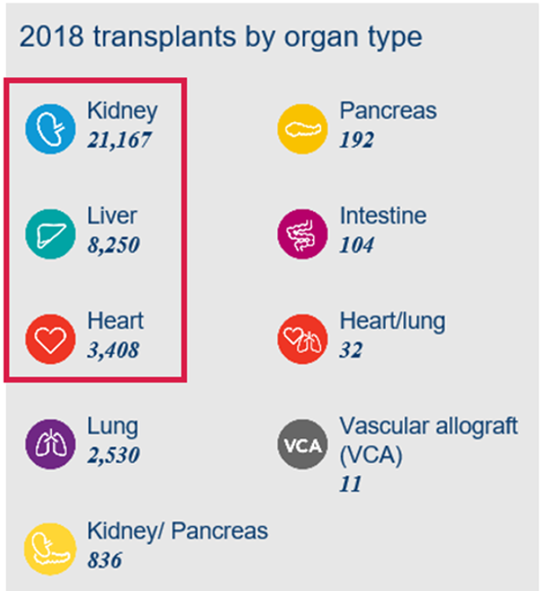
Why Not Run a CT for Lung Transplant (LTx)
Each organ is unique, with its own set of life-ending diseases, safety concerns, challenges and risks. Therefore, each organ requires its own approval
With so few patients (PTs), a registration CT may not be feasible
Tac & CsA Indications

Slide 11
Why Look for Approval
Medical Need
No I-Meds were approved
Approx. 15K living LTx recipients. The number of LTx recipients was growing annually: from ~700 in 1999 to ~2,300 in 2017 (~30 to 50 per year are pediatric PTs)
Challenges from payers (denial of insurance coverage) threatened access to life-saving/ prolonging therapies
Tacrolimus Already Widely Used
As of 2017, >80% of LTx recipients already treated with Tac+MMF
There was already strong evidence that Tac works well. Prior to CNI-based regimens, the 1-year survival was 0%. Now it is >80%
No dosing guidance (in the label)
FDA 2018 RWE Framework
2016 Cures Act
2018 Framework for FDA’s RWE Program supports lack of CT data

Slide 12
FDA 2018 RWE Framework (General)
What the Framework Does
Defines RWE/RWD
Identifies some RWE study designs
What the Framework Does Not Do
Endorse any one type of RWD
Endorse any specific approach/method of generating RWE
Detail what is acceptable RWE/RWD
Defines broad parameters for using RWE/RWD to support changes to labeling (sNDA)
Assess reliability/relevance of RW
Assess study designs leading to RWE
Assess regulatory suitability/appropriateness (e.g., do RWD/RWE meet regulatory requirements
Identifies some current/past uses of RWD in generating evidence for Safety and Efficacy
Give specific guidance on how Agency will determine if regulatory requirements are met
Data standards (collection, monitoring, cleaning, submission of, etc.)
Inspection readiness
https://www.fda.gov/media/120060/download

Slide 13
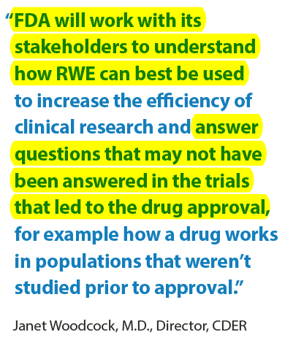
FDA 2018 RWE Framework (General)
What the Framework Does
Defines RWE/RWD
Identifies some RWE study designs
What the Framework Does Not Do
Endorse any one type of RWD
Endorse any specific approach/method of generating RWE
Detail what is acceptable RWE/RWD
Defines broad parameters for using RWE/RWD to support changes to labeling (sNDA)
Assess reliability/relevance of RW
Assess study designs leading to RWE
Assess regulatory suitability/appropriateness (e.g., do RWD/RWE meet regulatory requirements
Identifies some current/past uses of RWD in generating evidence for Safety and Efficacy
Give specific guidance on how Agency will determine if regulatory requirements are met
Data standards (collection, monitoring, cleaning, submission of, etc.)
Inspection readiness
Take-home Messages:
FDA does not have all the answers
FDA goal is to promote the use of RWE by being open minded and encouraging input
https://www.fda.gov/media/120060/download

Slide 14
Select Type C / B Meeting Feedback & Agreements
Notable Items
Planning documents: SAP: Skeptical about our plans for treatment comparisons SAP: Handling of missing or invalid data Full protocol and CSR expected
Dosing recommendation (label) based on published literature (notably it was based primarily heart Tx)
R-software as analysis tool: Accepted as the analysis tool; required to provide R-code and documentation Assistance required to deal with technical difficulties with LaTex editor and using SAS/CSV files w/R
Dataset submission: Native RWD structure (SAF) proposed & accepted but required to be submitted as SAS .XPT files .XPT v5 & v8 were considered and tested, with final agreement to submit as v8 Astellas required to submit data via regular pathway, due to internal FDA requirements Only fields used in the analysis would be annotated on the data collection forms
SAF: Standard Analytical File

Slide 15
Statistical Docs Submitted to Support Review of RWD Analysis Study
Protocol & SAP
CSR
V8 .XPT files for Raw RWD & ADaM-like dataset (non-CDISC compliant)
submitted via regular gateway
Partially annotated data collection forms
current forms only (1 exception for I-Meds)
Legacy SDRG
including code to convert .XPT into R datasets
ADaM-like ADRG
including details about R programs, packages & functions
Define files
Programming code
including additional programming code to assist review; e.g., IR for code to convert .XPT into .CSV

Slide 16
Decision-making in the development of RWE for regulatory submissions: Tacrolimus-Lung Transplant indication expansion
David Nimke, DrPH, MPH Senior Director of Real-World Evidence, US Advanced Informatics and Analytics October 2021

Slide 17
Speakers & Agenda
Speaker: | Richard Croy, Global Statistical Lead (Astellas Development)
Topic: | Introduction: Disease Area, Timeline, Context via FDA RWE framework. Regulatory interactions & submission contents
Speaker: | David Nimke, RWE-US Lead (Astellas AIA RWD & RWE)
Topic: | How appropriate RWD source was identified & selected. Potential & actual complications. The study design and planned analysis methods.
Speaker: | Josie Wolfram, Clinical Development Applications Lead (Astellas AIA RWD & RWE)
Topic: | Study analysis & reporting, and the journey to the agreed label. Operational considerations related to study conduct and quality.
Speaker: | Tim Weaver, Statistician (CDRG)
Topic: | Vendor perspective
Speaker: | Tae Hyun (Ryan) Jung, Biostatistics Reviewer (FDA)
Topic: | Regulatory perspective

Slide 18
Anticipated evidence needs
Exposure | Baseline Information | Safety Outcomes | Effectiveness Outcomes
Immunosuppression regimen Agents Dosing Trough | Single vs. double lung transplant Year of transplant Age Gender Reason for transplant Presence of IL2-r antibody induction | Cause of death Infections (bacterial, viral, fungal) Drug-treated hyperlipidemia Symptomatic bone disease Chronic liver disease Cataracts Diabetes Renal dysfunction Stroke Drug-treated hypertension Malignancy (overall and PTLD) Discontinuation of immunosuppression therapy | Rejection Treated rejection BOS Patient Survival Graft Survival

Slide 19
Potential secondary-use data sources
Transplant Centers Data could come from medical records, clinical trials (prior/current), and prospective cohorts Feasibility dependent on data collection, costs, partnerships, and more Center-based practice may not be generalizable or sufficiently large for a study | Claims databases Commonly used RWD with rich history of regulatory uses (e.g. PASS) Often lacks desired clinical information. Validity of study variables is often unknown. Often short follow-up. Death information often requires additional linkages.
Registry data Research-driven data collection Collected data is generally relevant to disease/treatment Potentially representative Continuity may be lacking | Combination or linking Potential for deeper data Can exacerbate issues related to patient selection (decreased external validity, decreased size) Resource intensive

Slide 20
 | SRTR only | SRTR linked | Claims only
Regimen | At assessments |  | Underestimated in claims (only 70% with Tac claim at 1y)
Single vs. double
Transplant year
Age
Gender
Reason for transplant |  |  | Based on comorbidity assessment in claims only
IL2-r antibody induction |  |  | Severely underestimated in claims only (2% with claim)
Rejection | At assessments |  | Beginning in Oct 2015, LTx rejection has a specific diagnostic code. Otherwise non-specific “complication”.
Treated rejection | At assessments |  | Feasibility unknown. Coding algorithm?
BOS | Unreliable staging information |  | No staging information.
Patient Survival | Exact date |  | Based on discharge information only.
Graft failure | Exact date |  | Feasibility unknown. Coding algorithm?
Cause of death | Non-standardized text field
Infections (bacterial, viral, fungal) | Limited to hospitalizations collected at assessment |  | Typically non-specific coding e.g. septicemia, pneumonia
Drug-treated hyperlipidemia | At assessments
Symptomatic bone disease |  |  | Coding algorithm?
Chronic liver disease |  |  | Poorly coded in claims
Cataracts |  |  | Difficult to establish temporality
Diabetes | At assessments
Renal dysfunction | Measured at assessments. Reporting changed over time |  | Poorly coded in claims
Stroke
Drug-treated hypertension |  |  | Treatment paradigm is somewhat complicated. Initiator vs. dose change vs. switch
Malignancy | At assessment for SRTR only. Best result may require cancer registry data | How to handle discrepant observations between data sources?
PTLD | At assessment for SRTR only. Best result may require cancer registry data | How to handle discrepant observations between data sources?
Discontinuation | At assessment |  | Treatments appear to be underrepresented

Slide 21
Study Design

Slide 22
Study Objectives
Primary Objective
Describe the use of Tacrolimus IR and other immunosuppressive agents over time in lung transplanted patients in the US
Describe the incidence of transplant-related outcomes over time in lung transplanted patients in the US
Secondary Objective
Evaluate the real-world effectiveness of Tacrolimus IR + MMF in lung transplantation
Evaluate the safety of Tacrolimus IR + MMF in lung transplantation
Exploratory Objective
Evaluate the contribution of individual agents (specifically Tacrolimus IR) over time

Slide 23
Study Design
Retrospective cohort study of primary lung transplant (not re-transplant) recipients
Transplant date identified as index date. Follow-up up to three years.
Exposure groups based on immunosuppressive regimens reported at discharge. Exposure was based on intention-to-treat (i.e. once exposed, always exposed).

Slide 24
Selection criteria
Inclusion Criteria
Patients receiving primary lung transplant (not re-transplant) in the SRTR registry between 1 Jan 1999 and 31 Dec 2017
Exclusion Criteria
Patients with history of organ transplant prior to and including the date of lung transplant. This includes patients that have received any previous transplant, lung or otherwise.
Transplant recipients of a multi-organ transplant
Transplant recipients of organ from a living donor
Transplant recipients that died during the index hospitalization or had graft failure on or prior to discharge. This includes patients retransplanted within the index hospitalization, but who did not fill in a graft failure date
Transplant recipients with missing discharge date, or discharge date more than 1 year post-transplant
Transplant recipients with missing maintenance immunosuppression information at discharge

Slide 25
Final exposures
Does the evidence need to comparative? If so, what is the appropriate comparison? Another unapproved medication (Cyclosporin A)? To historical comparator (i.e. pre-1980s?)
Do we need to measure tacrolimus benefit independent of other agents when the standard of care is multi-agent immunosuppressive agents?
Given treatment guidelines and standard of care, focus shifted to effectiveness of regimens
What are the appropriate treatment groups?
Tacrolimus IR + MMF, Tacrolimus IR + azathioprine, Cyclosporine + azathioprine, Cyclosporine + MMF.
How should we handle other treatment decisions (use of induction agents, addition of steroids to the regimen)?
Induction agents and Steroids considered as baseline variables
All analyses were intention-to-treat
Settled on multiyear study focused on current standard of care with a review of historical information on lung transplant and outcomes (literature)

Slide 26
Final outcomes
Prioritize OS and graft failure as outcomes.
Other endpoints were collected at assessment points. What is the preferred approach to handling events over time?
These were estimated by calculating cumulative incidences
What composite endpoints should be measured (if any)?
Multiple composite endpoints were pre-specified
How should we handle missing data and loss to follow-up?
Loss to follow-up and missing data was highly unlikely for the primary endpoints, since OS (Death Master File) and graft failure (OPTN wait list) data collection were augmented outside of SRTR reporting forms
Primary endpoint: Composite of graft failure or death at 1 year

Slide 27
Discussions to address immortal time
The team wanted to make a statement about survival post-transplant.
Treatment with immunosuppressive regimen at discharge requires a patient to survive after transplant through discharge.
This can introduce immortal time biases depending on how patients are analyzed.
Discharge Regimen
Transplant
Immortal Time
Database time at risk
Event
Patient 1
Patient 2

Slide 28
Approaches to address immortal time
Incident user design: at risk period begins on the date of discharge/treatment (index date), not the preceding transplant date
Interpretation is made in relation to discharge date
100% of patients are present in the at-risk population at Time 0.
Left-truncation: patients undergoing transplant (index date) are allowed to enter the at-risk population at the time of discharge/treatment
Interpretation is made in relation to transplant date
<100% of patients are present in the at-risk population at Time 0.

Slide 29
Planned analyses for primary endpoints
A Kaplan-Meier survival curve will be produced by exposure group, censored at 3 years post transplant. Cumulative incidence curves, percentages and 95% confidence intervals will also be presented.
Hazard ratios for each regimen of interest as compared to Tacrolimus IR +MMF and their 95% confidence intervals will be estimated using an adjusted Cox proportional hazards model.
Predict the regimen with multi-variable adjusted multinomial logistic regression with LASSO.
Identify risk factor for outcome based using univariable Cox proportional hazard models.
Adjusted Cox proportional hazards model including factors identified in step 1 and 2 plus several factors believed to be associated with post-transplant graft failure and death

Slide 30
Feedback from FDA on proposed approach
It appears that patient and graft survival (primary efficacy endpoint) can reliably be ascertained. However, the secondary efficacy and safety endpoints might not be reliably ascertained. Discuss the availability of these [secondary] endpoints and how you will ascertain them in the SAP.
In the SAP, include plans to describe the amount of missing data and how you will handle it in the analysis.
We also request that you submit the subgroup analyses specified in your meeting package, including outcome analyses based on single versus double lung transplantations
You plan to include the results of comparative analyses involving other treatments. Although such analyses may be considered as supplemental information, given that the non-randomized comparator groups might be “too different” to be compared, even after adjusting for confounders, we will not likely consider such analyses to be the primary basis for establishing efficacy. Rather, the rate of death or loss of graft in the tacrolimus IR + MMF will be our primary consideration to determine the efficacy of this product.

Slide 31
Speakers & Agenda
Speaker: | Richard Croy, Global Statistical Lead (Astellas Development)
Topic: | Introduction: Disease Area, Timeline, Context via FDA RWE framework. Regulatory interactions & submission contents
Speaker: | David Nimke, RWE-US Lead (Astellas AIA RWD & RWE)
Topic: | How appropriate RWD source was identified & selected. Potential & actual complications. The study design and planned analysis methods.
Speaker: | Josie Wolfram, Clinical Development Applications Lead (Astellas AIA RWD & RWE)
Topic: | Study analysis & reporting, and the journey to the agreed label. Operational considerations related to study conduct and quality.
Speaker: | Tim Weaver, Statistician (CDRG)
Topic: | Vendor perspective
Speaker: | Tae Hyun (Ryan) Jung, Biostatistics Reviewer (FDA)
Topic: | Regulatory perspective

Slide 32
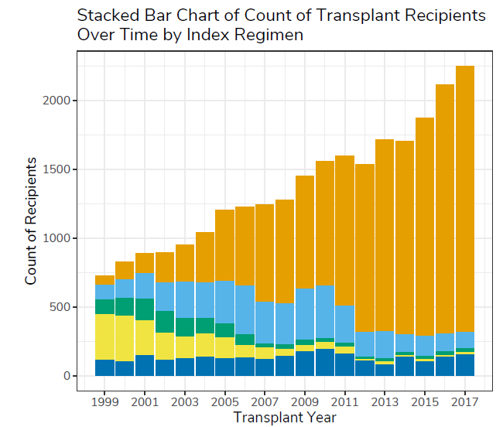
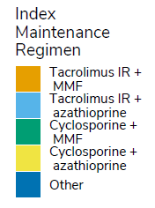
Treatment use over time
Study included 26,080 lung Tx recipients (25,355 adult; 725 pediatric)
Discharge immunosuppressive regimens changed over the 1999 - 2017 study period, with substantial increase in the use of tacrolimus IR and MMF after 2010. During the 2010 - 2017 transplant era, approximately 79% of adult patients and > 90% of pediatric patients received tacrolimus IR + MMF at hospital discharge.
“Other” = any immunosuppressive regimen except the two agents mentioned either with or without steroids. Decisions on exposure group assignment finalized prior to analyses of outcomes.
Total N
15,478
4,263
1,219
1,959
2,436

Slide 33
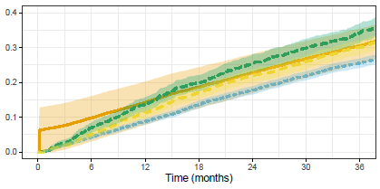
Surprise in the (adult) Kaplan Meier estimates
There are >15,000 patients in the Orange arm. There are <1/3 of that in other arms
Orange arm has huge jump in event rate within days of transplant (Tx). Other arms do not. Why?
Orange arm has wide CI throughout the 3-year period. Why?
Total N
15,478
4,263
1,219
1,959
Event = Composite of Death or Graft Failure

Slide 34
Surprise in the (adult) Kaplan Meier estimates
Only discharged patients were considered as being at risk. With very few patients discharged and events already occurring, the KM calculations resulted in a high & imprecise estimate for tacrolimus IR + MMF over the first week posttransplant.
“When the data is left truncated.., the Product-Limit estimator may have a relatively large variance for small t, where the risk sets are small,.. This early instability in the point estimator of the survival function may propagate throughout the entire curve.”*
Total N
15,478
4,263
1,219
1,959
Event = Composite of Death or Graft Failure
*Klein, J; Moeschberger M; ”Survival Analysis: Techniques for Censored and Truncated Data, 2nd Edition”, p 126, Springer.

Slide 35
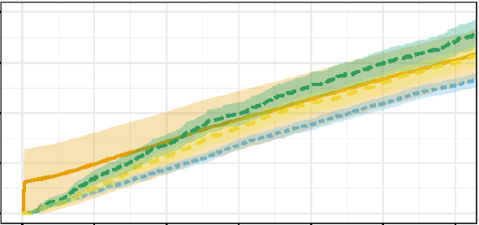
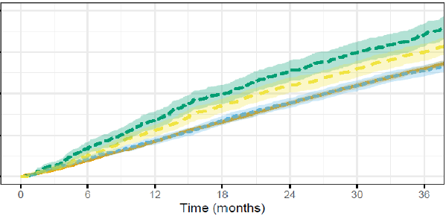
Modified left truncated KM estimate
Adjustment: The four early events shifted to D10
Justification:
Less extreme solution that presented by Klein and Moeschberger (2003)
Earliest event in other 3 arms = D10

Slide 36
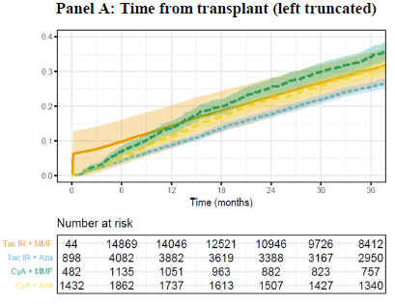
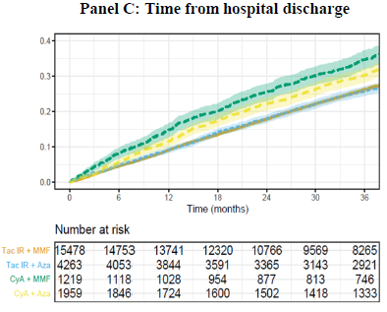
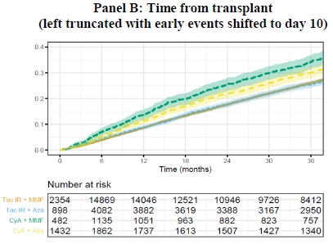
Deep Dive into Graft Survival Estimation
Three approaches presented in Study report
Additional analyses in response to FDA information requests:
removing the early posttransplant events in the tacrolimus IR + MMF exposure group (Klein & Moeschberger)
setting the time at risk from the date of transplant (assuming no left truncation and no hospitalization) in all four immunosuppression regimen groups
subgroup analysis to estimate the cumulative incidence rate of graft failure or death among adult and pediatric patients who had hospitalization greater than 7 days and 14 days using left truncation
Time from discharge selected for label

Slide 37
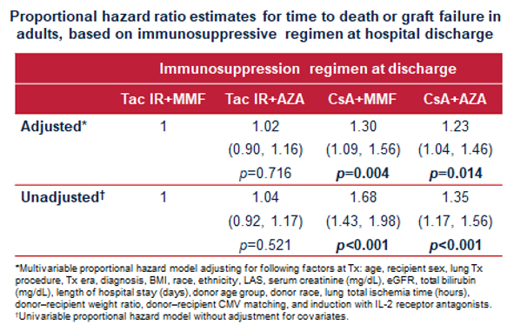
Cox Modelling
Cox proportional hazard models were used to compare exposure groups as well as to test for baseline characteristics associated with a greater risk of graft failure or death in adult lung Tx recipients
The low number of events in the pediatric population precluded modeling analysis
TAC+MMF at discharge in lung Tx was associated with higher 1-year graft survival vs CsA+MMF and CsA+AZA
Factors associated with greater risk of GF or death on TAC IR+MMF:
Recipient age ≥65 years, single lung Tx, hospital stay >24 days, BMI <18.5 kg/m², serum creatinine ≥1.0 mg/dL, lung Tx in the 2006–2009 era, donor age ≥55 years, donor race (black)
Factors associated with lower risk of death or GF on IRT+MMF:
Recipient age 35–49 years Double lung Tx Recipient race (black) Hospital stay ≤14 days Donor CMV-negative

Slide 38
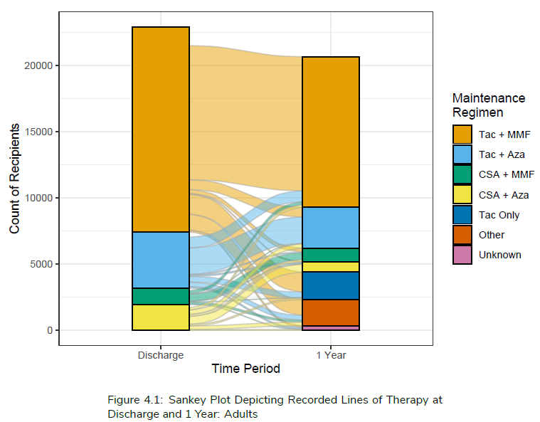
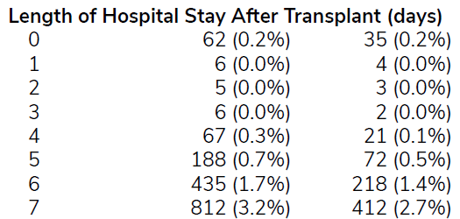
Data Completeness & Cleanliness
Confidence in complete ascertainment for primary endpoint
For secondary outcomes somewhat less confidence
To assess impact of missingness:
Summarized Data Availability at at 1y, 2y, and 3y Post-transplant based on forms submitted
A patient still in follow-up may have a form that submitted with a given outcome missing or indicated as “unknown”. A tabulation by endpoint was provided to quantify this missingness.
In sensitivity analyses of efficacy endpoints, we considered loss to follow-up an event and included in a composite
Handled covariates as categorical variables
Analyses of change in immuno-suppressive regimen limited to one year due to incomplete reporting
Discharge on day of transplant not plausible
(Total cohort)
(Tac+MMF)

Slide 39
Results in Clinical Studies section of Prescribing Information

Slide 40
Results in Clinical Studies section of Prescribing Information
https://www.fda.gov/drugs/news-events-human-drugs/fda-approval-demonstrates-role-real-world-evidence-regulatory-decision-making-drug-effectiveness?utm_medium=email&utm_source=govdelivery

Slide 41
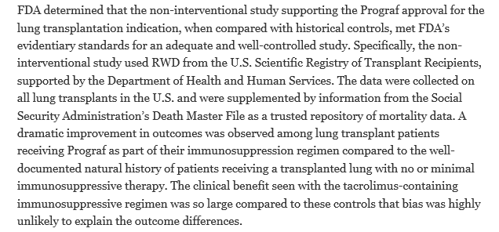
Results in Clinical Studies section of Prescribing Information
https://www.fda.gov/drugs/news-events-human-drugs/fda-approval-demonstrates-role-real-world-evidence-regulatory-decision-making-drug-effectiveness?utm_medium=email&utm_source=govdelivery

Slide 42
Insource vs outsource data handling and analysis
This was Astellas’s first experience carrying out a study with SRTR data
Insourcing advantages include opportunities to handle data, increasing understanding of data contents
Outsourcing advantages include direct utilization of data-specific expertise and tools, third-party execution of analytics
Opted for outsourcing data handling and analysis to optimize data-specific expertise (we used 20 years of data!) and speed

Slide 43
Vendor oversight & inspection readiness
This was Astellas’s first experience with a RWE study for efficacy-related regulatory decision making
With clinical trials we follow GCP from source through reporting, what’s the expectation for RWE?
Data management up to the SRTR “Standard Analytical Files” (SAFs) we could inform ourselves of but not (or not easily) modify
For SAFs through analysis-ready datasets and reports we agreed QC levels with CDRG and worked to an “Oversight Plan”
We batched reports sets with rolling delivery and review, and in particular ensured that choices for variables for Cox models comparing exposure groups were made prior to receipt of outcome data by exposure group
Additional work to convert the data dictionary into “define-like” format and to annotate the data collection forms to support data submission

Slide 44
Speakers & Agenda
Speaker: | Richard Croy, Global Statistical Lead (Astellas Development)
Topic: | Introduction: Disease Area, Timeline, Context via FDA RWE framework. Regulatory interactions & submission contents
Speaker: | David Nimke, RWE-US Lead (Astellas AIA RWD & RWE)
Topic: | How appropriate RWD source was identified & selected. Potential & actual complications. The study design and planned analysis methods.
Speaker: | Josie Wolfram, Clinical Development Applications Lead (Astellas AIA RWD & RWE)
Topic: | Study analysis & reporting, and the journey to the agreed label. Operational considerations related to study conduct and quality.
Speaker: | Tim Weaver, Statistician (CDRG)
Topic: | Vendor perspective
Speaker: | Tae Hyun (Ryan) Jung, Biostatistics Reviewer (FDA)
Topic: | Regulatory perspective
c
c

