Slide 1
Recent U.S. Regulatory Efforts on Complex Innovative Clinical Trial Design
John Scott, Ph.D.
Director, Division of Biostatistics
Office of Biostatistics and Epidemiology
Center for Biologics Evaluation and Research
FDA

Slide 2
Disclaimer
This presentation reflects the views of the author and should not be construed to represent FDA’s views or policies

Slide 3
Outline
FDA adaptive design guidance
FDA complex and innovative trial design (CID) interactions guidance
CID pilot review program
Pilot program examples

Slide 4
Adaptive design guidance

Slide 5
Background
FDA published a draft guidance in 2010 on Adaptive Design Clinical Trials for Drugs and Biologics
Intent was to encourage use of AD trials that fit well into regulatory decision-making
Classified designs into “Well-Understood” or “Less Well-Understood”
Seen by some as inherently discouraging of designs in the latter category
What was less well understood in 2010 shouldn’t remain so forever….

Slide 6
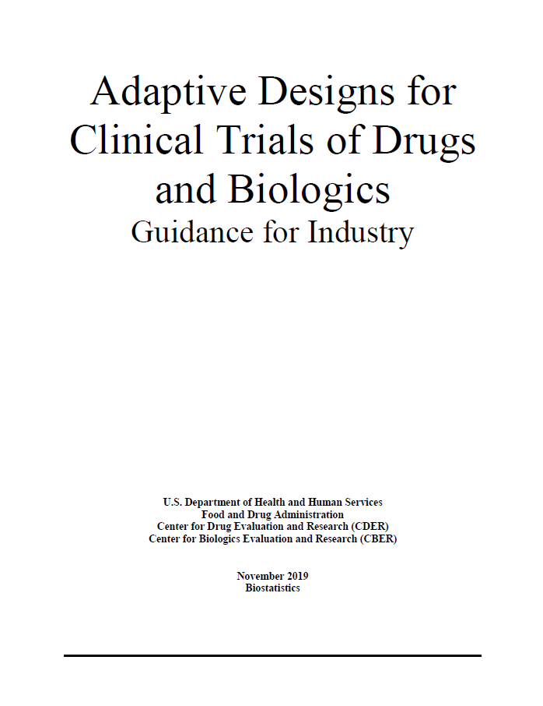
New adaptive design guidance
New guidance finalized in November 2019
Replaces 2010 draft
Moves away from categorization as well-understood or less well-understood
Focuses on key principles in design, conduct, analysis, and reporting
Expands discussion on technical aspects such as estimation, simulations, Bayesian methods
Adds clarity on what should be submitted

Slide 7
Regulatory principles for adaptive designs
Chance of erroneous conclusions should be adequately controlled
Estimation of treatment effects should be sufficiently reliable
Details of design should be completely pre-specified
Trial integrity should be appropriately maintained

Slide 8
CID INTERACTIONS Guidance

Slide 9
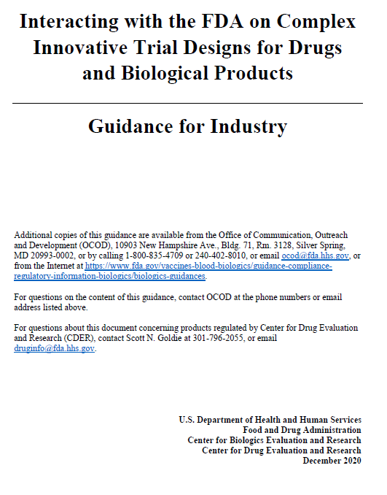
CID Interactions guidance
Draft issued September, 2019, finalized December, 2020
Satisfies, with the AD guidance, a 21st Century Cures Act mandate
Discusses interacting with FDA on CID proposals
Some detail on specific design considerations

Slide 10
Scope
Doesn’t precisely define CID
Moving target
Generally, CID designs are those that have rarely or never been used to support approval in a given indication
Often need for trial simulations for operating characteristics
Primary focus is confirmatory designs
Does not identify which specific designs are appropriate for regulatory purposes
Instead provides structure for communication

Slide 11
CID includes:
Complex Adaptive Designs (frequentist or Bayesian)
Seamless designs
For example, combining dose-finding and hypothesis confirmation in a trial
Adaptations to multiple design features such as treatment arm selection, patient allocation, or endpoint selection
Formal incorporation of “prior” information
Placebo augmentation using external controls or other data sources (e.g. real world data)
Leveraging or borrowing strength from information internal or external to the trial

Slide 12
Interacting with FDA
Meeting availability
Extra meetings may be available to discuss trial simulations, especially for serious and life-threatening conditions
Pilot program
Common elements to be submitted for review
Bayesian features
Priors
Decision criteria
Simulations (covered in detail in AD guidance)

Slide 13
CID Pilot program

Slide 14
CID Pilot Program motivation
To be successful with an innovative proposal, sponsors may need:
Robust regulatory feedback
High-level buy-in
To encourage the use of innovative designs, FDA needs:
Case studies that we can talk about publicly
Hence, the CID Pilot Program

Slide 15
Pilot review program
Joint CDER/CBER effort
Sponsors
submit designs
have the opportunity to engage with regulatory staff on designs via two meetings
Agency
will select up to 2 submissions per quarter
uses the design as a case study for continuing education and information sharing
Meetings led by Biostatistics groups (CDER/OTS/OB or CBER/OBE/DB) with participation from all relevant disciplines
Five year duration

Slide 16
Eligibility criteria
The sponsor must have a pre-IND or IND number for the medical product(s) included in the CID proposal with the intent of implementing the CID in the pilot program application
The proposed CID is intended to provide substantial evidence of effectiveness to support regulatory approval of the medical product
The trial is not a first in human study, and there is sufficient clinical information available to inform the proposed CID
The sponsor and FDA are able to reach agreement on the trial design information to be publicly disclosed

Slide 17
Evaluation of proposals
Need for simulations to assess trial design operating characteristics
Therapeutic need
Trial design appropriateness for CID Pilot Meeting Program
Level of innovation of the trial design
Value proposition of the CID

Slide 18
Website
https://www.fda.gov/CIDpilot

Slide 19
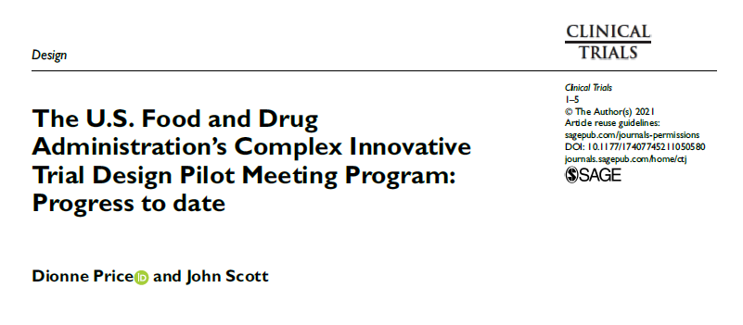
Manuscript
https://doi.org/10.1177/17407745211050580

Slide 20
CID Pilot program examples

Slide 21
Case example 1
Population: Duchenne muscular dystrophy
Randomized, double-blind, placebo-controlled, phase 2/3 trial
Primary endpoint change in dystrophin levels from baseline to a specified timepoint
Important secondary endpoint: Change from baseline in a clinical outcome assessment
Endpoints analyzed via a Bayesian repeated measures model with multiple interim analyses

Slide 22
Case example 1
Bayesian adaptive design with the following potential adaptations:
Stop the trial for efficacy or safety
Modify the sample size
Drop an arm
Pool doses
Change randomization ratio
Also proposed to explore placebo augmentation with historical controls
Regulatory discussions focused on areas needing clarification and simulation space

Slide 23
Case example 2
Randomized, double-blind, placebo-controlled, master protocol to evaluate multiple interventions across multiple pain conditions
Primary endpoint pain relief from baseline measured on a numerical scale
Bayesian mixed-model repeated measures analysis to allow for:
Borrowing patient information from placebo groups within a pain condition
Borrowing treatment effect information across pain conditions for a given intervention

Slide 24
Case example 2
Possible adaptations
Stop for futility
Modify sample size
Add or remove arms
Regulatory discussions focused on:
Potential drift in placebo response
Exchangeability assumptions across pain conditions
Missing data frequently encountered in chronic pain trials

Slide 25
Case example 3
Population: Systemic lupus erythematosus
Randomized, double-blind, Bayesian adaptive design
Patients randomized to placebo or one of three doses
Primary endpoint: Response index at a specified timepoint
Primary analysis was Bayesian hierarchical model with dynamic borrowing to estimate response rates
Features
Response adaptive randomization
Interim analyses for futility and to inform dose and endpoint selection for future studies
Regulatory discussions focused on simulations
Nuisance parameters and additional scenarios

Slide 26
Case example 4
Population: oncology setting with unmet need
Multicenter randomized trial with both internal and external control arms
Primary endpoint: Progression-free survival
Analyzed with internal control arm comparison
Key secondary outcomes including overall survival would incorporate external control information with a Bayesian dynamic borrowing approach
Regulatory discussions focused on:
Patient population
Model assumptions
Incorporation of propensity score as a covariate

Slide 27
Related FDA initiatives
Benefit-Risk Assessment
Patient-Focused Drug Development
Model-Informed Drug Development
Real-World Evidence
Rare Disease initiatives

