Slide 1
Carcinogenicity Statistics Discussion Group
Steven Bailey, Pfizer
June 29, 2021

Slide 2
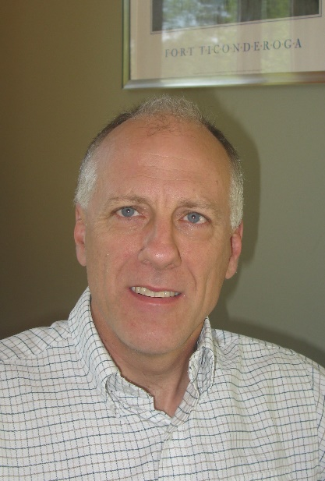
My Background
Qualifications:
BS Applied Mathematics – Carnegie-Mellon University
MS Statistics – Carnegie-Mellon University
Professional Statistician (PStat) (American Statistical Association)
Experience:
37 years supporting drug development/drug safety at Ayerst, Wyeth, Pfizer
Currently departmental expert in:
Carcinogenicity
Developmental and Reproductive Toxicology
Juvenile animal testing
Behavioral testing
Have published chapters in 2 books and multiple articles

Slide 3
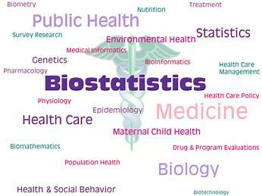
History
Nonclinical Biostatistics Leadership Forum (NBLF)
April 2019 meeting – Discussion on support for
Carcinogenicity Studies
Interest in starting an informal group to discuss
issues
June 7, 2019 first meeting
13 people from 7 companies invited

Slide 4
Current Status
Meet once every two months for 90 minutes
Time chosen to allow US and Europe based colleagues to attend
1-2 topics discussed per meeting
20 Statisticians from 13 companies (2 CROs and 1 consulting firm)

Slide 5
Topics
Introductory Overview – Dan Holder (Merck)
Early termination of a group in carcinogenicity studies – Jim Saul (Covance)
Alternate ways to present results, rather than providing p-values for
each comparison – Helena Geys (J&J)
Analysis of studies with multiple untreated control
groups – Steve Denham (Charles River)

Slide 6
Topics
Peto vs. Poly-k analysis of tumor data - Les Freshwater &
Roger Collins (BioStat Consultants)
Poly-k simulations – Nana Wang & Dan Holder (Merck)
Use and misuse of palpation information – Steve Bailey (Pfizer)
New decision rules – Lin and Rahman paper review – Dingzhou Li (Pfizer)

Slide 7
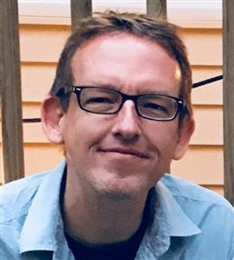
Topics
Evaluating the need for assessment of the carcinogenic potential of
biologics – Carol Gleason (BMS)
The FDA’s nonparametric Bayesian survival analysis of submission data – Dingzhou Li (Pfizer)
Why terminate a dose group early in a 2-year carci
study? – David Potter (Pfizer)
Adjustment of intervals for early study termination – Steve Bailey (Pfizer)

Slide 8
Topics
July meeting:
Paper review - Exact statistical tests on comparing tumor incidence
trend in Transgenic mouse carcinogenicity studies
(Shu et al, 2017) - Andrew Gehman (GSK)

Slide 9
Potential Future Topics
Translatability of studies
Multiple comparison approaches
Incorporating historical control data
Approaches to handle rare tumors
How findings are reported and effect on drug labels
Interactions with CROs and managing the process
Correct handing of tumor combinations
Study design, sample size and power

Slide 10
Interested in Joining?
Anyone interested can email Steven.Bailey@Pfizer.com
Any knowledge/experience level with Carcinogenicity is acceptable
Members rotate in introducing topics for discussion

Slide 11
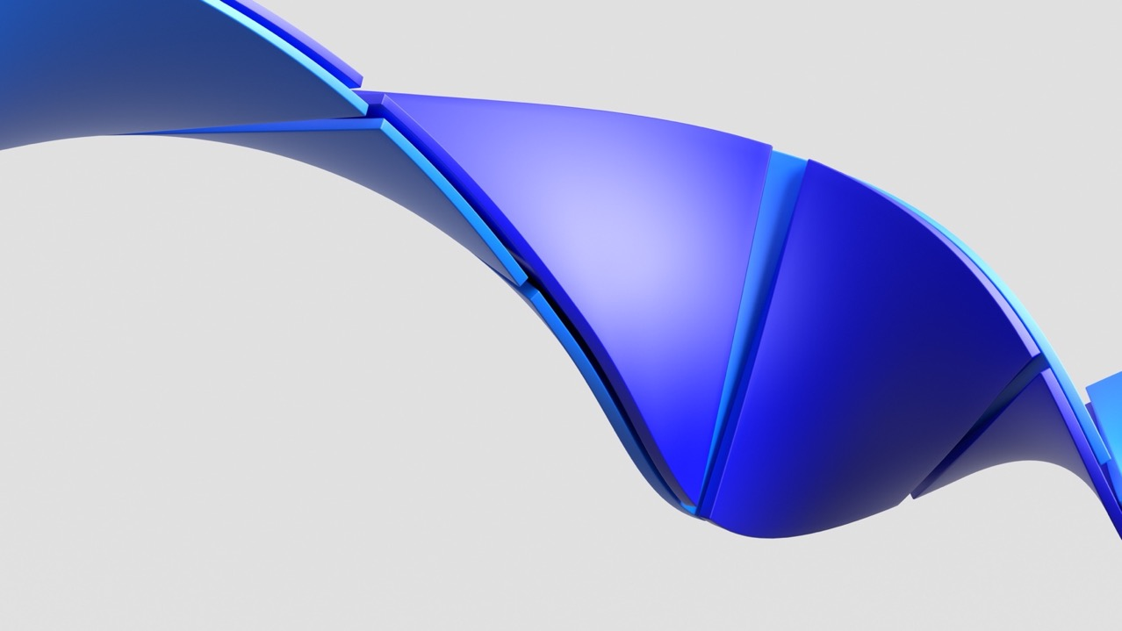

Slide 12
Poly-k Analysis
Presentations:
Peto vs. Poly-k analysis of tumor data - Freshwater & Collins
Poly-k simulations – Wang & Holder
Poly-k is an extension of the Cochran Armitage Trend test,
adjusting sample size to account for animals that do not survive
to end of study, and therefore have reduced exposure to test compound
Much interest in Poly-k analysis as possible alternative to Peto
Has been implemented in some of the member companies
Has been requested at some CRO’s

Slide 13
Poly-k Analysis
Interesting points from discussion:
Multiple implementations of Poly-k in the literature
Portier et al 1986
Bailer and Portier 1988
Bieler and Williams 1993
Standard use of k=3 based on analysis of NTP historical control data (Portier et al 1986)
Software implementation is critical
At least one package hard codes study length as 104 weeks
Exact version can pose some challenges

Slide 14
Poly-k Analysis
Interesting points from discussion (continued):
Advantages:
No need for cause of death information
No reason to stop study early due to mortality for statistical reasons
FDA has been using Poly-3 for submission reviews since 2008
Can lead to queries if FDA Poly-3 results differ from Peto results

Slide 15
Multiplicity Adjustments
Presentations:
New decision rules – Lin and Rahman paper review – Li
Poly-k simulations – Wang & Holder
Standard Approach:
FDA (draft) guidance for industry:
Sets p-value cutoffs based on 1 vs. 2 two-year studies and common vs. rare tumors
Based on simulations and chosen to maintain approximately 10% Type I error rate
Lin and Rahman (2018) updated cutoffs based on additional research
Clarified use of trend tests and/or pairwise comparisons to control
Follow up paper by Rahman and Lin (2018) applying rules to Poly-k analysis
Discussion regarding other multiplicity adjustments, namely adjustment based on paper “Adjusting for Multiplicity of Statistical Tests in the Analysis of Carcinogenicity Studies” Heyse & Rom (1988)

Slide 16
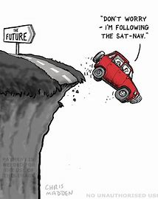
Early Termination of Groups
Presentations:
Early termination of a group in carcinogenicity studies – Saul
Why terminate a dose group early in a 2-year carci study? – Potter
Adjustment of intervals for early study termination – Bailey
Case 1: All groups (in a sex) terminated early
Peto: Discussed options for strategies to modify intervals for analysis
Poly-k: Decision to be made regarding time for end of study
Should be no need to terminate early for statistical reasons
May still be terminated early for animal welfare reasons

Slide 17
Early Termination of Groups
Case 2: One dosed group terminated early due to mortality
For Peto, options for handling animals (Saul & Ashcroft-Hawley, 2020)
Do not include group in statistical analysis
Include group in the terminal sacrifice stratum
Treat early terminated group as natural deaths and include in incidental intervals.
Analyse tumours from decedents only up to the point of the early termination
Include all groups in a single terminal sacrifice stratum that starts at the time of the early termination
For poly-k, would use time-on-study as if natural death
Group would not need to be terminated early

Slide 18
Bayesian Analysis
Presentations:
The FDA’s nonparametric Bayesian survival analysis of
submission data – Li
Comments:
Much interest, would need Poly-k analysis
May be an approach to more appropriately handle rare events
with the use of historical controls
FDA has implemented Bayesian in survival. May see in
histopathology analysis in the future

Slide 19
Translatability of Studies
Presentations:
Evaluating the need for assessment of the carcinogenic potential of
biologics – Gleason
Comments:
There is much interest in this topic in the group, but not much confidence in our ability to
address it.
Interest in a presentation from a Pathologist or
Regulatory professional to learn more
Currently, ICH S1B(R1) Addendum to the Guideline on
Testing for Carcinogenicity of Pharmaceuticals
document is available for comment

Slide 20
Thank You

