Slide 1
PSI Journal Club – 6th July 2021

Slide 2
Agenda – The Use Of External Controls
Overview
Involving Statisticians
Sources Of Bias
Adjusting for Variability & Bias
Benefits & Risks
Importance of Quality
Examples & Applications
Conclusions

Slide 3
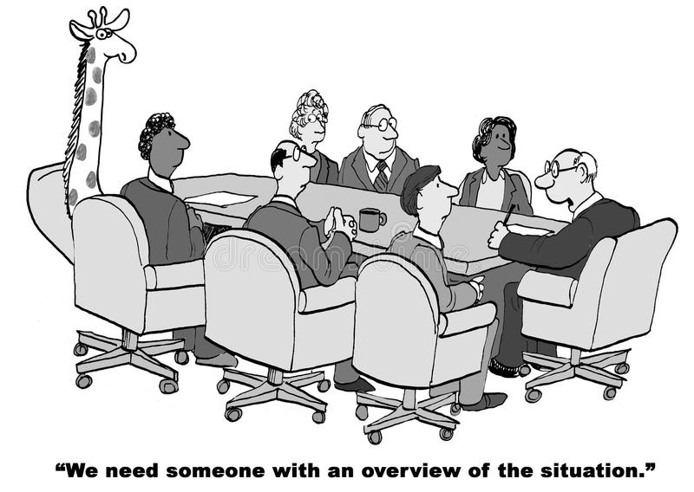
Overview
RCT is the established gold standard for medical research
  Unbiased treatment effects, and allows for type 1 error control
Increasing use of and application of RWD in clinical development with greater availability of data sources
Recently increasing numbers of single arm studies and use of external controls to supplement RCTs
In a regulatory setting, examples of acceptance and examples of rejection
  Very situation specific, difficult to generalised
Health Authorities open to dialogue, but expected to maintain high standard of evidence for approval
Single arm studies without reference to external controls, simple to analyse but don’t permit any causality conclusions so may be difficult to interpret
Hybrid designs allow fallback of just comparing to randomised controls, but carry risk of inflated type 1 errors

Slide 4
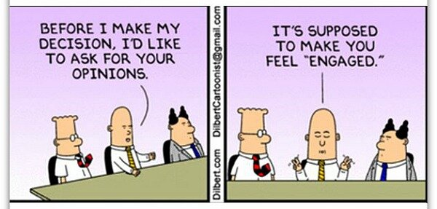
Why Is It Important For Statisticians To Get Engaged?
External controls have potential to provide benefits to patients
External controls studies open up the risk of biases and may increase the risk of false positive and false negative decisions
Critical to maintain same high level of scientific rigour associated with RCTs and maintain high levels of quality and evidence for regulatory approval
Statisticians have a unique set of skills and understanding of data and methodology which could help define the best place for these new opportunities as well as ensuring quality and rigour are maintained

Slide 5
Sources Of Bias When Using External Controls
Potential Biases & Mitigation Strategies
Potential bias | Description
Selection bias | Patients enrolled in clinical trials are different in some ways compared to patients treated in clinical practice.
Calendar time bias | Patients treated in the past do differently than those treated today.
Regional bias | Patient outcome may vary between regions.
Assessment bias | Knowledge of therapy can influence the outcome assessment.
Different endpoint bias | Response and progression in clinical trials are measured differently than in routine clinical practice.
Immortal bias | Study start is difficult to determine as an anchor for patient specific time scale
Potential bias | Description
Retrospective selection bias | Select retrospectively external data and key analysis features.
Study bias | Patients in clinical trials have different outcomes than in clinical practice. (e.g., due to placebo effect, different care)
Between study variability | High between study variability that cannot be explained, indicates that important factors affecting the outcome of an endpoint in a study cannot be controlled for.
Intercurrent event bias after study entry | Intercurrent events after study entry may be correlated with outcome and jeopardize comparability with external control

Slide 6
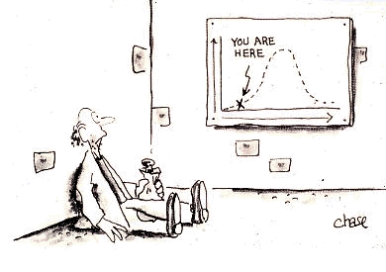
Adjusting for Additional Variability & Bias
External controls generate additional variability and bias
Cannot perform an exact quantification of these -> can lead to alpha inflation of unknown size
Researchers have started to perform systematic comparisons with completed RCTs to compare what would have been concluded if the RCT had been run as a single arm study with an external comparator
Ideas being developed of using these in a meta-analytic framework to ascertain the expected levels of variability and bias and potentially adjust the results
Parallels with using surrogate endpoints

Slide 7

Benefits & Risks Of External Controls
Claims of time and cost savings should be considered realistically
  A 50% reduction in sample size often does not equate to a 50% reduction in time or cost
Any benefits of shorter study duration should be viewed in the context of the overall time required to get treatment to patients
If external controls are only used for long term comparisons in chronic diseases, benefit is in increase in quality of conclusions, rather than time or cost
Increased recruitment through attractiveness to patients
  Could be at odds with equipoise of the study
Strongest arguments around patients’ perspective and ethical implications, particularly in medical situations without hope
  Need to balance ethics of current patients entering a trial vs future patients
Risk of a single-arm trial is that it may have a lower chance of approval or lead to a false investment, either due to the interpretation of the results against a biased control or because of the of lower levels of evidence to convince a regulator

Slide 8
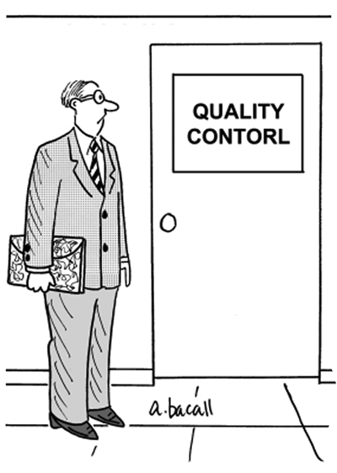
The Importance of Quality
The outcome of any study can only be as good as the quality of its underlying data
  This can be hard enough in a randomised clinical trial setting
With RWD external data the quality may be beyond the control of the investigator
Can often require substantial efforts to bring them up to a level of quality comparable with the clinical study
Transparency is critical
  Pre-specification of all analysis steps including data cleaning
  Avoiding any perception of “gaming the system” by selecting positive options in decisions
Patient level data may be harder to share with the research community from an RWD source than from a clinical trial.

Slide 9
Examples & Applications
Category | Examples
Threshold Crossing | End stage oncology – spontaneous response highly unlikely Type 1 Spinal Muscular Atrophy (SMA) with Unassisted Sitting as a response
Randomised Control Unfeasible Due To Recruitment Limitations | Male breast cancer Life threatening conditions in pediatrics
Randomised Control Unfeasible Due To Practical Constraints | Open label extension periods of RCTs
Platform Designs | Using non-concurrent controls
Early Development Studies | Sponsor’s risk

Slide 10

Conclusions
RCTs likely to remain gold standard for foreseeable future
  Higher levels of credibility with regulators and other stakeholders
External control trials for situations where RCTs not feasible or ethical
  Ethical considerations should be most important factor
  Make sense in some scenarios, not in others
Methodology available with opportunities for refinement
Requires rigorous assessment of any potential bias and variability, and of data quality
Need to adequately balance type I and type II error
External control studies are only one way to innovate in clinical development. Many other options are available.

