Slide 1
ChatGPT & Beyond
Tuesday 12th September 2023 12pm GMT
CB

Slide 2
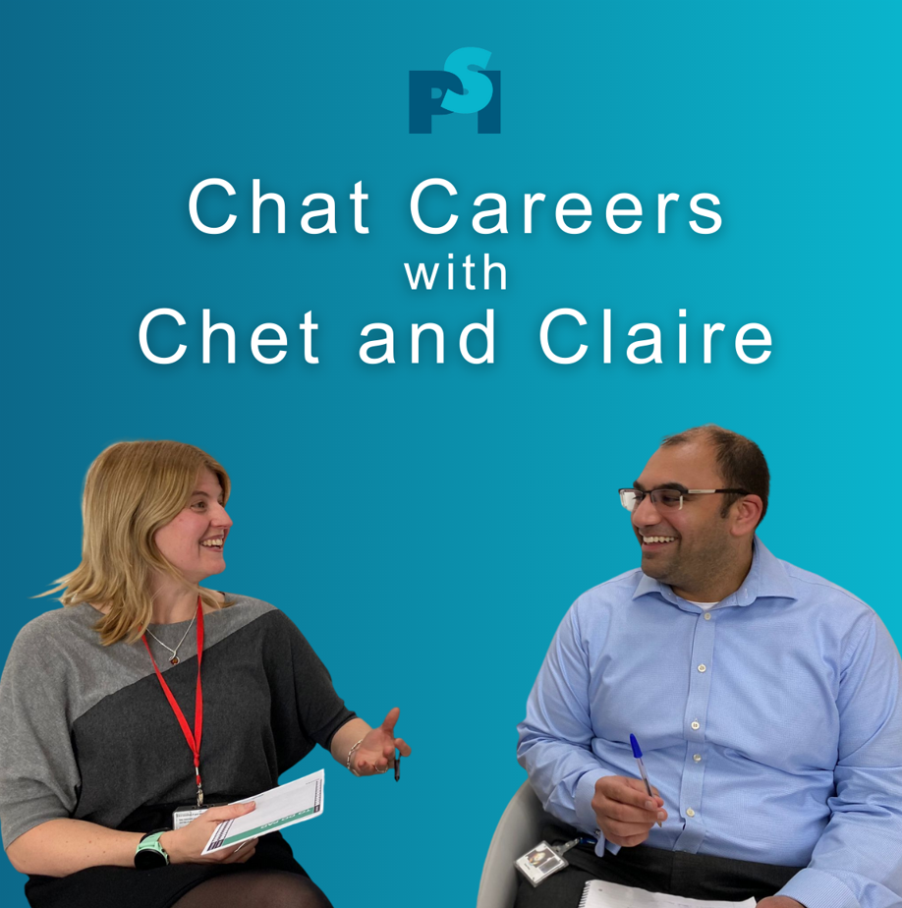
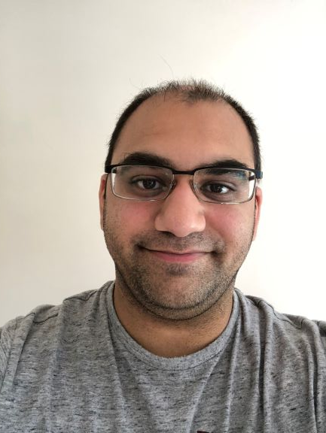
Your Hosts…
Claire Brittain (UCB)
Chetan Mistry
(Veramed)
CB

Slide 3
Introduction
In these Lunch and Learns we will be inviting a panel of guests to discuss various career related topics such as:
Career Journey
The Ladder
Progression
Wellbeing
…and anything and everything in-between (that’s career related)!
CM

Slide 4
Today
Today’s session will focus on:
ChatGPT & Beyond
CM

Slide 5
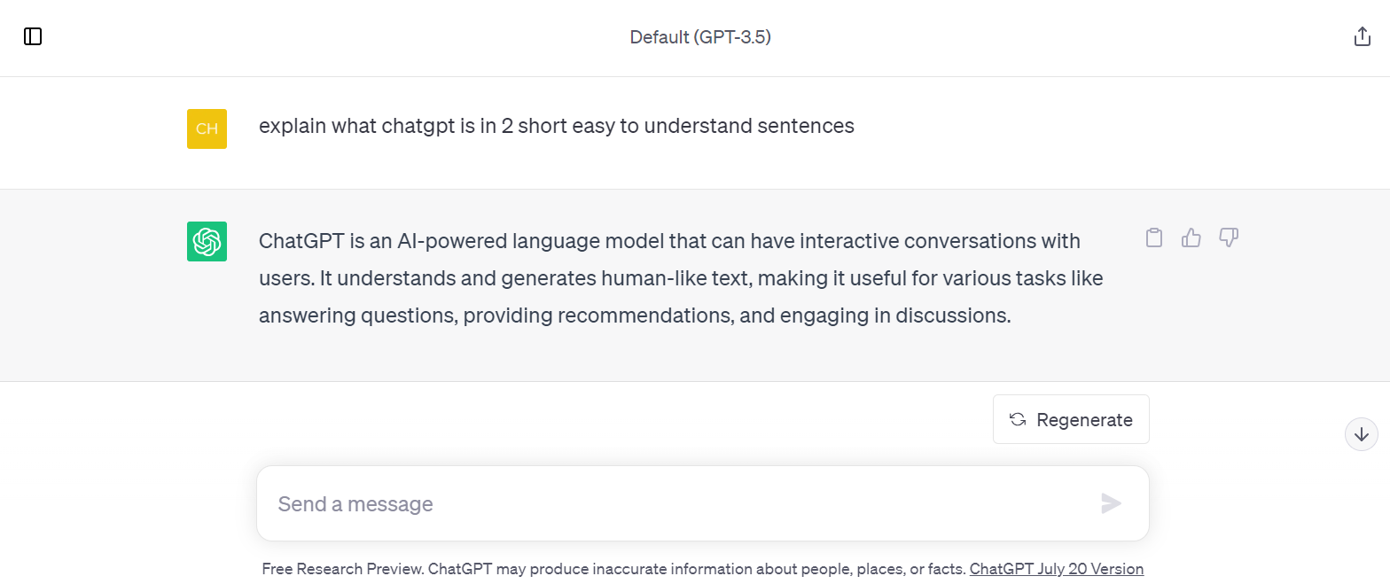
What is ChatGPT?
CM
Notes:
We asked ChatGPT to explain what it is – this was the output.

Slide 6
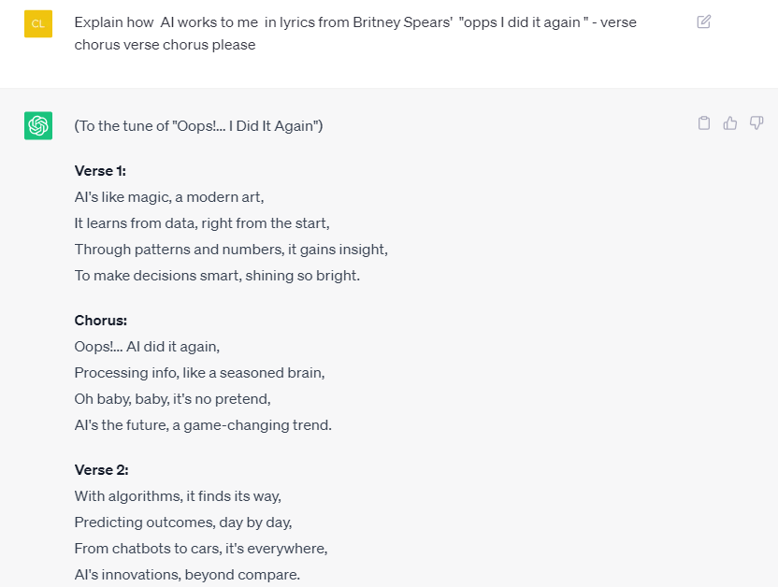
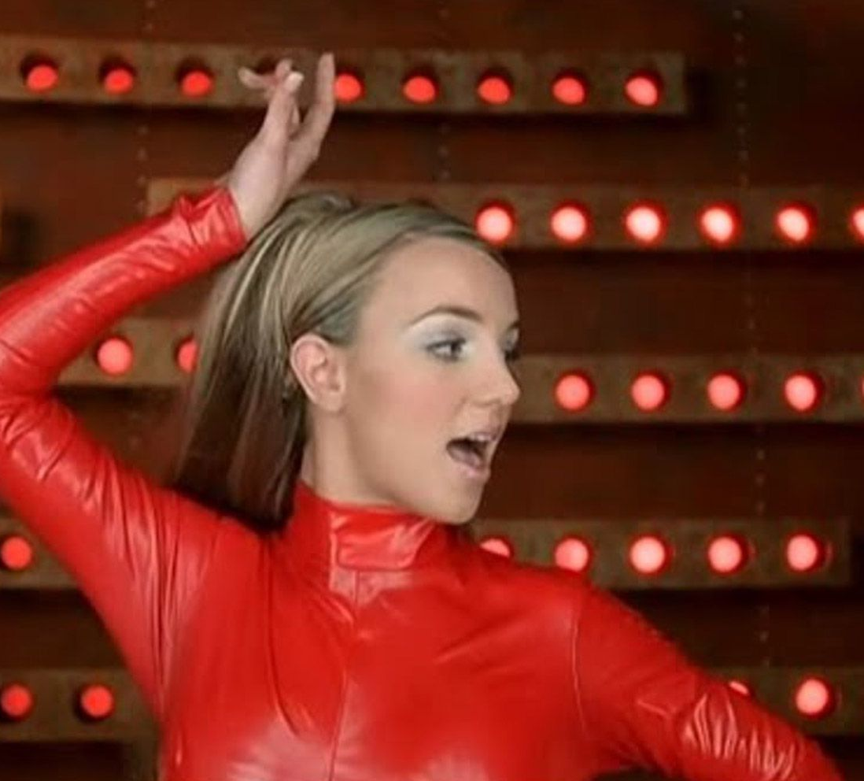
What is AI?
CB
Notes:
We asked ChatGPT to explain what it is – this was the output.

Slide 7
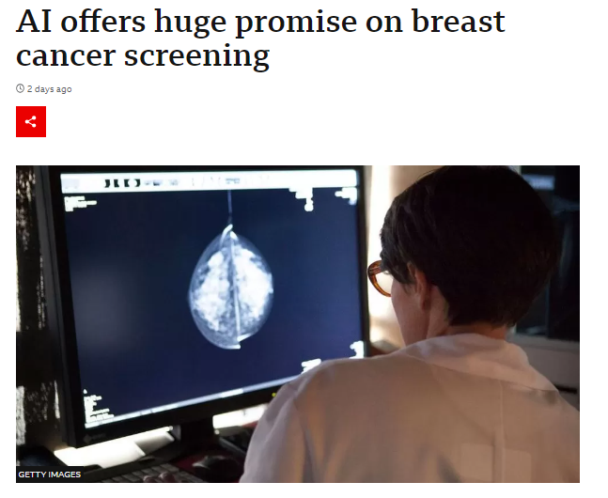
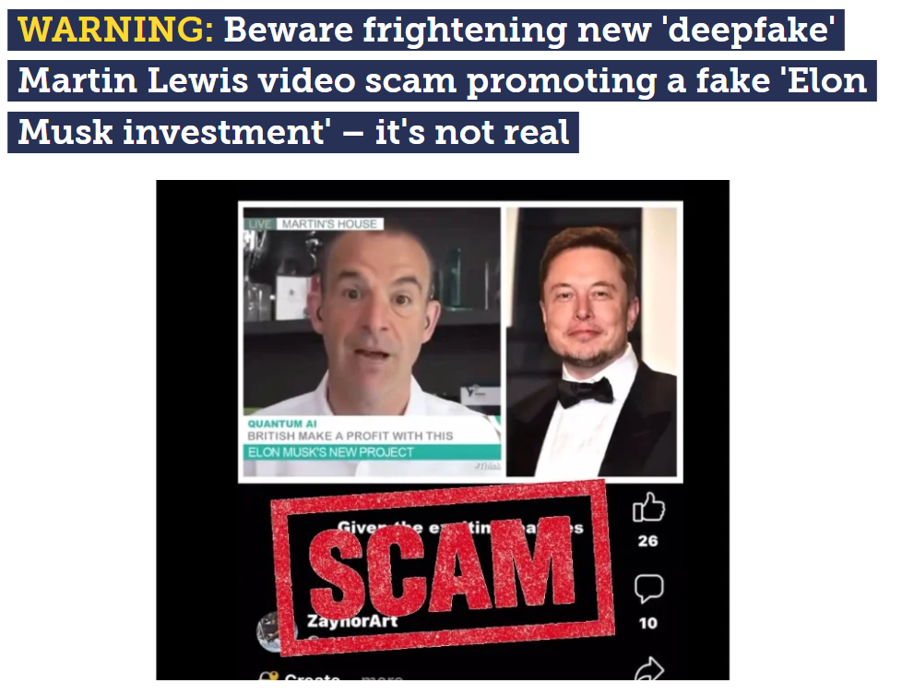
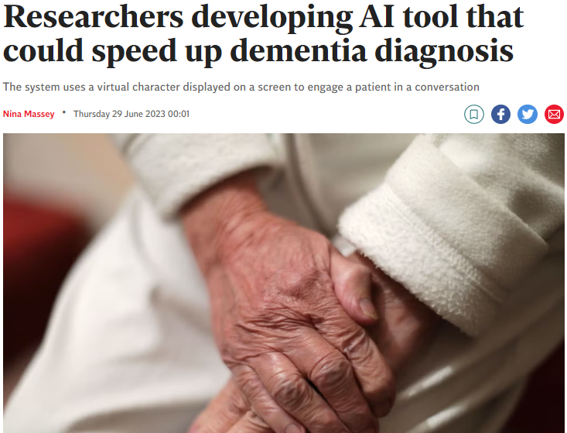
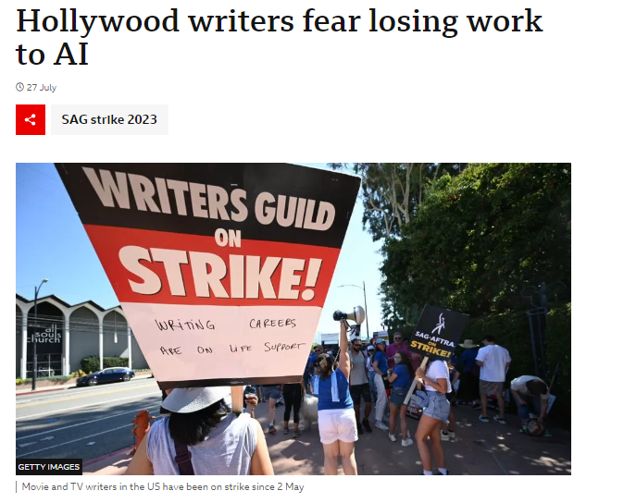
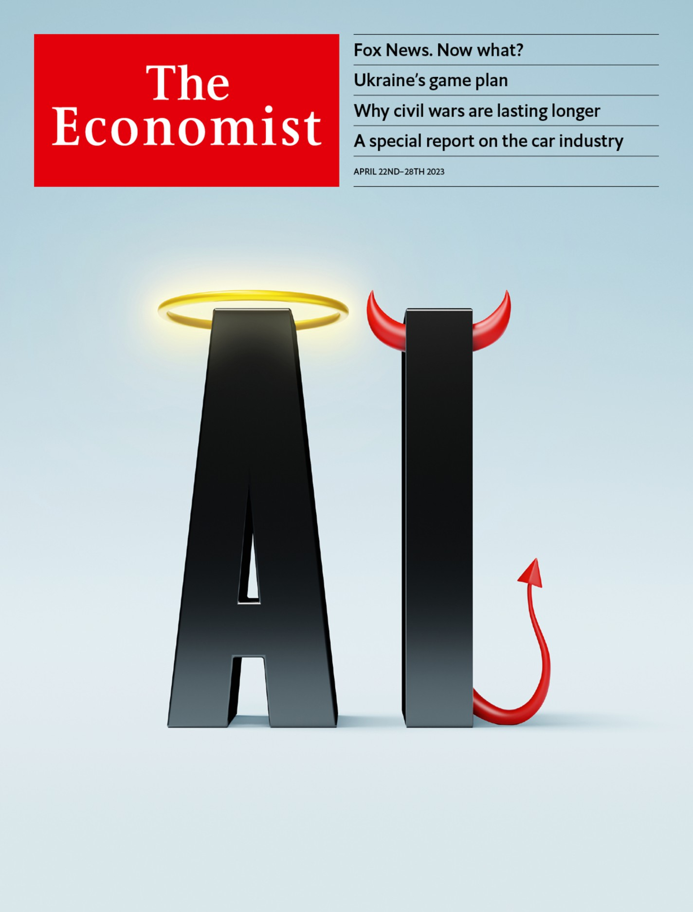
AI News Headlines
CM
Notes:
This is what you may have heard in the news
Not many positive stories
Wildly different opinions and views on AI
Assertions from the ‘godfathers of AI’ relating to the extinction of humanity vs. stories around improved healthcare
Going to discuss responsible use in this LnL

Slide 8
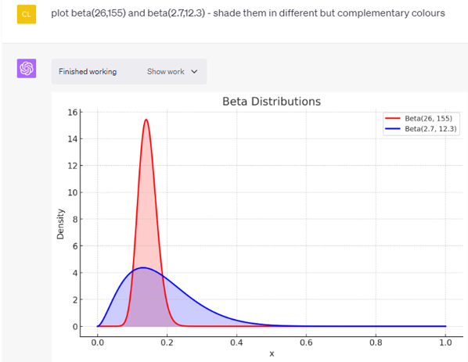
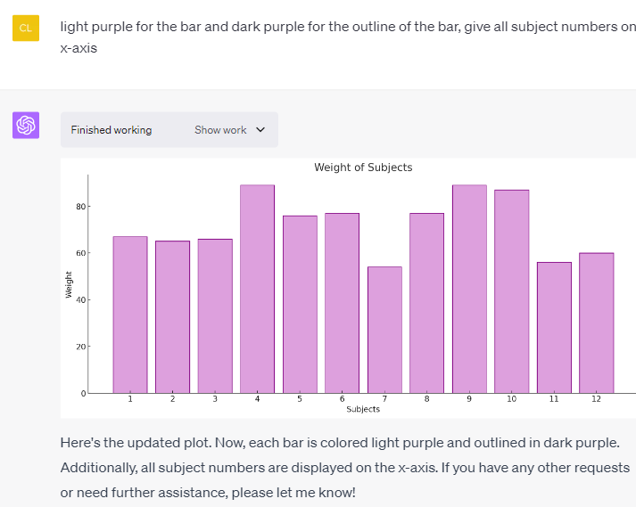
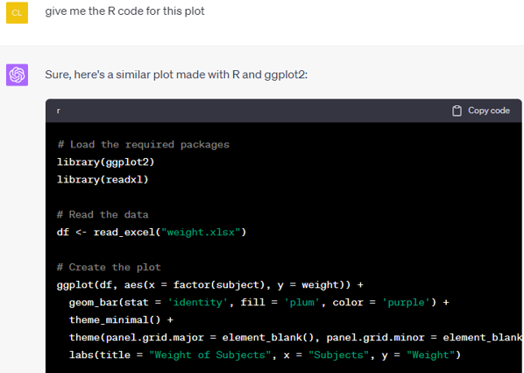
What is Advanced Data Analysis/Code interpreter? (ChatGPT, paid)
Can create figures, creates, reads, execute and executes code within platform
Can upload data directly to tool
CB
Notes:
We asked ChatGPT to explain what it is – this was the output.

Slide 9
Polls
Questions
Have you ever used ChatGPT or any other AI chat software?
[Options: a) Yes, b) No]
How frequently do you use ChatGPT or any other AI chat software?
[Options: a) Daily, b) Weekly c) Infrequently d) Never]
How do you feel about emerging AI technology and its impact on the pharmaceutical industry?
[Options: a) Positive – I think it will be good for pharma, b) Negative – I think it will be bad for pharma, c) Not sure – I don’t know enough d) Unconcerned – it's all hype]
CB

Slide 10
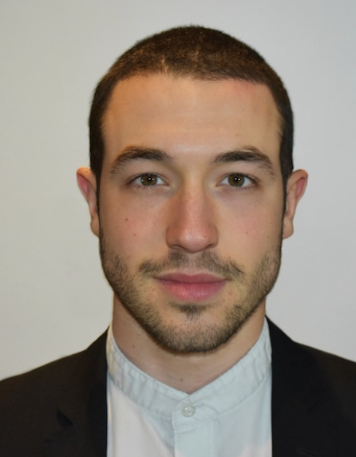
Our guests for today
Kleio Kipourou (GSK)
Tom Fisher
(UCB)
Andy Nicholls (GSK)
CB
Notes:
Bios to introduce?

Slide 11
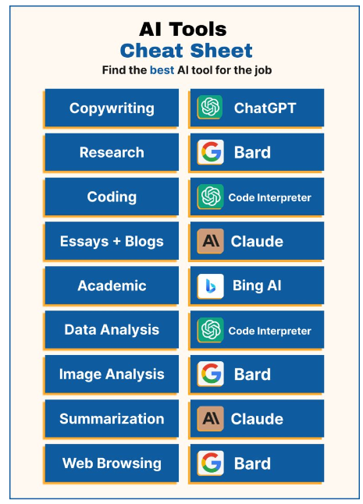
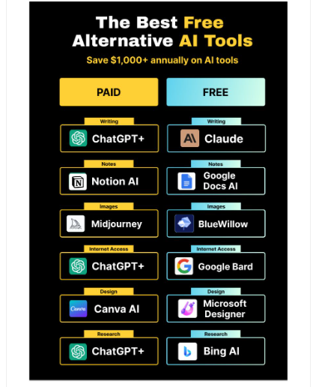
Other AI software out there
CM
Notes:
Tons of AI software now available
Ranging from chatbots, image creation, music production, creation of art and even movies based on still images!
1,000+ AI tools get released every month.May seem overwhelming but you only need to be familiar with a few

Slide 12
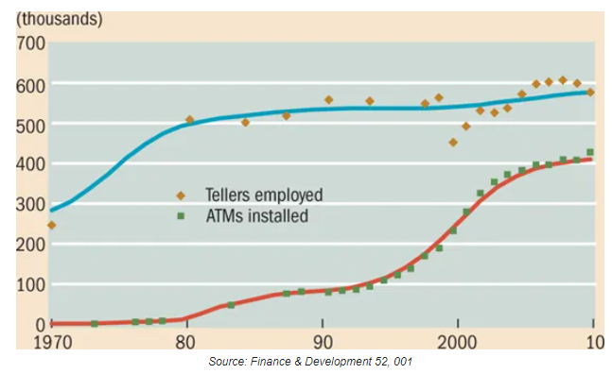
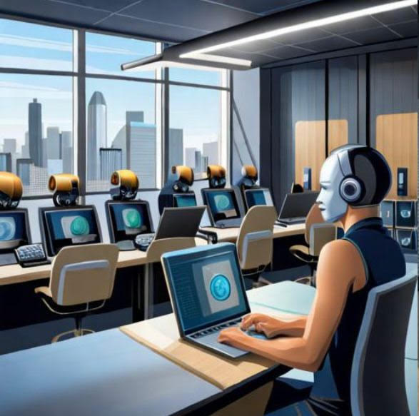
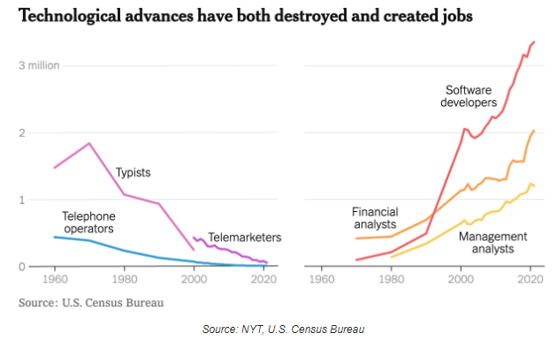
Final note…
CB

Slide 13
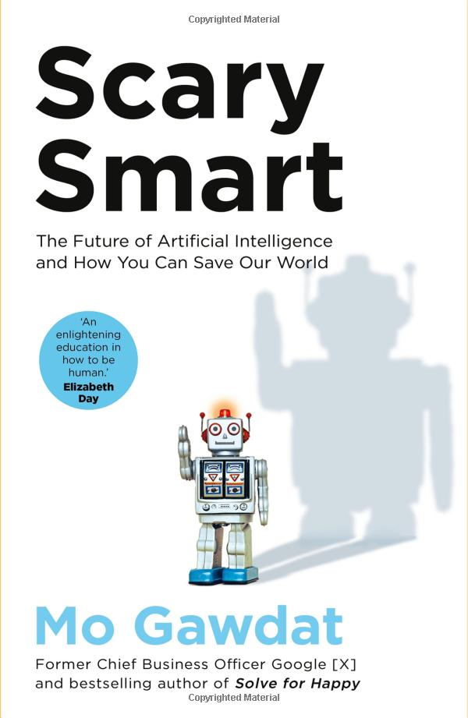
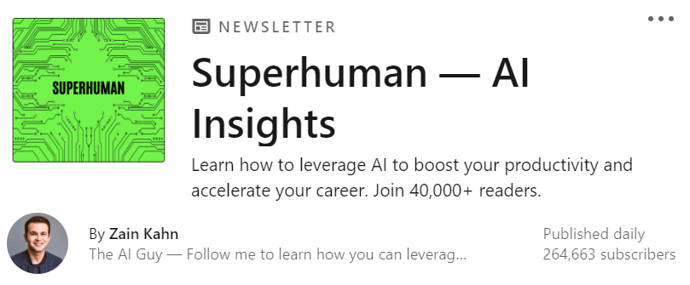
Further Reading & Material
Scary Smart: The Future of AI and How You Can Save Our World. Written by Mo Gawdat – Former CBO of Google [X] [Dec 2022]
LinkedIn newsletter: Superhuman – AI insights by Zain Kahn.
CM

Slide 14
Thank you!

