Slide 1
Estimands and Complex Innovative Designs
PSI Scientific Meeting: Adaptive Designs and their Application, 13/10/22
Olivier Collignon, PhD
Associate Director

Slide 2
Acknowledgement
EU sub-team of the DIA Innovative Design Scientific Working Group
Frank Bretz (Novartis)
Carl-Fredrik Burman (AstraZeneca)
Kaspar Rufibach (Roche)
Martin Posch (Medical University of Vienna)
Anja Schiel (Norwegian Medicines Agency, European Medicines Agency)

Slide 3
Disclaimer
The content of this presentation and other commentary made during this conference are reflective of my own personal opinions and not those of my employer GSK

Slide 4
Key messages
Principles and thinking process outlined in ICH E9(R1) are relevant whenever a treatment effect is estimated
ICH E9(R1) therefore remains applicable to CID
The estimand guides the trial design, not the converse
Pre-specification in the protocol of potential adaptations and link with estimands is key
Differentiation between planned and unplanned changes
Notes:
European Medicines Agency (EMA). Reflection paper on methodological issues in confirmatory clinical trials planned with an adaptive design (2007).
US Food and Drug Administration. Guidance document: adaptive design clinical trials for drugs and biologics guidance for industry (2019).
US Food and Drug Administration. Interacting with the FDA on complex innovative trial designs for drugs and biological products (2020).

Slide 5
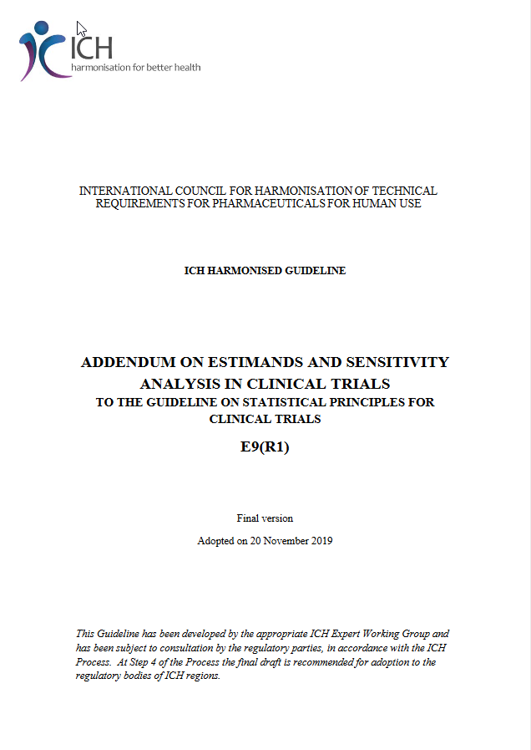
The Estimand Framework
Estimand
A precise description of the treatment effect reflecting the clinical question posed by the trial objective.
E9-R1_EWG_Step2_TrainingMaterial.pdf (ich.org)

Slide 6
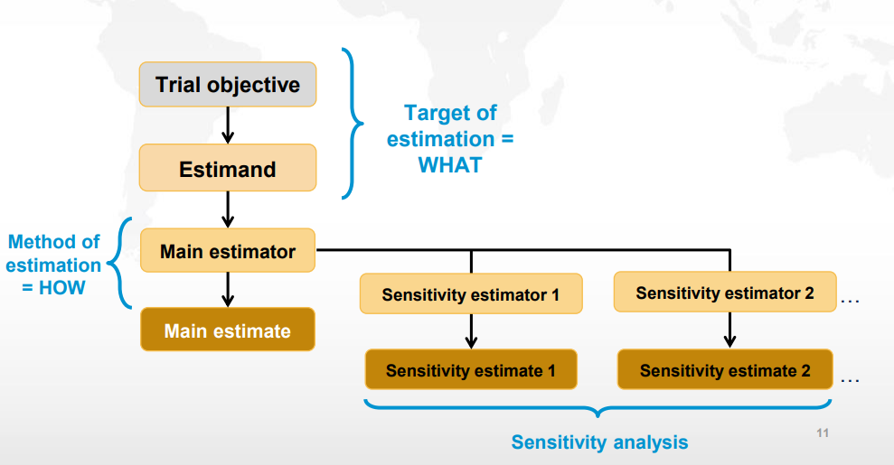
The Estimand Framework
E9-R1_EWG_Step2_TrainingMaterial.pdf (ich.org)

Slide 7
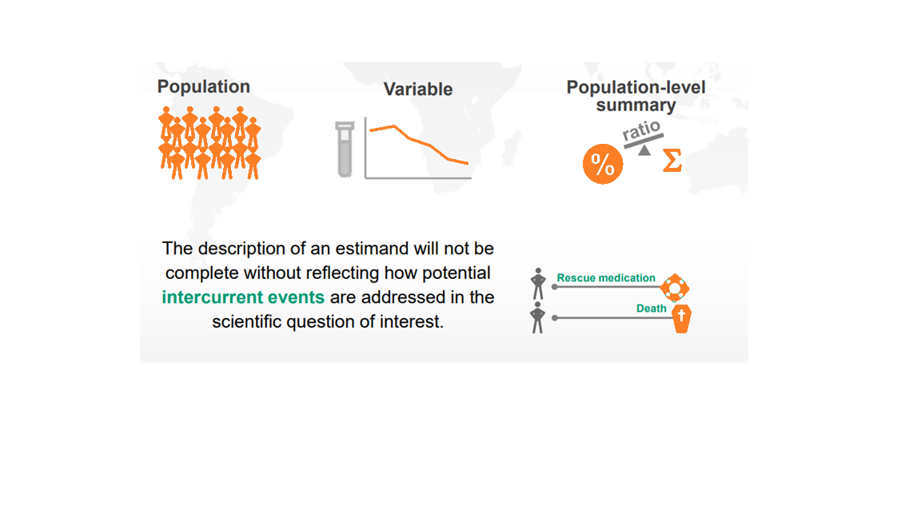
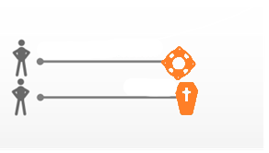
The Estimand Framework
Treatment
Intercurrent events
Rescue medication
Death
E9-R1_EWG_Step2_TrainingMaterial.pdf (ich.org)

Slide 8
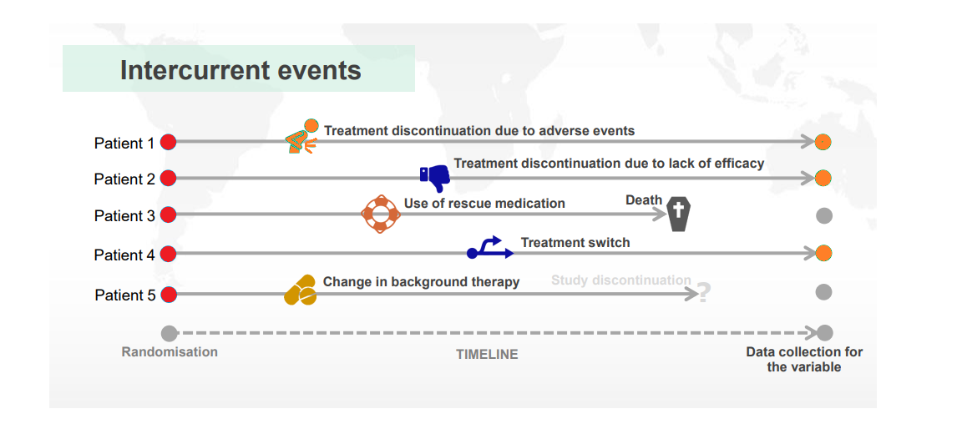
The Estimand Framework
Intercurrent events
E9-R1_EWG_Step2_TrainingMaterial.pdf (ich.org)

Slide 9
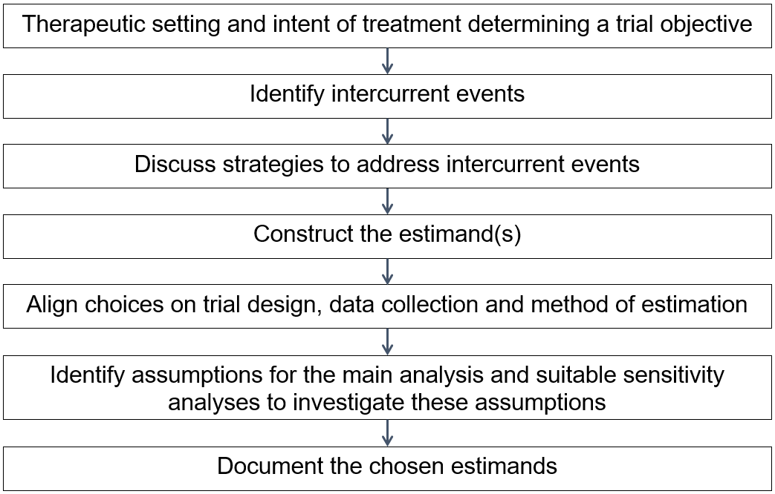
The estimand guides the trial design, not the converse
  Pre-specification in the protocol of potential adaptations and link with estimands is key

Slide 10
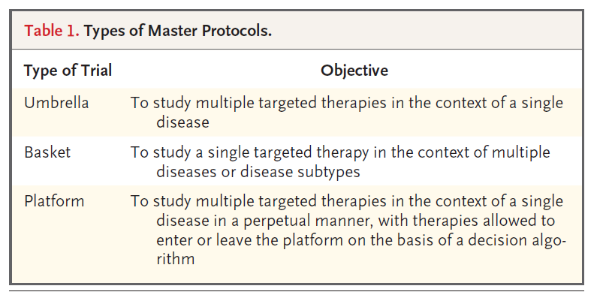
Complex Innovative Designs
Group sequential and adaptive designs
  - Early stop for overwhelming efficacy / futility
  - Dose / treatment selection
  - Sample-size reassessment
  - Change in randomisation ratio
  - Enrichment designs
  - Change of primary endpoint
Master protocols
  - Umbrella trials
  - Basket trials
  - Platform trials
Bayesian designs
  - Informative analysis prior, e.g. paediatrics
  - Borrowing information:
    - From historical / external controls
    - From other treatment arms
    - From other subgroups
Woodcock, Janet, and Lisa M. LaVange. "Master protocols to study multiple therapies, multiple diseases, or both." New England Journal of Medicine 377.1 (2017): 62-70.
Notes:
European Medicines Agency (EMA). Reflection paper on methodological issues in confirmatory clinical trials planned with an adaptive design (2007).
US Food and Drug Administration. Guidance document: adaptive design clinical trials for drugs and biologics guidance for industry (2019).
US Food and Drug Administration. Interacting with the FDA on complex innovative trial designs for drugs and biological products (2020).

Slide 11
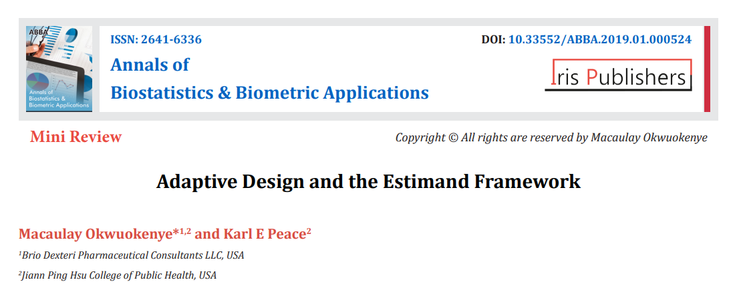
Estimands and CID
First attempt to link the estimand framework and different types of adaptations
- sample size reassessment
- group sequential designs
- enrichment designs
Our proposal is to extend the discussion to other types of innovative characteristics
- Adding or selecting treatment arms
- Modifying the control arm or standard of care
- Adding, selecting, pooling subpopulations
- Bayesian borrowing

Slide 12
Adding or selecting treatment arms
Example: Platform Trial
Interim analysis
time
Drug 4
Drug 3
Drug 1
R
Drug 2
Control

Slide 13
Adding or selecting treatment arms
Example: Platform Trial
Interim analysis
time
Drug 4
Drug 3
Drug 1
R
Drug 2
Control

Slide 14
Adding or selecting treatment arms
Platform trials with several treatment-specific objectives mean several treatment specific estimands
  - Adding an arm = adding an objective = adding an estimand
  - Dropping an arm = dropping an objective = dropping an estimand
  - There are no changes to the original estimands relative to the initial two treatments

Slide 15
Adding or selecting treatment arms
How to describe these estimands in the protocol?
Differences and similarities between the estimands attribute of several treatments for the same disease studied within the platform trial
estimand attribute | guidance
A. Treatment | Different for each treatment investigated but common comparator
B. Population | Similar for each treatment investigated
C. Variable | Could vary with the drug as different treatments could target different aspects of the disease (e.g remission, disease severity, pain...)
D. Intercurrent events | Population-specific IE would be similar (e.g. change in background medication) whereas treatment-specific IE would vary, e.g. positivity to antidrug antibodies (ADAs)
E. Population Level Summary | Would change with the variable

Slide 16
Modifying the control arm
Example: Platform Trial
time
Drug 3
Drug 1
R
Drug 2
Control 1
Control 2

Slide 17
Modifying the control arm
Example: Platform Trial
time
Drug 3
Drug 1
R
Drug 2
Control 1
Control 2

Slide 18
Modifying the control arm
Can the original estimand still be estimated?
Scenario 1: treatment comparisons of interest are against the current best control
  Modifying the control arm leads to a new objective and the treatment component of the estimand needs to be modified accordingly
  Population might change (e.g. ineligibility to new standard of care)
  New intercurrent events might have to be defined
  Which analysis becomes (remains) primary, versus Control 1 as initially intended or vs Control 2?
Scenario 2 : treatment comparisons of interest are against the control arm, regardless of any changes to the comparator throughout the trial
- Estimand components needs to refer upfront to a state-of-the-art control therapy
- All concurrent controls from both Control 1 and Control 2 would be used for the estimation

Slide 19
Adding, selecting or pooling sub-populations
Example: Basket trial
  Several sub-populations treated independently as separate studies for e.g. logistic efficiency:
    Sub-populations= independent target populations
    Separate benefit/risk assessment
    Separate objectives = separate estimands
  A trial targeting a single homogeneous population:
    Sub-populations=sub-groups
    Assessment of consistency
    Primary estimand would target the overarching population
    Secondary estimands would be sub-population specific
Target population 1
Target population 2
Target population 3
B/R
B/R
B/R
Sub-population 1
Sub-population 2
Sub-population 3
B/R

Slide 20
Adding, selecting or pooling sub-populations
  Pooling
    Primary estimand targets the pooled populations at interim
    Secondary population-specific estimands remain of interest
    Data-dependent pooling can induce selection bias
interim analysis
Target population 1
Target population 2
Target population 3
B/R
Target population 1
B/R
B/R
Target population 3
B/R
Target population 1
Target population 2
Target population 3
B/R
  Borrowing
    Each target population has its own specific estimand
    A problem of estimation rather than estimand since the treatment effect in Target Population 1 is informed by the treatment effect of Target population 2 and 3

Slide 21
Adding, selecting or pooling sub-populations
Differences and similarities between the estimands of a given treatment tested in different diseases/subtypes within the same basket trial
estimand attribute | guidance
A. Treatment | Same for each disease / subtype
B. Population | Different for each disease / subtype
C. Variable | Could vary as the same drug could target different aspects in different populations (e.g., in oncology: OS, PFS, ORR)
D. Intercurrent events | Population-specific IEs would be different, whereas treatment-specific IEs would be the same
E. Population Level Summary | Would change with the variable and the population (e.g., a same binary variable could lead to percent difference in one population and odds ratio in the other if needed)

Slide 22
Borrowing of treatment effect
Example: platform trial
time
Drug 3
Drug 1
Borrowing treatment difference
R
Drug 2
Control
Borrowing “non-concurrent” controls

Slide 23
Borrowing of treatment effect
A careful estimand discussion needs to take place
Important to ensure the different sources have the appropriate estimand components in common
  Corresponding adjustments (e.g., for inclusion and exclusion criteria, covariates, or if populations differ) will be required
Borrowing information within a trial is less prone to biases than borrowing from external trials, as many aspects of trial conduct are standardized and are less likely to cause bias
A problem of estimation rather than estimand
  e.g., implementation of a Bayesian hierarchical model
Importance of supplementary estimands and sensitivity analyses,
- e.g., with and without non-concurrent controls

Slide 24
Other types of innovative characteristics
Sample size reassessment
Change to randomisation ratio
Early stopping for overwhelming efficacy
Early stopping for futility
Would not be linked to any changes to the estimand

Slide 25

An example of unplanned adaptation
Change of primary endpoint
Coprimary endpoints
  - First occurrence of a major adverse cardiovascular event
  - First occurrence of death from cardiovascular causes or hospitalization for heart failure
Because of lack of funding, the study could not enrol the expected number of participants therefore coprimary endpoints changed to more sensitive endpoint in order to make up for loss of power
One single new primary endpoint
- total number of deaths from cardiovascular causes, hospitalizations for heart failure, and urgent
visits for heart failure
Estimand component should be updated because the objective of the trial has changed
Difference between planned vs unplanned changes

Slide 26
Points to consider on estimation
ICH E9(R1) emphasizes that analysis methods need to be aligned with the trial estimands (‘estimand-aligned estimation’)
CID typically have multiple objectives and therefore multiple estimands, corresponding to different subpopulations or treatments
Further complexities of CID may be possible
  For example, in platform trials new estimands may be added, dropped or selected at interim analyses
  Such data-dependent selection of estimands poses additional challenges to define reliable estimators,
confidence intervals, and hypothesis tests
  Bias associated with the selection of estimands is closely related to the problem of multiplicity testing
  Estimation becomes even more challenging if the estimand changes in an ongoing trial
    For example, a change in the control arm leads to different trial objectives and estimands, such that the corresponding estimators need to be adapted

Slide 27
Conclusions
Estimand framework is applicable to any study in which a treatment effect is estimated
  - This applies to complex innovative designs
  - Estimands guide the trial design, not the converse
  - Pre-specification in the protocol of potential adaptations is key
Difference between planned vs unplanned changes, e.g. COVID19
  - Change in population
  - New intercurrent events
  - Treatment landscape, e.g. new standard of care
  - Can the original estimand still be estimated?
Engagement with regulators via e.g. Scientific Advice is paramount
More examples needed
  - Non inferiority trials
  - PK/PD studies
  - Observational studies, RWD, causal inference

Slide 28
References
Collignon, O., Schiel, A., Burman, C. F., Rufibach, K., Posch, M., & Bretz, F. (2022). Estimands and Complex Innovative Designs. Clinical Pharmacology & Therapeutics.
Collignon, Olivier, et al. "Current Statistical Considerations and Regulatory Perspectives on the Planning of Confirmatory Basket, Umbrella, and Platform Trials." Clinical Pharmacology & Therapeutics 107.5 (2020): 1059-1067.
Collignon, Olivier, et al.. (2020) Collaborative platform trials to fight COVID-19: methodological and regulatory considerations for a better societal outcome. Accepted (2020)
Collignon, Olivier, Martin Posch, and Anja Schiel. "Assessment of tumour-agnostic therapies in basket trials." The Lancet Oncology 23.1 (2022): e8.
Collignon, Olivier. "An Economic Perspective on Platform Trials—The Gift and the Curse." JAMA Network Open 5.7 (2022): e2221149-e2221149.
International Council For Harmonisation of Technical Requirements For Pharmaceuticals For Human Use (ICH). ICH E9(R1) addendum on estimands and sensitivity analysis in clinical trials to the guideline on statistical principles for clinical trials <https://datab ase.ich.org/sites/ defau lt/files/ E9-R1_Step4_Guide line_2019_1203.pdf> (2019)
Akacha, M., Bretz, F., Ohlssen, D.I., Rosenkranz, G.K. & Schimdli, H. Estimands and their role in clinical trials. Stat. Biopharm. Res. 9, 268–271 (2017).
Okwuokenye, Macaulay, and Karl E. Peace. "Adaptive Design and the Estimand Framework." Annals of Biostatistics & Biometric Applications 1.5 (2019): 1.
Bretz, F., Koenig, F., Brannath, W., Glimm, E. & Posch, M. Adaptive designs for confirmatory clinical trials. Stat. Med. 28, 1181–1217 (2009).
Sridhara, Rajeshwari, et al. "Use of Non-concurrent Common Control in Master Protocols in Oncology Trials: Report of an American Statistical Association Biopharmaceutical Section Open Forum Discussion." Statistics in Biopharmaceutical Research just-accepted (2021): 1-6.
Bhatt, Deepak L., et al. "Sotagliflozin in patients with diabetes and chronic kidney disease." New England Journal of Medicine 384.2 (2021): 129-139
Bofill Roig, Marta et al, “On model-based time trend adjustments in platform trials with non-concurrent controls”, https://arxiv.org/pdf/2112.06574.pdf, Model-based time trend adjustments in platform trials with non-concurrent controls | Zenodo

Slide 29
References
Woodcock J, LaVange LM. Master protocols to study multiple therapies, multiple diseases, or both. New England Journal of Medicine. 2017;377(1):62-70.
Beckman R, Antonijevic Z, Kalamegham R, Chen C. Adaptive design for a confirmatory basket trial in multiple tumor types based on a putative predictive biomarker. Clinical Pharmacology & Therapeutics. 2016;100(6):617-25.
Renfro LA, Mandrekar SJ. Definitions and Statistical Properties of Master Protocols for Personalized Medicine in Oncology. Journal of Biopharmaceutical Statistics. 2017(just-accepted).
Renfro L, Sargent D. Statistical controversies in clinical research: basket trials, umbrella trials, and other master protocols: a review and examples. Annals of Oncology. 2016;28(1):34-43.
Cunanan, Kristen M., et al. "An efficient basket trial design." Statistics in medicine 36.10 (2017): 1568-1579.
Howard DR, Brown JM, Todd S, Gregory WM. Recommendations on multiple testing adjustment in multi-arm trials with a shared control group. Statistical methods in medical research. 2018;27(5):1513-30.
Sudhop, Thomas, et al. "Master protocols in clinical trials: a universal Swiss Army knife?." The Lancet Oncology 20.6 (2019): e336-e342.
Clinical Trials Facilitation and Coordination Group (CTFG) – “Recommendation Paper on the Initiation and Conduct of ComplexClinical Trials”
Blagden, Sarah P., et al. "Effective delivery of Complex Innovative Design (CID) cancer trials—A consensus statement." British journal of cancer 122.4 (2020): 473-482.
Sridhara, Rajeshwari, et al. "Type I error considerations in master protocols with common control in oncology trials: report of an American statistical association biopharmaceutical section open forum discussion." Statistics in Biopharmaceutical Research (2021): 1-4.
Lengliné, Etienne, et al. "Basket clinical trial design for targeted therapies for cancer: a French National Authority for Health statement for health technology assessment." The Lancet Oncology 22.10 (2021): e430-e434.

Slide 30
References
Meyer, Elias Laurin, et al. "The evolution of master protocol clinical trial designs: a systematic literature review." Clinical Therapeutics (2020)
Cohen, Dena R., et al. "Adding a treatment arm to an ongoing clinical trial: a review of methodology and practice." Trials 16.1 (2015): 1-9
Dodd, Lori E., Boris Freidlin, and Edward L. Korn. "Platform trials—beware the noncomparable control group." New England Journal of Medicine 384.16 (2021): 1572-1573.
Ren, Yixin, Xiaoyun Li, and Cong Chen. "Statistical considerations of phase 3 umbrella trials allowing adding one treatment arm mid-trial." Contemporary Clinical Trials 109 (2021): 106538.
Bai, Xiaofei, Qiqi Deng, and Dacheng Liu. "Multiplicity issues for platform trials with a shared control arm." Journal of Biopharmaceutical Statistics 30.6 (2020): 1077-1090.
Lu, Chengxing Cindy, et al. "Practical Considerations and Recommendations for Master Protocol Framework: Basket, Umbrella and Platform Trials." Therapeutic Innovation & Regulatory Science (2021): 1-10.
Lee, Kim May, and James Wason. "Including non-concurrent control patients in the analysis of platform trials: is it worth it?." BMC medical research methodology 20.1 (2020): 1-12.
Sridhara, Rajeshwari, et al. "Use of Non-concurrent Common Control in Master Protocols in Oncology Trials: Report of an American Statistical Association Biopharmaceutical Section Open Forum Discussion." Statistics in Biopharmaceutical Research just-accepted (2021): 1-6.
Lee, Kim May, et al. "Statistical consideration when adding new arms to ongoing clinical trials: the potentials and the caveats." Trials 22.1 (2021): 1-10
Lee, Kim May, James Wason, and Nigel Stallard. "To add or not to add a new treatment arm to a multiarm study: A decision‐theoretic framework." Statistics in medicine 38.18 (2019): 3305-3321.

Slide 31
References
Collignon, Olivier, Martin Posch, and Anja Schiel. "Assessment of tumour-agnostic therapies in basket trials." The Lancet Oncology 23.1 (2022): e8.
Collignon, Olivier. "An Economic Perspective on Platform Trials—The Gift and the Curse." JAMA Network Open 5.7 (2022): e2221149-e2221149.

Slide 32
Thank you
Olivier Collignon, PhD
Estimands and Complex Innovative Designs
GSK

