Slide 1
NEOS: An innovative Bayesian non-inferiority trial design in pediatric multiple sclerosis
Marius Thomas, Dieter Haering
21 October 2021
Joint PSI, EFSPI & ASA BIOP Webinar on Complex Innovative Designs

Slide 2
Background
Pediatric MS is rare: Only ~3-5% of MS cases start in childhood or adolescence^{1,2}
Vulnerable population: Children with MS show higher disease activity (2-3 time higher relapse frequency compared to adults)³, lose brain volume from the onset (i.e. no true remission)⁴, and have worse long-term prognosis, i.e. disabled at younger age⁵
High unmet need: ~20 approved therapies in adults, pediatric patients only 1 approved based on randomized controlled trials in the US (Gilenya, based on only successful trial so far, PARADIGMS)
¹ Ghezzi et al. (1997) Multiple sclerosis in childhood: clinical features of 149 cases. Multiple Sclerosis Journal
² Chitnis T et al. (2009) Demographics of pediatric-onset multiple sclerosis in an MS center population from the Northeastern United States. Multiple Sclerosis Journal
³ Gorman et al., 2009 Increased relapse rate in pediatric-onset compared with adultonset multiple sclerosis. Arch Neurol 2009; 66: 54-9.
⁴ Arnold et al., 2019 Effect of fingolimod on MRI outcomes in patients with paediatric-onset multiple sclerosis: results from the phase 3 PARADIGMS study. Neurology, Neurosurgery & Psychiatry
⁵ Renoux et al. (2007) Natural history of multiple sclerosis with childhood onset. N Engl J Med 2007; 356: 2603-13.

Slide 3
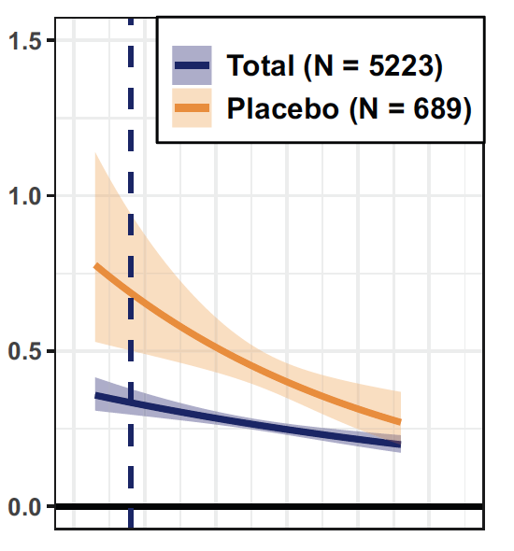
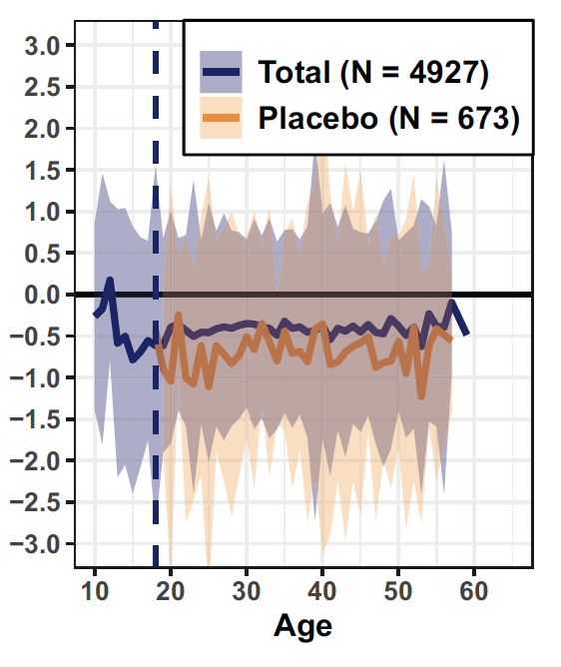
Pediatric MS Key facts
Biological processes involved in MS are largely shared across age span¹
Higher relapse rates than adults but also stronger relative effect size
Irreversible brain volume and loss of neurons from the start (=no true remission)
Brain volume change %
Relapses per year
¹ Waubant et al. Neurology 2019.
Figures from Dahlke et al. (2021) Characterization of MS phenotypes across the age span. Multiple Sclerosis Journal. Total refers to active and placebo treated patients.

Slide 4
Challenging recruitment with competitive trial landscape and rarity of pediatric MS population makes feasibility a key concern
Fingolimod approved in US in pediatric MS
PARADIGMS enrolment re-opened for 10-12 year olds
 | n | 2013 | 2014 | 2015 | 2016 | 2017 | 2018 | 2019 | 2020 | 2021 | 2022 | 2023 | 2024
PARADIGMS NCT01892722 | 215 / 30
TERIKIDS NCT02201108 | 165
CONNECT NCT02283853 | 156
LEMKIDS NCT03368664 | 50
DMF, Peginterferon vs. IFN NCT03870763 | 260
Peginterferon efficacy RCT NCT03958877 | 142
Ocrelizumab PK study NCT04075266 | 36
Phase 1 Metformin NCT04121468 | 30
Ocrelizumab (confirmatory)* | NK
Evobrutinib* | NK
Ponesimod* | NK
Ozanimod* | NK
GNbAC1* | NK
Approval
Enrolment completed
Enrolment ongoing*
Enrolment upcoming
*Estimated
NK = Not Known
Today

Slide 5
The path to innovation
Standard RCT Demonstrate superiority vs placebo or inferior active control
Bayesian design
Extrapolation from adults to pediatric patients
Non-inferiority design vs highly efficacious control drug

Slide 6
NEOS (NCT04926818): An innovative, efficient trial design in pediatric MS

Slide 7
NEOS trial summary
2-year double-blind, triple-dummy Phase 3 study in pediatric MS to establish the efficacy and safety 2 novel MS treatments :
New test drug 1: Kesimpta (ofatumumab): first fully human anti-CD20 monoclonal antibody treatment, approved worldwide in adults
New test drug 2: Mayzent (siponimod): S1P modulator, approved worldwide in adults
Non-inferiority design vs active control Gilenya (fingolimod):
Active control: Gilenya (fingolimod): Approved treatment for pediatric MS; reduced relapse rates vs interferon beta-1a by 82% in a randomized double-blind clinical trial (PARADIGMS¹)
Active control avoids placebo or low efficacy comparator, minimizing the risk of MS relapses, which can be associated with irreversible disability
Primary endpoint: Annualized relapse rate (ARR), analyzed via negative binomial model (standard phase 3 endpoint in MS)
¹PARADIGMS is so far the only successfully completed RCT to confirm the efficacy of a DMT in pediatric MS.

Slide 8
The path to innovation
Standard RCT Demonstrate superiority vs placebo or inferior active control
Bayesian design
Extrapolation from adults to pediatric patients
Non-inferiority design vs highly efficacious control drug

Slide 9
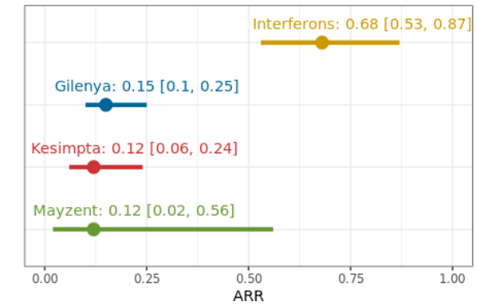
Summary of historical information from adults and children
Estimated ARR based on meta-analysis of historical studies
Patients on interferons (or untreated patients) have much higher relapse rates than with more modern DMTs.
Showing non-inferiority (NI-margin of 2.0¹) against a tested highly efficacious treatment and superiority over historical IFN in an indirect comparison avoids the use of placebo or low efficacy comparators
¹ If non-inferiority of a new test drug can be demonstrated vs Gilenya, the probability that the new drug is more efficacious than IFN beta-1a is >99% (based on the historical data).

Slide 10
The path to innovation
Standard RCT Demonstrate superiority vs placebo or inferior active control
Bayesian design
Extrapolation from adults to pediatric patients
Non-inferiority design vs highly efficacious control drug
Specify NI-margin so that non-inferiority clearly demonstrate superiority over interferons or placebo
+ Avoids placebo or low efficacy controls

Slide 11
Can we extrapolate from adults to children in MS?
Extrapolation from adult patients from the TRANSFORMS study in year 2010. Predictions of relapse rates at age 15.3 (the mean age of the PARADIGMS study) from a negative binomial model with age x treatment interaction (the model was built in year 2010).
Projections |  | Between-treatment comparison
Treatment | Adjusted ARR (95% CI) | % rate reduction | ARR ratio (95% CI) | P-value
IFNß-1a N=431 | 0.667 | 81.7% | 0.183 | <.001
FTY720 N=429 | 0.122
K=0.824
Model contained all FAS patients from TRANSFORMS, including 420 on FTY 1.25 mg. Shown here are only FTY 0.5mg and IFN beta-1a

Slide 12
Can we extrapolate from adults to children in MS?
Extrapolation from adult patients from the TRANSFORMS study in year 2010. Predictions of relapse rates at age 15.3 (the mean age of the PARADIGMS study) from a negative binomial model with age x treatment interaction (the model was built in year 2010).
Projections |  | Between-treatment comparison
Treatment | Adjusted ARR (95% CI) | % rate reduction | ARR ratio (95% CI) | P-value
IFNß-1a N=431 | 0.667 | 81.7% | 0.183 | <.001
FTY720 N=429 | 0.122
K=0.824
Model contained all FAS patients from TRANSFORMS, including 420 on FTY 1.25 mg. Shown here are only FTY 0.5mg and IFN beta-1a
Observed primary results from PARADIGMS (FTYD2311) in year 2017
Treatment | Adjusted ARR (95% CI) | % rate reduction | ARR ratio (95% CI) | P-value
IFNß-1a N=107 | 0.675 (0.515,0.885) | 81.9% | 0.181 (0.108,0.303) | <.001
FTY720 N=107 | 0.122 (0.078,0.192)
Gilenya: 25 relapses in 180 patient-years: ARR=0.14
IFN: 120 relapses in 163 patient-years: ARR=0.73
K=0.835
Model contained all FAS patients from PARADIGMS which included an FTY and an IFN beta-1a arm

Slide 13
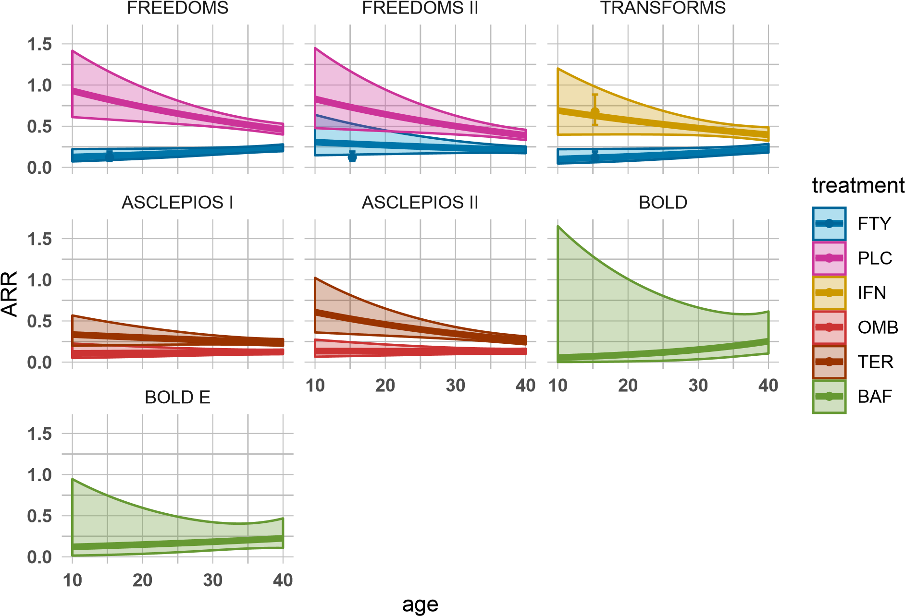
Phase 3 data in adults with MS is typically available at the start of a new pediatric study and can be leveraged
Extrapolation from adult phase 3 data to pediatric patients for placebo and different DMTs
Relapse frequency is strongly age dependent in untreated patients or under low efficacy treatment.
Age-dependent extrapolation from adults to pediatric MS patients should be considered to inform new trial design options
PARADIGMS
Lines and confidence boundaries are based on negative binomial models of relapse rates, extrapolated from trials in adults to pediatric patients. N refers to the sample size of the trials in adults. The point estimates and confidence intervals represent the observed ARR in children in PARADIGMS.

Slide 14
The path to innovation
Standard RCT Demonstrate superiority vs placebo or inferior active control
Bayesian design
Extrapolation from adults to pediatric patients¹
Disease biology is similar, but children relapse more frequently.
+ Similar power with less N compared to trials in adults
Non-inferiority design vs highly efficacious control drug
Specify NI-margin so that non-inferiority clearly demonstrate superiority over interferons or placebo
+ Avoids placebo or low efficacy controls
¹Schmidli et al., (2020) Beyond Randomized Clinical Trials: Use of External Controls. Clinical pharmacology & Therapeutics.

Slide 15
Primary analysis model
$$Y \sim Negbin(μ, κ)$$
$$log\left(μ\right)=θ^{(0)} + I\left(Z=1\right)\left(θ^{(1)}−θ^{(0)}\right)+ I\left(Z=2\right)\left(θ^{(2)}−θ^{(0)}\right)+β_{1}x_{1}+…+β_{K}x_{K}+ log(T)$$
Y: number of relapses
κ : overdispersion parameter of the negative binomial distribution (so that Var(Y) = $μ+ μ^{2}κ$)
Z: treatment variable
$θ^{(0)}$: log-ARR on fingolimod
$θ^{(1)}$ : log-ARR on ofatumumab
$θ^{(2)}$ : log-ARR on siponimod
$x_{1}$,..., $x_{K}$: covariates
$T$: time in study (offset)
Historical information from pediatric and adult studies is used to form priors for the log-ARRs on all three treatments

Slide 16
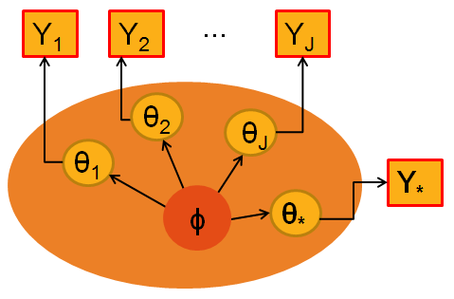
Incorporating historical data via meta-analytic predictive approach ^{1, 2}
Source data models
p(Y_{j} | θ_{j} ) j=1,...,J
Target data model for planned trial
p(Y* | θ* )
Meta-analytic model to link parameters (hyper-parameter ϕ): p( θ*, θ₁, ... ,θ_{J} | ϕ )
MAP-prior for new study: p_{MAP}(θ*) = p(θ* | Y₁ , ..., Y_{J})
Parameters from different studies are linked through hierarchical model
Takes between-trial heterogeneity into account
¹ Spiegelhalter, D. J., Abrams, K. R., & Myles, J. P. (2004). Bayesian approaches to clinical trials and health-care evaluation (Vol. 13). John Wiley & Sons.
² Neuenschwander B, Capkun-Niggli G, Roychoudhury S, et al (2010). Summarizing historical information on controls in clinical trials. Clin Trials; 7(1): 5-18.

Slide 17
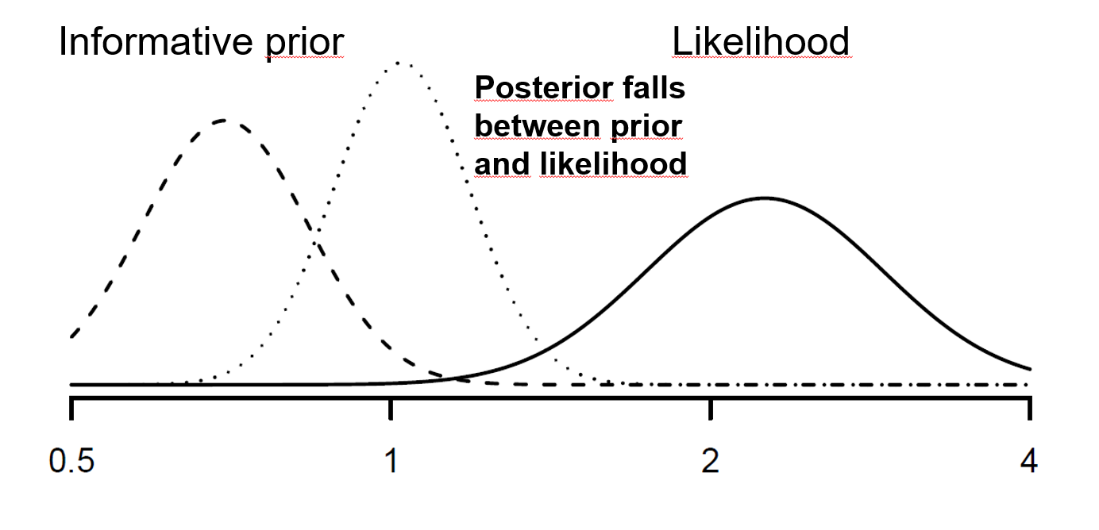
Prior-data conflict potential issue with Bayesian design
Extrapolation from adults accurate and consistent, however limited data from pediatric trials available (in particular none for ofatumumab and siponimod)
Possibility that exchangeability assumptions does not hold and as a result a prior-data conflict occurs, has to be considered:

Slide 18
Protecting against prior-data conflicts
Exchangeability assumption can be relaxed by adding vague, weakly-informative components to the MAP mixture¹ :
p_{Robust}(θ*) = (1-ε) p_{MAP}(θ*) + ε p_{Vague}(θ*)
Mixture weight ε chosen to reflect skepticism on relevance of source data
Robust priors are heavy-tailed, and hence informative part is discarded in case of prior-data conflicts
Use ε = 0.2 for fingolimod and ε = 0.5 for ofatumumab and siponimod to reflect lack of pediatric data for the investigational drugs
¹ Schmidli H, Gsteiger S, Roychoudhury S, et al (2014). Robust meta‐analytic‐predictive priors in clinical trials with historical control information. Biometrics; 70(4): 1023-1032.

Slide 19
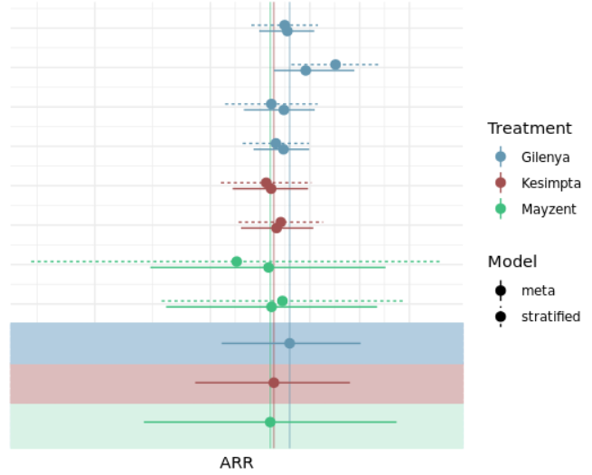
Bayesian study design is efficient and robust
Extrapolated ARR estimates from individual studies and derived MAP-priors
Meta-analytic predictive approach allows robust incorporation of historical data from adults
Reduction in required sample size: prior information is worth approx. 90 patients
Allows for an efficient study design with adequate power that is also scientifically robust (i.e. type I error rates are controlled for relevant scenarios)
Historical studies
MAP priors

Slide 20
Summary of regulatory feedback: Reaching global alignment for non-standard design features can be a challenge
Topic | FDA CID discussions | EMA (PDCO and SAWP)
Extrapolation | Concerns about extrapolation models relying on «unverifiable assumptions» Exploration and discussion of (all) other possible prognostic or effect modifying factors required | No specific concerns
NI-margin | Proposed margin of 3¹ too large (some discounting is required) Lack of pediatric data to assess between-trial variability Systematic literature review and meta-analysis requested to have a comprehensive understanding all potentially relevant prior knowledge | Initially proposed NI-margin of 3 was discussed as large but finally accepted for OMB PIP by PDCO based on scientific and feasibility considerations
Bayesian design | «Bayesian framework may be useful» Concerns about double-use of historical information in Bayesian non-inferiority design Extensive simulations requested to understand operating characteristics under all conditions | Bayesian design not accepted for initial OMB PIP SAWP primarily concerned with lack of type I error control and subjectivity of weight given to historical information
Interim analysis | An interim analysis for efficacy stopping is endorsed | Interim analyis not accepted for initial PIP Concerns related to inadequate assessment of long-term safety Interim analysis not endorsed by SAWP due to adding another level of complexity to already complex design

Slide 21
Key modifications on study design based on HA feedback
Non-inferiority margin, after discounting, changed to 2.0 (instead of 3.0) with additional upper limit of the ARR (0.3) on test drugs to conclude non-inferiority vs fingolimod; as a consequence sample size increased from 50 to 60 patients per arm
Key secondary analysis added to compare test treatments versus historical interferon data (based on a meta-analysis of historical studies)
Ofatumumab and siponimod studies were combined into one design based on recommendation from FDA and EMA
Tipping point sensitivity analysis prespecified to assess robustness of conclusions from Bayesian analysis under different weights to prior information; i.e. from pre-spedified weight to a «no borrowing» strategy (frequentist design)
Final study design was accepted by both FDA and EMA/PDCO

Slide 22
The path to innovation
Standard RCT Demonstrate superiority vs placebo or inferior active control
Extrapolation from adults to pediatric patients¹
Disease biology is similar, but children relapse more frequently.
+ Similar power with less N compared to trials in adults
Non-inferiority design vs highly efficacious control drug
Specify NI-margin so that non-inferiority clearly demonstrate superiority over interferons or placebo
+ Avoids placebo or low efficacy controls
Bayesian design
Robust integration of prior knowledge about test medication (e.g. from Phase 3 trials) into the new trial in ped. MS²
+ Allows to leverage prior knowledge about the disease and drug
¹Schmidli et al., (2020) Beyond Randomized Clinical Trials: Use of External Controls. Clinical pharmacology & Therapeutics.
²Schmidli et al., (2014) Robust meta‐analytic‐predictive priors in clinical trials with historical control information. Biometrics.

