Slide 1
Limitations and Challenges of Mixed Models Repeated Measures (MMRM) Analysis
Moses Mwangi
Kenya Medical Research Institute (KEMRI)
Centre for Public Health Research (CPHR)
Biostatistics and Bioinformatics unit

Slide 2
Overview
Introduction to MMRM
Model Formulation
Motivating Case Study
Limitations and Challenges of MMRM
Concluding Remarks

Slide 3
Introduction to MMRM
Introduction to MMRM
Repeated Measures refer to multiple measurements taken from the same unit or subject (within experimental designs or observational studies) - each unit or subject measured repeatedly over time, space or both.
Longitudinal data - special case of repeated measures - duration typically a variable of interest.
MMRM - popular choice for randomized trials with longitudinal continuous outcomes.
Suited to model continuous outcomes - repeatedly measured at discrete time points (or within defined time-windows).

Slide 4
Introduction to MMRM contd…
MMRM is widely covered in statistical literature on randomized trials, particular pharmaceutical industry trials.
In this context patients are intended to be measured at each of a fixed number of measurement times.
These time points are typically visits according to a schedule that is pre-defined in the trial protocol.
In dose-response studies, MMRM can be applied for highly variable repeated measure data and is a way to estimate the drug effect at each visit and dose without any assumptions regarding the dose-response shape.

Slide 5
Introduction to MMRM contd…
MMRM is a specific model for balanced longitudinal data.
For the ‘fixed effects’, one typically specifies effects of time (as a categorical or factor variable), randomized treatment group, and their interaction.
This implies a saturated model for the mean - a separate mean parameter for each time point in each treatment group.
Additionally, one can adjust for baseline covariates as simple main effects, or additionally with an interaction with time.

Slide 6
Motivating Case Study
2 Treatment x 2 Period Cross-over trial
Outcome: Diastolic blood pressure (DBP)
Treatment: 0=High-dose iodine salt; 1=Low-dose Iodine salt
Period: 0=Period 1 (wk0-wk3); 1=Period 2 (wk4-wk6)
Sequence | Subjects | Period 1 |  |  |  | Period 2
 |  | wk0 | wk1 | wk2 | wk3 | wk4 | wk5 | wk6
1 | 85 | High-dose iodine |  |  |  | Low-dose iodine
2 | 89 | Low-dose Iodine |  |  |  | High-dose iodine
No washout period: contrary to standard cross-over design studies, was informed by ethical issues. unethical denying participants iodized household salts.

Slide 7
General Model Framework
Laird and Ware (1982) introduced the basic linear mixed-effects (LME) model for a single $n_{i}$-dimensional response (column) vector $Y_{i}$ for the $i$th subject as:
$Y_{i}=X_{i}β+Z_{i}b_{i}+ε_{i}$ ; $i=1,…,N$ ;
$b_{i}$∼ $N$ (0, $G$) ; $ε_{i}$ ∼ $N$ (0,$σ^{2}I_{n_{i}}$)
Where;
$Y_{i}$ is the $n_{i} x 1$dimensional vector of observed responses for the $i$th individual,
$β$is the p-dimensional vector of fixed-effects,
$b_{i}$ is the q-dimensional vector of random subject-specific effects,
$X_{i}$ (of size $n_{i} x p$) and $Z_{i}$ (of size $n_{i} x q$) are known covariates matrices associated with observations to the fixed-effects and random-effects, respectively, and
$ε_{i}$ is the , $n_{i}$-dimensional within-subject error.

Slide 8
Formulation for MMRM
MMRM - an extension from a basic LME model to incorporate within-subject errors with unequal variances and/ or are correlated.
For this purpose, we can express the within-subject errors as:
$ε_{i}$ ∼ $N$ (0,$R_{i}$) ; $i=1,…,N$
The within-group errors $ε_{i}$ assumed to be independent for different $i$and independent of the random effects $b_{i}$.
The variance-covariance matrix of the response vector $Y_{i}$
Comprises a random-effects component and a within-subject component $R_{i}$.
In longitudinal studies with only one level of grouping, the within-subject component is particularly important to be considered in order to account for within-subject correlation, whereas an additional random-effects component is often not strictly needed.

Slide 9
Formulation for MMRM contd…
In clinical trial setting, one often chooses to directly model the variance-covariance structure of the response (to account for within-subject dependency) using the within-subject component $R_{i}$, and can omit the random effects component $Z_{i}b_{i}$.
The variance-covariance matrix of the response vector $Y_{i}$
This yields the MMRM
$$Y_{i}=X_{i}β+ε_{i}$$
$ε_{i}$ ∼ $N$ (0,$R_{i}$)
The linear predictor $X_{i}β$ typically considers fixed-effects of baseline values, treatment and visit, as well as interactions between treatment and visit, and possibly between baseline and visit.
Commonly the fixed effects are of most interest and the correlation structure $R_{i}$ can be viewed as a nuisance quantity. However, it is important to model it carefully, since it affects validity of the estimated variance of $β$.

Slide 10
Modeling cross-over data - MMRM
Algebraic notation for the three candidate models:
Grizzles Mixed-effects (GME) model:
$$y_{ij}={\text{β}}_{0}+{\text{β}}_{1}t_{j}+{\text{β}}_{2}P_{j}+{\text{β}}_{3}T_{ij}$$
$$+∈_{ij}$$
Jones & Kenward Mixed-effects (JKME) model:
$$y_{ij}={\text{β}}_{0}+{\text{β}}_{1}t_{j}+{\text{β}}_{2}P_{j}+{\text{β}}_{3}P_{j}t_{j}+{\text{β}}_{4}T_{ij}+{\text{β}}_{5}T_{ij}t_{j}$$
$$+∈_{ij}$$
Piecewise Linear Mixed-effects (PLME) model:
$$y_{ij}={\text{β}}_{0}+{\text{β}}_{1}t_{j}+{\text{β}}_{2}P_{j}+{\text{β}}_{3}P_{j}t_{j}+{\text{β}}_{4}T_{ij}+{\text{β}}_{5}T_{ij}t_{j}+{\text{β}}_{6}{P_{j}T}_{ij}+{\text{β}}_{7}{P_{j}T}_{ij}t_{j}$$
$$+∈_{ij}$$
The PLME model does not assume fixed (constant) treatment effect across periods, hence more flexible in modeling curvilinear trends (in different periodic phases), without putting constrain on the curve evolution.

Slide 11
Modeling cross-over data - MMRM contd…
MMRM – JKME SAS code
PROC MIXED data = bloodpressure;
CLASS PNO Period treatment time2;
MODEL dbp = time2 treatment Period treatment*time2 Period*time2/
DDFM=KR;
REPEATED treatment*time2/ SUBJECT = PNO TYPE = UN;
/*7x7 - Correlated residuals between period 1 and 2; first 4 rows rep period 1 at the 4 time points; last 3 rows rep period 2 over the 3 time points*/
REPEATED time/ SUBJECT = PNO*treatment TYPE = UN;
/*4x4 - Uncorrelated residuals between period 1 and 2*/
LSMEANS treatment*time2/ cl alpha = 0.05 diff e;
ODS OUTPUT lsmeans = lsmeans diffs=diffs;
RUN;

Slide 12
Modeling cross-over data - MMRM contd…
MMRM – PLME SAS code
PROC MIXED data = bloodpressure;
CLASS PNO treatment time2 timespl1;
MODEL dbp = time2 timespl1 treatment treatment*time2 treatment*timespl1/
DDFM=KR;
REPEATED treatment*time2*timespl1/ SUBJECT = PNO TYPE = UN;
/*7x7 - Correlated residuals between period 1 and 2; first 4 rows rep period 1 at the 4 time points; last 3 rows rep period 2 over the 3 time points*/
REPEATED time*timespl1/ SUBJECT = PNO*treatment TYPE = UN;
/*4x4 - Uncorrelated residuals between period 1 and 2*/
LSMEANS treatment*time2 treatment*timespl1/ cl alpha = 0.05 diff e;
ODS OUTPUT lsmeans = lsmeans diffs=diffs;
RUN;

Slide 13
Limitations and Challenges of MMRM
It generally only makes sense to fit the MMRM if subjects are measured at a common set of times, typical of designed studies (randomized trials in particular). If the measurements occur on a more ad-hoc basis, such that the times of measurement vary across subjects, it may no longer be feasible to treat time as a categorical variable. MMRM model can’t really be fitted.
With highly unbalanced designs, occasioned by intermittent missingness and dropouts, MMRM may encounter considerable challenges associated with cross-level bias (Sheppard 2003).
Even with balanced RCT designs, the choice of treating time as a factor or a continuous variable depends on the research goal. If one prefers to see at what time-point the change was significant, across particular time-points, treating time as a categorical variable would be recommended. However, if one is interested in studying the functional relationship between the outcome and time, it is appropriate to treat time as a continuous variable, hence not feasible with MMRM.

Slide 14
Remarks - MMRM
Typically, MMRM specifies no patient level random effects, but instead models the correlation within the repeated measures over time by specifying that the residual errors are correlated.
Which means, subject-specific random effects (which are not of direct interest for estimation and inference) are considered as residual effects, i.e. they are part of the error correlation matrix.
To account for the correlation in measurements from the same patient, the MMRM specifies an unstructured covariance matrix for the residual errors.
The unstructured covariance matrix of residual errors reduces chances of model misspecification.
Only suitable in experimental designs

Slide 15
Modeling cross-over data - LME
LME models consider both fixed and random effects and thus allow considerable modeling flexibility.
However, it restricts within-group errors to be independent, identically distributed random variables with mean of zero and constant variance.
In the case of clinical trials with repeated measurements of subjects over time, observations are not independent and within-subject correlation needs to be accounted for by the model.

Slide 16
Modeling cross-over data - LME contd…
Algebraic notation for the three candidate models:
Grizzles Mixed-effects (GME) model:
$$y_{ij}={\text{β}}_{0}+{\text{β}}_{1}t_{j}+{\text{β}}_{2}P_{j}+{\text{β}}_{3}T_{ij}$$
$$+b_{i0}+{\text{b}}_{i1}t_{j}+∈_{ij}$$
Jones & Kenward Mixed-effects (JKME) model:
$$y_{ij}={\text{β}}_{0}+{\text{β}}_{1}t_{j}+{\text{β}}_{2}P_{j}+{\text{β}}_{3}P_{j}t_{j}+{\text{β}}_{4}T_{ij}+{\text{β}}_{5}T_{ij}t_{j}$$
$$+b_{i0}+{\text{b}}_{i1}t_{j}+∈_{ij}$$
Piecewise Linear Mixed-effects (PLME) model:
$$y_{ij}={\text{β}}_{0}+{\text{β}}_{1}t_{j}+{\text{β}}_{2}P_{j}+{\text{β}}_{3}P_{j}t_{j}+{\text{β}}_{4}T_{ij}+{\text{β}}_{5}T_{ij}t_{j}+{\text{β}}_{6}{P_{j}T}_{ij}+{\text{β}}_{7}{P_{j}T}_{ij}t_{j}$$
$$+b_{i0}+{\text{b}}_{i1}t_{j}(1−P_{j})+{\text{b}}_{i2}t_{j}+∈_{ij}$$
The PLME model does not assume fixed (constant) treatment effect across periods, hence more flexible in modeling curvilinear trends (in different periodic phases), without putting constrain on the curve evolution.

Slide 17
Modeling cross-over data - LME contd…
MMRM – JKME SAS code
PROC MIXED data = bloodpressure;
CLASS PNO Period treatment;
MODEL dbp = time2 treatment Period treatment*time2 Period*time2/
DDFM=KR;
RANDOM intercept time2/ SUBJECT = PNO TYPE = UN;
/*7x7 - Correlated residuals between period 1 and 2; first 4 rows rep period 1 at the 4 time points; last 3 rows rep period 2 over the 3 time points*/
LSMEANS treatment/pdiff CL;
ODS OUTPUT lsmeans = lsmeans pdiff=pdiff;
RUN;

Slide 18
Modeling cross-over data - LME contd…
MMRM – PLME SAS code
PROC MIXED data = bloodpressure;
CLASS PNO treatment;
MODEL dbp = time2 timespl1 treatment treatment*time2 treatment*timespl1/
DDFM=KR;
RANDOM intercept ime2 timespl1/ SUBJECT = PNO TYPE = UN;
/*7x7 - Correlated residuals between period 1 and 2; first 4 rows rep period 1 at the 4 time points; last 3 rows rep period 2 over the 3 time points*/
LSMEANS treatment/pdiff CL;
ODS OUTPUT lsmeans = lsmeans pdiff=pdiff;
RUN;

Slide 19
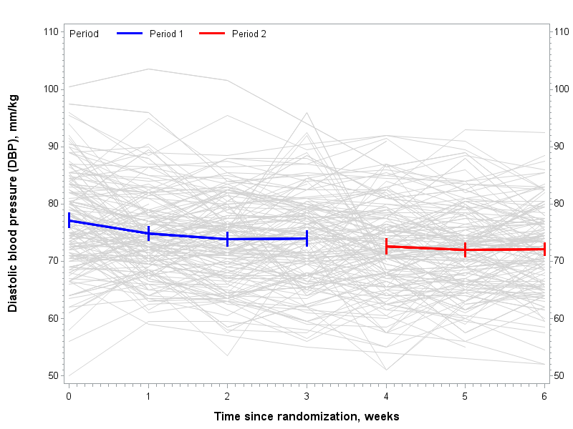
RESULTS
Figure 1: Spaghetti plot for DBP individuals profile

Slide 20
RESULTS contd…
Table 1: Model for continuous DBP with fixed- and random-effects
Label | Parameter | GME model |  | JKME model |  | PLMEmodel
 |  | Estimate(s.e.) | p value | Estimate(s.e.) | p value | Estimate(s.e.) | p value
Fixed effects
Intercept: L | $${\text{β}}_{0}$$ | 74.96(0.58) | <0.0001 | 74.38(0.61) | <0.0001 | 75.96 (0.77) | <0.0001
Intercept: H | ${\text{β}}_{0}$+${\text{β}}_{4}$ | 74.37(0.58) | <0.0001 | 74.62(0.60) | <0.0001 | 77.19 (0.79) | <0.0001
Intercept: H - L | $${\text{β}}_{4}$$ | -0.60 (0.30) | 0.0480 | 0.24 (0.47) | 0.6159 | 1.23 (0.98) | 0.2113
Slope(time) before week 3: L | $${\text{β}}_{1}$$ |  |  | -0.34 (0.23) | 0.1484 | -0.63 (0.26) | 0.0139
Slope(time) before week 3: H | ${\text{β}}_{1}$+${\text{β}}_{5}$ |  |  | -1.02(0.23) | <0.0001 | -1.71 (0.26) | <0.0001
Slope(time) before week 3: H - L | $${\text{β}}_{5}$$ |  |  | -0.68 (0.30) | 0.0225 | -1.08 (0.37) | 0.0035
Slope(time) after week 3: H | ${\text{β}}_{1}$+${\text{β}}_{3}$ |  |  |  |  | -0.68 (0.30) | 0.0248
Slope(time) after week 3: L | ${\text{β}}_{1}$+${\text{β}}_{3}$+${\text{β}}_{5}$+${\text{β}}_{7}$ |  |  |  |  | -0.13 (0.29) | 0.6643
Slope(time) after week 3: L - H | ${\text{β}}_{5}$+${\text{β}}_{7}$ |  |  |  |  | 0.55 (0.48) | 0.2462
Slope(time) change: LtoH | $${\text{β}}_{3}$$ |  |  |  |  | -0.04 (0.45) | 0.9213
Slope(time) change: HtoL | ${\text{β}}_{3}$+${\text{β}}_{7}$ |  |  |  |  | 1.58 (0.44) | 0.0004
Carry-over: (HtoL) - (LtoH) | $${\text{β}}_{7}$$ |  |  |  |  | 1.63 (0.64) | 0.0111
Average effect of H on DBP: (-(HtoL) - (LtoH))/2 |  |  |  |  |  | -0.81 (0.64) | 0.0111
Random effects
Intercept | $${σ^{2}}_{b0}$$ | 44.55 (5.80) |  | 44.56 (5.79) |  | 48.78 (6.88)
Intercept∗time | $${\text{σ}}_{b0}{\text{σ}}_{b1}$$ | -1.06 (1.25) |  | -1.00 (1.23) |  | -2.14 (1.62)
Time | $${σ^{2}}_{b1}$$ | 0.88 (0.50) |  | 0.80 (0.49) |  | 1.83 (0.66)
Intercept∗timespl1 | $${\text{σ}}_{b0}{\text{σ}}_{b2}$$ |  |  |  |  | 0.04 (2.59)
time∗timespl1 | $${\text{σ}}_{b1}{\text{σ}}_{b2}$$ |  |  |  |  | -2.22 (1.05)
timespl1 | $${σ^{2}}_{b2}$$ |  |  |  |  | 3.73 (1.87)
Residual | $$σ^{2}$$ | 23.97(1.21) |  | 23.79(1.20) |  | 21.02 (1.19)

Slide 21
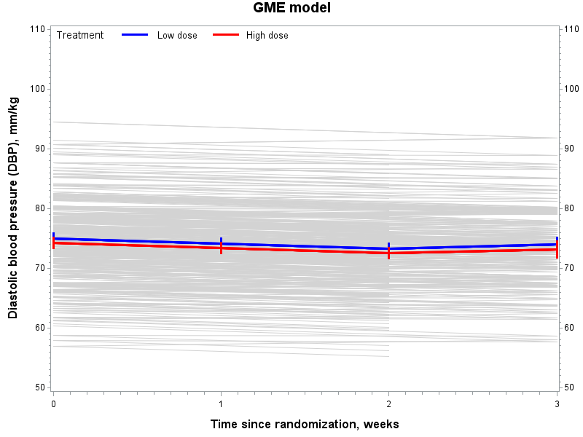
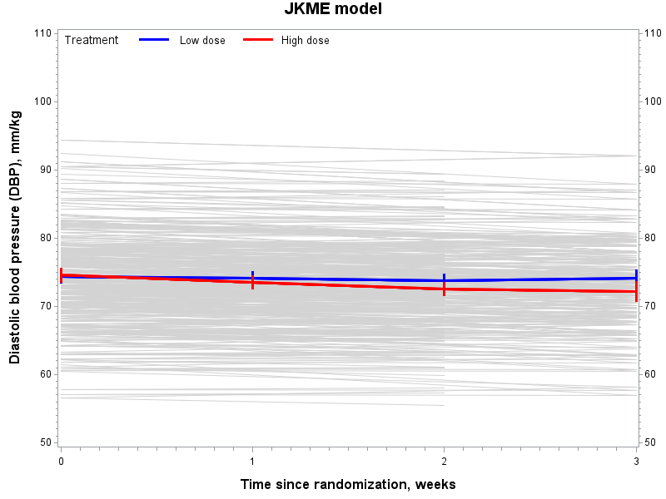
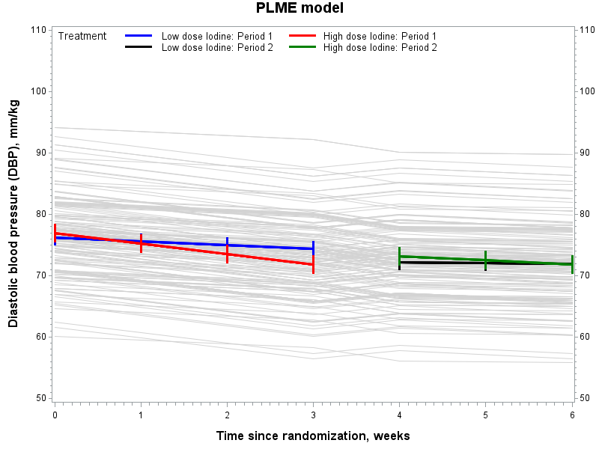
RESULTS contd…
Results from the Analysis of DBP data
Figure 2: Predicted DBP individual and mean profiles by treatment
The PLME model does not assume fixed (constant) treatment effect across periods, hence more flexible in modeling curvilinear trends (in different periodic phases), without putting constrain on the curve evolution.

Slide 22
RESULTS contd…
Table 2: Model Fit with time, treatment and period as fixed effects
Model fit criteria | Covariance matrix | GME model | JKME model | PLME model
-2logL(θ) | G Side - LME | 7263.8 | 7251.9 | 7248.1
 | R Side - MMRM | 7165.0 | 7127.6 | 7084.9
AIC | G Side - LME | 7267.8 | 7255.9 | 7252.1
 | R Side - MMRM | 7237.0 | 7199.6 | 7294.9
BIC | G Side - LME | 7274.1 | 7262.2 | 7258.4
 | R Side - MMRM | 7350.8 | 7313.3 | 7626.6

Slide 23
References
Fitzmaurice, G. M., Laird, N. M., & Ware, J. H. (2012). Applied longitudinal analysis (Vol. 998). John Wiley & Sons.
Grizzle, J. E. (1965). The two-period change-over design and its use in clinical trials. Biometrics, 467–480.
Grizzle, J. E. (1974). Correction to grizzle (1965). Biometrics, 30 (4), 727.
Jones, B., & Kenward, M. G. (2015). Design and analysis of cross-over trials, third edition. Chapman and Hall/CRC.
Molenberghs, G., & Verbeke, G. (2005). Models for discrete longitudinal data. New York: Springer.
Sheppard L. Insights on bias and information in group-level studies. Biostatistics. 2003;4(2):265-78.
Verbeke, G., & Molenberghs, G. (2009). Linear mixed models for longitudinal data. Springer Science & Business Media.
Verbeke, G., Molenberghs, G., & Rizopoulos, D. (2010). Random effects models for longitudinal data. In Longitudinal research with latent variables (pp. 37– 96). Springer

Slide 24
Acknowledgement
The Gov. of Kenyan - MoH
The Gov. of Belgium - VLIR-UOS
The Gov. of Canada - IDRC
KEMRI
UHasselt
JKUAT
UoN
All staff involved in making the VLIR-UOS TEAM Project Kenya a success

