Slide 1
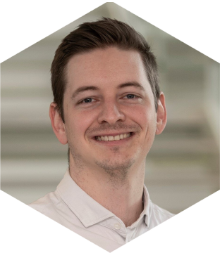
Completing a submission and beyond in R
Ari Siggaard Knoph,
Principal Statistical Programmer
aikp@novonordisk.com
PSI

Slide 2
This presentation represents the views of the author and not necessarily Novo Nordisk
Any regulatory communication shown will not be applicable to all projects. Please communicate with the appropriate health authorities about your submission
Notes:
This presentation represents the views of the author and not necessarily Novo Nordisk.
And, any regulatory communication shown will not be applicable to all projects. Please communicate with the appropriate health authorities about your submission.

Slide 3
1923
2023

Slide 4
https://y2u.be/t33dS17QHuA

Slide 5
5
The extent of R in the FDA submission package
All TFL for all 6 phase 3a trials
All big data ADaM programs
All TFL for 5/8 clinical pharmacology trials
All TFL for Integrated Summary of Efficacy (ISE)
All TFL for Integrated Summary of Safety (ISS)
All BIMO lists
ADaM
Clinical
Trials
TFL
https://y2u.be/t33dS17QHuA
R used in all project deliverables since January 1, 2021
TFL: Tables, Figures, Lists. BIMO: Bioresearch Monitoring (FDA)
2021

Slide 6
The extent of R in the FDA submission package
All TFL for all 6 phase 3a trials
All big data ADaM programs
All TFL for 5/8 clinical pharmacology trials
All TFL for Integrated Summary of Efficacy (ISE)
All TFL for Integrated Summary of Safety (ISS)
All BIMO lists
ADaM
Clinical
Trials
TFL
R used in all project deliverables since January 1, 2021
TFL: Tables, Figures, Lists. BIMO: Bioresearch Monitoring (FDA)
2021

Slide 7
It doesn’t work on my machine

Slide 8
Internal bias
OS issues
Compiled vs not-compiled software

Slide 9
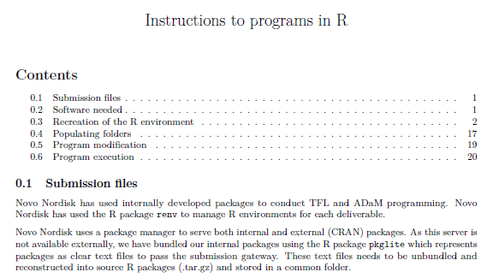
The “new” ADRG
24 pages
Information on submitted files
Information on environment restoration and setup with screenshots
Code explanation with screenshots
Information on modification of submitted programs with screenshots
Information on what to expect from code execution with screenshots
2023

Slide 10
The “new” ADRG
Available at:
https://github.com/NNaikp/phuse-css-2023
2023

Slide 14
1923
2023

Slide 15
Internal bias
OS issues
Compiled vs not-compiled software

Slide 16
Why didn’t you submit an image?

Slide 19
Fix an issue
Alternative version
2035

Slide 20
2035
Linux Based OS
C++ compilers and tools
R + Rstudio
(Other languages?)
Package Managers
Packages
Data layer
Programs
Metadata Repository
TFL and apps

Slide 21
Internal bias
OS issues
Compiled vs not-compiled software

Slide 22
Internal bias
OS issues
Compiled vs not-compiled software

Slide 23
2035
Linux Based OS
C++ compilers and tools
R + Rstudio
(Other languages?)
Package Managers
Packages
Data layer
Programs
Metadata Repository
TFL and apps

Slide 24
2035
Linux Based OS
C++ compilers and tools
R + Rstudio
(Other languages?)
Package Managers
Packages
Data layer
Programs
Metadata Repository
TFL and apps
A
B
C
D
E
F

Slide 25
2035
Linux Based OS
C++ compilers and tools
R + Rstudio
(Other languages?)
Package Managers
Packages
Data layer
Programs
Metadata Repository
TFL and apps
A
B
C
Submission as we know it
D
E
F

Slide 26
Submission as we know it
2035
Linux Based OS
C++ compilers and tools
R + Rstudio
(Other languages?)
Package Managers
Packages
Data layer
Programs
Metadata Repository
TFL and apps
A
B
C
Big Bang
A+B+C+D+E+F
D
E
F

Slide 27
Fix an issue
Alternative version
$f_{i}$: Fix i
$A_{i}$: Alternative i
2035

Slide 28
Submission as we know it
2035
Linux Based OS
C++ compilers and tools
R + Rstudio
(Other languages?)
Package Managers
Packages
Data layer
Programs
Metadata Repository
TFL and apps
A
B
C
Big Bang
A+B+C+D+E+F
D
$$B_{A_{i, …, n}}+D_{A_{i, …, n}}$$
E
F
$$E_{f_{i, …, n}}+D_{f_{i, …, n}}$$
$$C_{A_{i, …, n}}$$
$f_{i}$: Fix i
$A_{i}$: Alternative i

Slide 29
E
D
F
C
Linux Based OS
C++ compilers and tools
R + Rstudio
(Other languages?)
Package Managers
Packages
Data layer
Programs
Metadata Repository
TFL and apps
A
B
B
C
D
A
E
F
A+B+C+D+E+F
Big Bang

Slide 30
Metadata
Programs
TFL and apps
Data layer
Linux Based OS
C++ compilers and tools
R + Rstudio
(Other languages?)
Package Managers
Packages
Data layer
Programs
Metadata Repository
TFL and apps
A
B
Packages
C
D
System
E
F
A+B+C+D+E+F
Big Bang

Slide 31
Metadata
Programs
TFL and apps
Data layer
Linux Based OS
C++ compilers and tools
R + Rstudio
(Other languages?)
Package Managers
Packages
Data layer
Programs
Metadata Repository
TFL and apps
A
B
Packages
C
D
System
E
F
A+B+C+D+E+F
Big Bang

Slide 32
What do we do with all these fixes and alternative versions?

Slide 33
Metadata
Programs
TFL and apps
Data layer
Linux Based OS
C++ compilers and tools
R + Rstudio
(Other languages?)
Package Managers
Packages
Data layer
Programs
Metadata Repository
TFL and apps
A
B
Packages
C
D
System
E
F
A+B+C+D+E+F
Big Bang

Slide 34
Metadata
Programs
TFL and apps
Data layer
Linux Based OS
C++ compilers and tools
R + Rstudio
(Other languages?)
Package Managers
Packages
Data layer
Programs
Metadata Repository
TFL and apps
A
B
Packages
C
D
System
E
F
A+B+C+D+E+F
Big Bang
2023
Big Bang
A*+B+C+D+E
$f_{i}$: Fix i
$A_{i}$: Alternative i

Slide 35
Metadata
Programs
TFL and apps
Data layer
Packages
System
A+B+C+D+E+F
Big Bang
2023
Linux Based OS
C++ compilers and tools
R + Rstudio
(Other languages?)
Package Managers
Packages
Data layer
Programs
Metadata Repository
TFL and apps
A
B
C
Big Bang
A*+B+C+D+E
D
E
F
$f_{i}$: Fix i
$A_{i}$: Alternative i

Slide 36
What do we do with all these fixes and alternative versions?

Slide 37
Submission as we know it
2023
Linux Based OS
C++ compilers and tools
R + Rstudio
(Other languages?)
Package Managers
Packages
Data layer
Programs
Metadata Repository
TFL and apps
A
B
C
Big Bang
A*+B+C+D+E
D
E
F
$f_{i}$: Fix i
$A_{i}$: Alternative i

Slide 38
Submission as we know it
2023
Linux Based OS
C++ compilers and tools
R + Rstudio
(Other languages?)
Package Managers
Packages
Data layer
Programs
Metadata Repository
TFL and apps
A
B
C
Big Bang
A*+B+C+D+E
D
$$D_{A_{i, …, n}}$$
E
F
$$E_{f_{i, …, n}}+D_{f_{i, …, n}}$$
$$C_{A_{i, …, n}}$$
$f_{i}$: Fix i
$A_{i}$: Alternative i

Slide 39
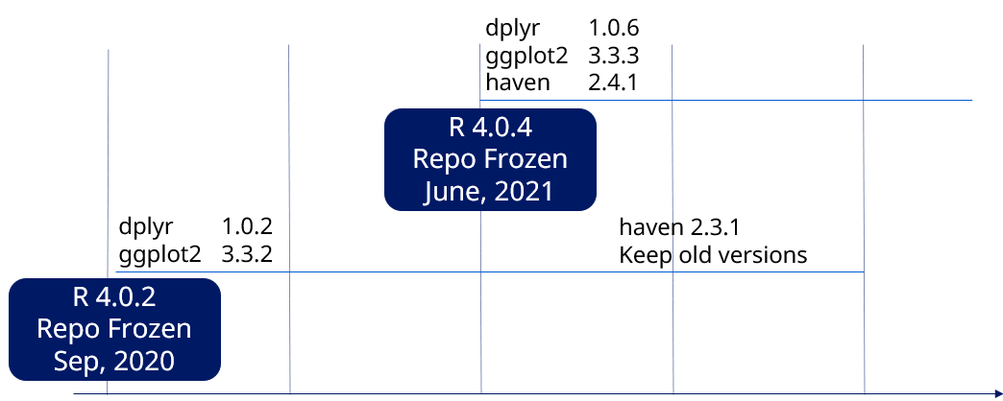
2024
When we receive questions
git version control
Azure DevOps
Azure Pipelines
1
Select appropriate R-version
2
3

Slide 40
2024
When we receive questions
git version control
Azure DevOps
Azure Pipelines
1
Select appropriate R-version
2
3
Open source Q3

Slide 41
2024
We assume:
Original setup as described in ADRG is retained
We currently don’t submit packages again every time!

Slide 42
How ready is FDA to work with all of this?

Slide 43
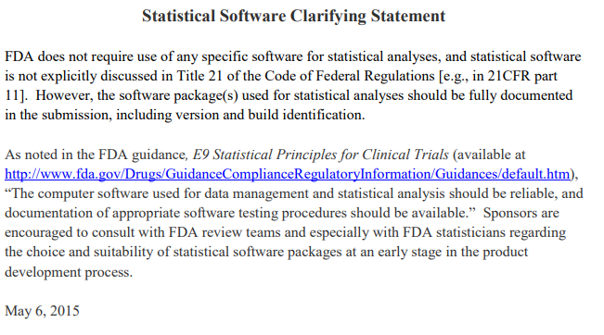

Slide 46
46
2023-09-12
Journey to an R-based FDA submission

