Slide 1
Building a BiggeR Community of R Users at AstraZeneca
Matt Lyon, Community Lead of R@AZ

Slide 2
Goal of R @ AZ: Federate the community of R users at AstraZeneca

Slide 3
Agenda
Brief History of the R@AZ Community
Lead and the Steering Committee
Key milestones/events
3 Main Questions:
1. What is the value of your community?
2. What is a Key Performance Indicator of your community?
3. What is the Return on Investment of your community?
Current Initiatives
How are we growing internally?
How are we growing externally?

Slide 4
Brief History of R@AZ
R@AZ is the internal social media community set-up within AstraZeneca(AZ) in April 2021.
This was driven by two questions:
Who are the R Users at AZ?
Where do they sit within the company (department + geography)?
Initial initiative was derived from a public #TidyTuesday -> #AZTidyTuesday
Also Function of the month: Highlighting potential functions to make life easier using R at AZ.

Slide 5
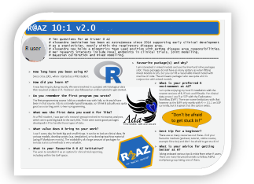
Key Milestone/Events- Getting the community to 750 members
AZ R Conference: Feb 2022
Opening Keynote from Software Engineer @ Rstudio
More than 30 speakers and nearly 100 poster authors
Covered governance, machine learning and reproducibility.
Over 500+ collaborators across 22 countries
1st R@AZ 10:1 : Mar 2022
Fostering connections across departments
Showcasing an R user in AZ and ask them 10 questions
This was condensed into 1 slide which was shared in R@AZ

Slide 6
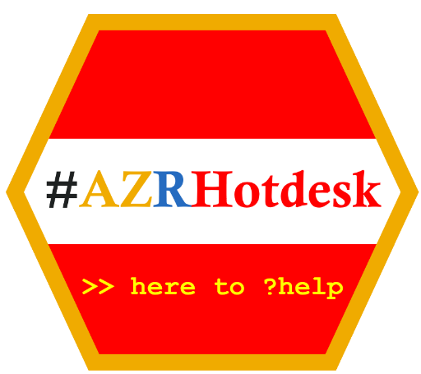
Key Milestone/Events cont.- Increasing to 1000 members
1st Lunch and LeaRn: Mar 2022
Started as internal speakers talking about R topics (30mins)
Taking place at lunchtime alternating between US and Europe
Now include External speakers and occur roughly once a quarter
Creation of the Gothenburg R Hot Desk: Sept 2022
Once a month, R experts meet in an open area of the office for 2 hours
Now expanded virtually across Teams

Slide 7
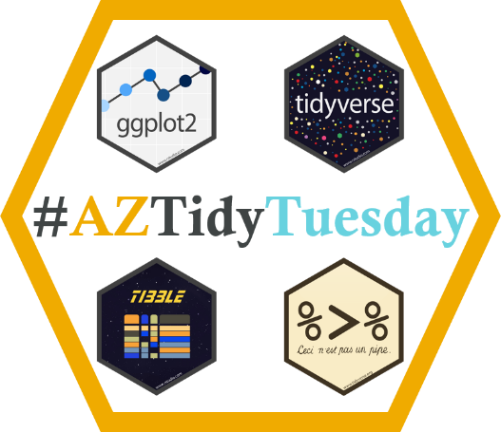
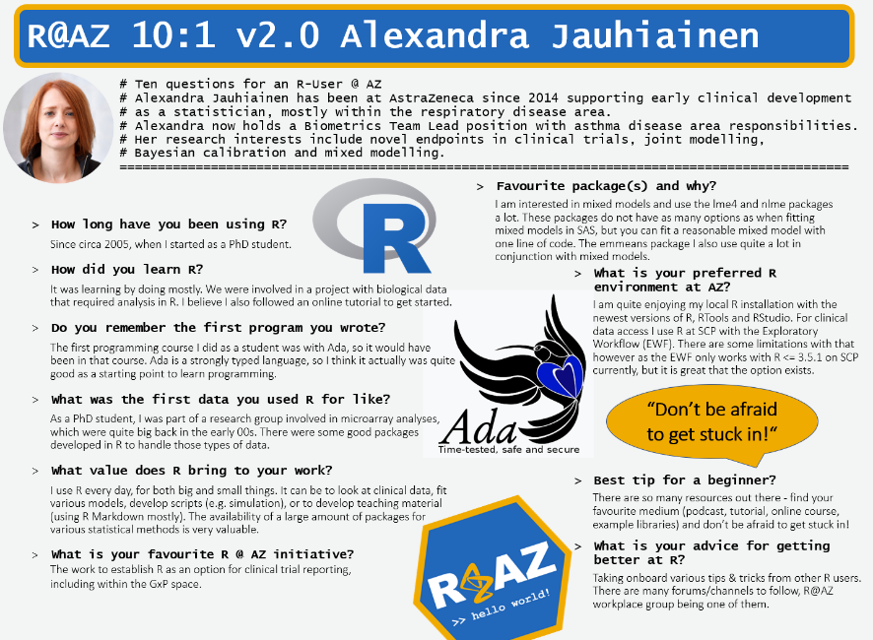
R @ AZ initiatives: diversity of learning in action!
Self-led learning
📚
Lunch & LeaRn
x
Workshops
🔙
Retrospective
⌚
In the moment
Let’s meet each otheR!
Group participation
🤝

Slide 8
The 3 main Questions
In 2022, the R@AZ Leads were asked by stakeholders:
1. What is the value of your community?
2. What is a Key Performance Indicator (KPI) of your community?
3. What is the Return on Investment (ROI) of your community?
This could not initially be answered but became the driving force in building the community both internally and externally in 2022-2023.

Slide 9
The Value of the Community
Regularly cited as a success story
UseR! 2022
R in Pharma 2022
Posit Blog Post
The Effective Statistician Podcast 2023
R@AZ internally
Currently sitting at 1693 members (as of Mar 2024)
Steering committee of 11 people
Advertising 9 R related internal training courses per year

Slide 10
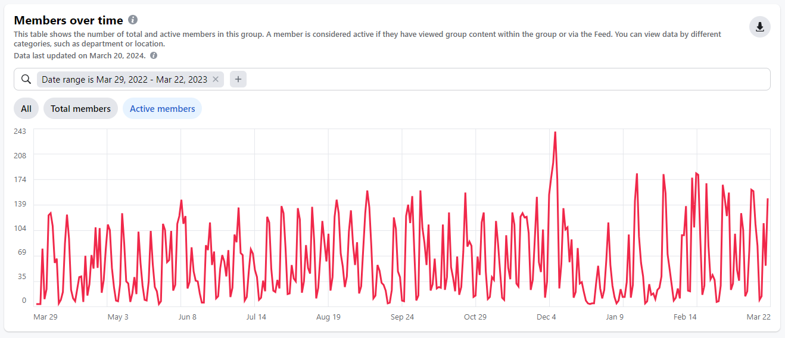
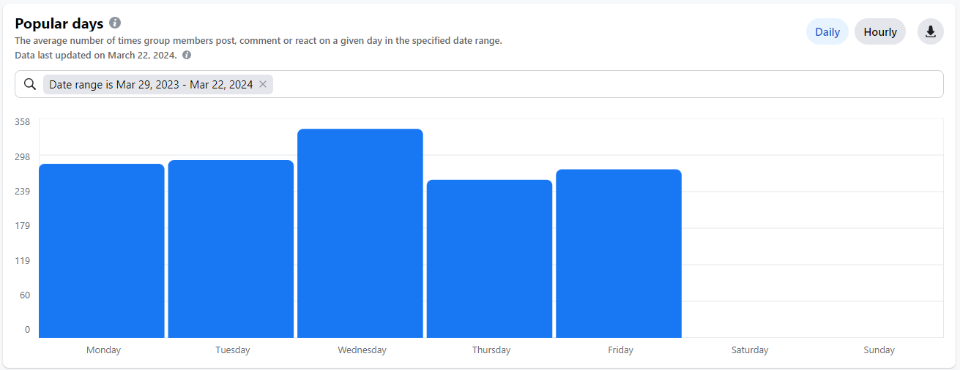
Key Performance Indicators of the Community
Average of 61 active members per day in the R@AZ group
Table shows active members from Mar 22-Mar 23
Average of 28 posts/comments/reactions per working week in the R@AZ group
Table shows popular days Mar 22-Mar 23.

Slide 11
The growth of the R@AZ Workplace Community 2021-2023

Slide 12
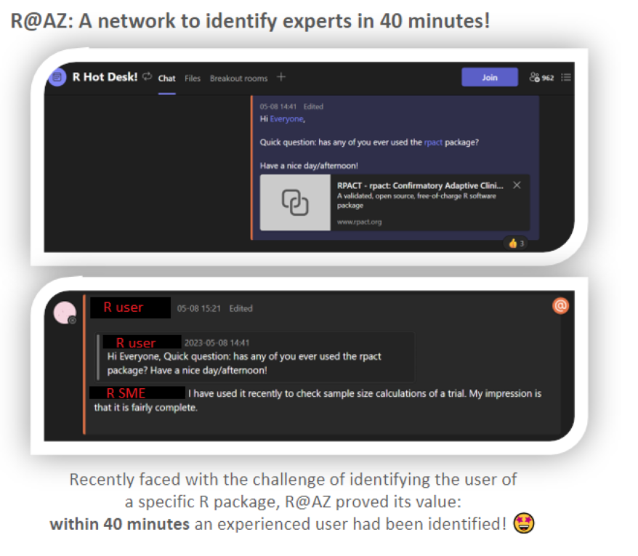
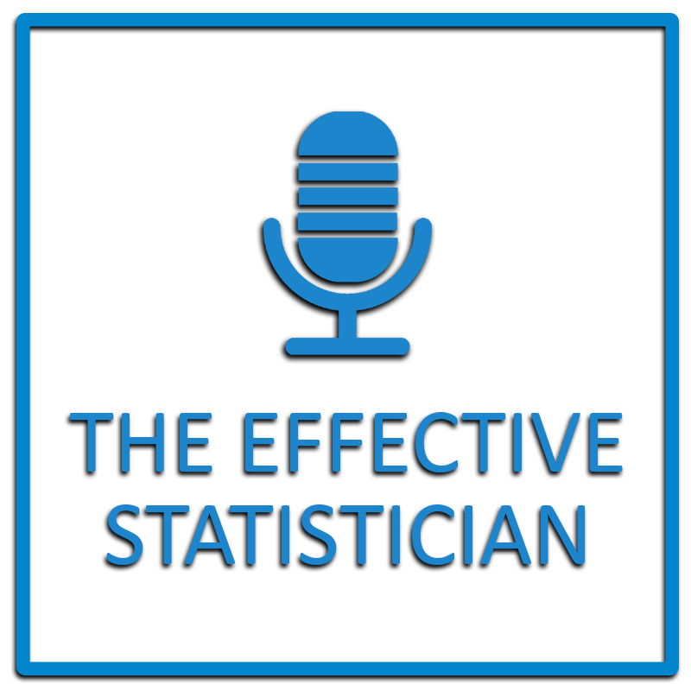
Return on Investment (ROI)
Collaborations with external companies
Testimonies
Cross-functional and cross-project teams now being formed to solve a common goal
R@AZ R Hot Desk increased efficiency
Finalists @ AZ R&D awards 2022 and 2023- People & Sustainability: Collaboration in Action Awards

Slide 13
Current Initiatives- Where are we now?
Change of R@AZ Community Lead
Addition of new steering committee members with fresh ideas
Streamlining initiatives- phasing out low ROI
Fun initiatives- increase engagement
Continued collaboration with external speakers
Continued diverse range of webinars/educational courses
Scoping out potential new collaborators
To help grow the community of R users
To help maximise efficiency of locating solutions

