Slide 1
The assessment of quality attributes for biosimilars: a statistical perspective on current practice and a proposal
Johanna Mielke
Joint work with: Byron Jones, Martin Schiestl, Franz Innerbichler, Nicolas Ballarini

Slide 2
Disclaimer and acknowledgment
The opinions expressed in this presentation and on the following slides are solely my own and not necessarily those of Novartis or Sandoz or Bayer.
This project was supported by the Swiss State Secretariat for Education, Research and Innovation (SERI) under contract number 999754557. The opinions expressed and arguments employed herein do not necessarily reflect the official views of the Swiss Government. The project is part of the IDEAS European training network (http://www.ideas-itn.eu/) from the European Union’s Horizon 2020 research and innovation programme under the Marie Sklodowska-Curie grant agreement No 633567.

Slide 3
Analytical similarity in biosimilar development
Biosimilar development
Establishing of analytical similarity is the foundation of all biosimilar development programms
However still no clear answers to:
Definition of analytical similarity (what does “similar” mean)
Preferred statistical approaches
Clinical
PK/PD
Pre-clinical
Analytical
Can we learn from clinical development strategies?

Slide 4
Transferring strategies from clinical development is challenging
Often extremely limited sample size (cannot be increased)
Many dimensions of molecule to consider (➔ multiple testing, but limited sample size available)
Relevance to clinical safety and efficacy often unclear (➔ establishing of meaningful equivalence margins is difficult/sometimes impossible)
Concept of independent and identical distributed might not hold (e.g., shifts and drifts)
Kim et al. (2017): doi: 10.1080/19420862.2017.1305530

Slide 5
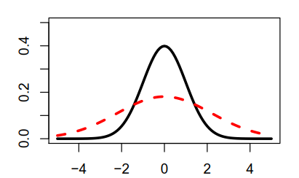
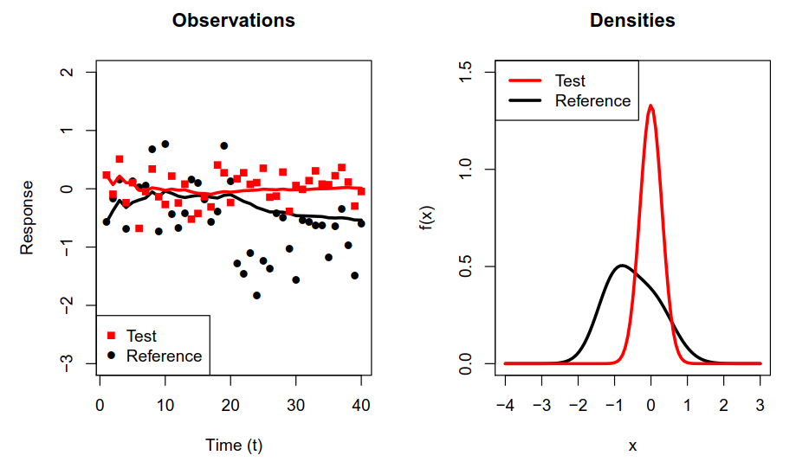
Without the correct research question: no appropriate statistical analysis
What does “analytical similarity” mean?
Equivalence in mean value?
Intuition:☹ Test: ☺
Products with observed values for Reference are on the market ➔ Biosimilar acceptable as long as it is in line with distribution of Reference?

Slide 6
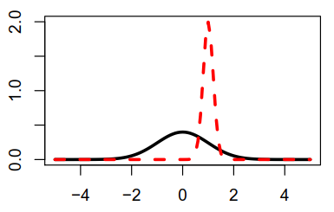
Without the correct research question: no appropriate statistical analysis
What does “analytical similarity” mean?
Equivalence in distribution?
Intuition: ☺ Test: ☹
Range-type hypothesis?
“The probability to observe an extremer value for the biosimilar than for the reference product is small”

Slide 7
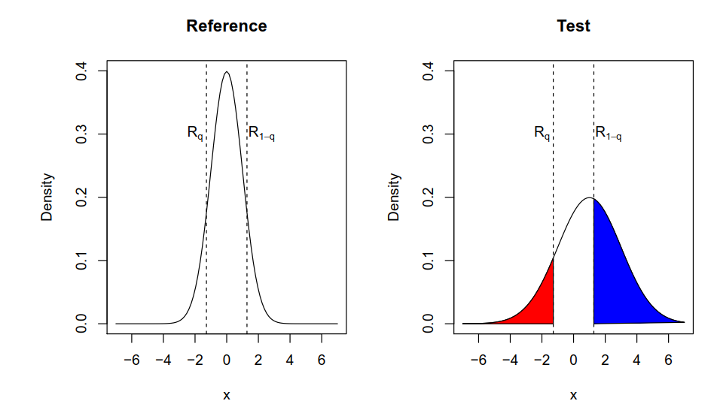
A range-type hypothesis for analytical similarity
Reference product
Biosimilar
„Tails of Reference are heavier than tails of Test“
Equivalence margin

Slide 8
The tail-test

Slide 9
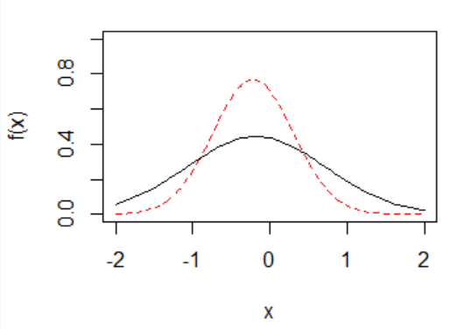
The tail-test: numerical example
Set q=0.1, α=0.05, c=-0.1 (hyperparameter)
Estimate mean values and standard deviations:
Estimate quantiles of reference product:
Calculate test statistic values:
Comparison to simulated critical values ➔ equivalent

Slide 10
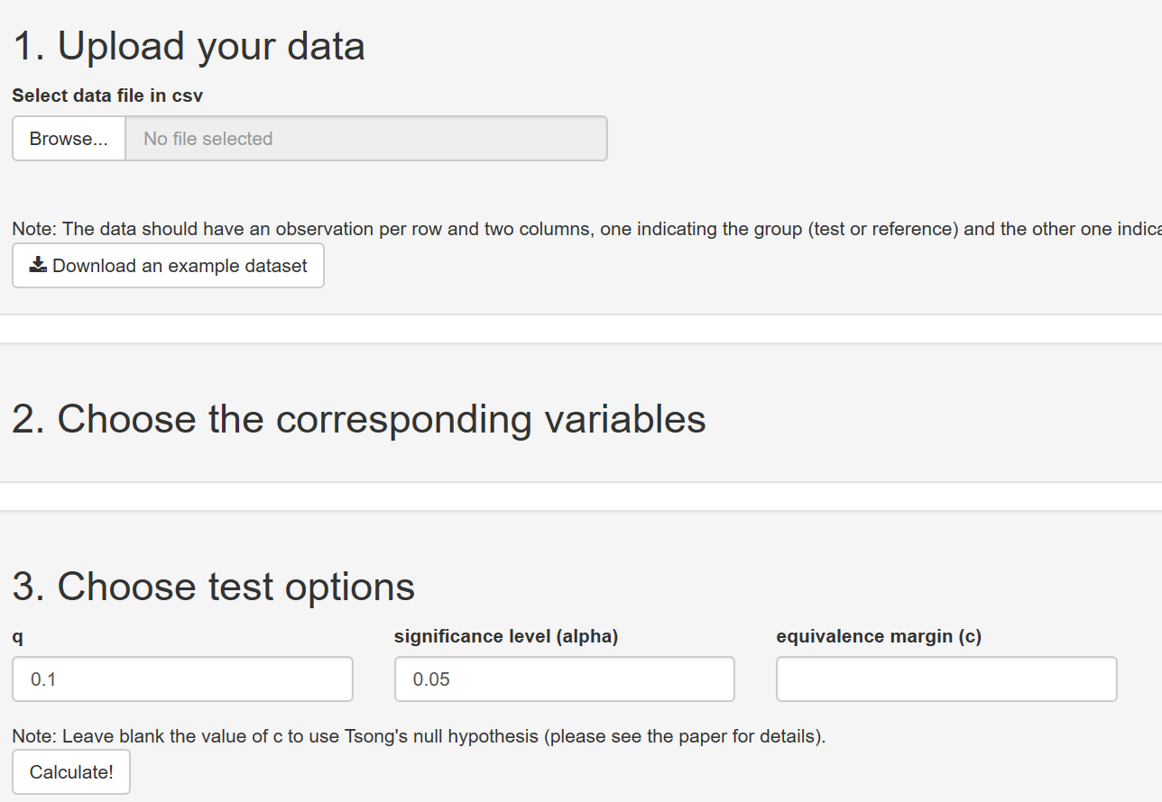
The tail-test: Shiny app
https://nballarini.shinyapps.io/tailTest/

Slide 11
Operating characteristics: compared approaches
Methodologies:
T1: Mean value comparison (Tsong et al.):
qr: Quality ranges: Z% of T observations in
mm: Min/max approach: range of observed values for biosimilar lies within observed values of reference product
piti: Prediction-interval-within-tolerance interval (Boulanger et al.)
To enable comparability: tune all approaches to reject in 5% of the cases for Tsong’s null hypothesis

Slide 12
Operating characteristics: considered settings

Slide 13
Operating characteristics: results
T1: not appropriate for this type of hypothesis
mm: Only reasonable if variability of biosimilar is much smaller than reference
qr: low power
piti: performance highly depends on sample size
tail: reasonable properties, but not most powerful in all situations

Slide 14
Desirable features of assessment strategy
Use available batches from reference product for “equivalence margins” – no need to pre-specify an acceptable difference
Works in low sample sizes, but encourage the use of high sample sizes (reasonable asymptotic performance)
Low rate of false positives (low type I error rate) and false negatives (high power)
Robust against deviation of iid samples assumption
No (strong) dependence on unrealistic assumptions for underlying distribution

Slide 15
Discussion and conclusion
Still high uncertainty on appropriate statistical strategy for establishing analytical comparability
Method development requires input from subject matter experts on research question (what do we want to know?)
Range-type hypotheses as proposed today appear reasonable – but is difficult to handle from a statistical point of view
From my perspective: all currently available approaches have flaws
Future research required to identify best solution

Slide 16
Thank you very much!
Question/Comments? Please let me know!
Johanna Mielke [johanna.mielke@bayer.com]

