Slide 1
BSSR – AZ COPD Exacerbation Study Experiences
Mike Greenwood: AstraZeneca
PSI One Day Meeting
03 Nov 2016

Slide 2
Aim of Talk
Experience of running a BSSR on AZ COPD Exacerbation Study
Hints and tips for communicating to non-statisticians
Please feel free to interrupt and ask questions at any time
Slides are a mixture of
those used when either explaining the BSSR process or disseminating the BSSR results.
Suggestions, advice and thoughts to consider
Notes:
COPD – Chronic Obstructive Pulmonary Disease

Slide 3
Reminder – Why are we performing this BSSR
Unsure of the variability assessment in our Sample Size Calculations
BSSR allows early assessment of variability in the Study,
Two (anticipated) potential decisions:
Power ‘reasonable’ – no need to increase sample size
Increase Sample size to retain ‘reasonable’ power (within pre-defined limits)
Two more potential scenarios :
Initial estimate of variability was too high (Power > required)
Initial estimate of variability was far too low (Power <<< required) and may not be feasible to increase sample size sufficiently
Agree your decision rules beforehand

Slide 4
BSSR – Key Messages
Remember the reason for doing the BSSR
Unsure of the variability assessment in your Sample Size Calculations
Agree your decision rules beforehand
Do a Pilot BSSR
Planning
You need to know the results of your BSSR before you complete recruitment of the study
Keep it Simple (Statistically)
Graphs are (usually) better
Know your audience

Slide 5
BSSR – Know your audience
Potentially have 4 different ‘Customers’
All need to know the results (will our study be positive) but have different priorities
Your Study team (will also be interested in)
Practical concerns & Data Management requirements
Your Project team (will mainly be interested in)
Resource and Timings (and what to tell ‘3’)
The holders of the ‘purse-strings’ (will only be interested in)
How much more will the study cost and how much longer will it take to complete!
Your fellow Statisticians (may be interested in) – outside of study time frame
Does this affect any of their studies?

Slide 6
‘Agenda’
AZ COPD Exacerbation Study Design
BSSR Process
Communication of the Results
Pilot BSSR
Final BSSR
Conclusions and Advice

Slide 7
AZ COPD Exacerbation Study Design

Slide 8
AZ COPD Study: Introduction/background – Template Slide
Aim of AZ COPD Exacerbation Study
Expand the current COPD indication for AZ product to also include reducing exacerbations in patients with COPD in US
AZ product use in US
AZ product is indicated for the treatment of:
Asthma in patients 12 years of age and older
Twice daily maintenance treatment of airflow obstruction in COPD, including chronic bronchitis and emphysema
AZ product is currently not approved in the US for reducing exacerbations in patients with COPD
Two other similar products are currently approved by FDA for reducing exacerbations in patients with COPD

Slide 9
AZ COPD Exacerbation Study: Study design – Template Slide
Randomisation
N = 1136
AZ product x 2 BID
AZ product x 2 BID
reference product x 2 BID
FU
follow-up
phone call
Periods
Enrolment
Run-in
Treatment
Visits
1
2
3
4
5
6
7
FU
Weeks
–5 to –4
0
4
8
17
26
28
Objective: To demonstrate that AZ product is superior to reference product
Design: Double-blind, double-dummy, randomized, parallel group, multicenter phase IIIB study
Patient population:
subjects with moderate to very severe COPD
male and female subjects ≥40 years of age
COPD diagnosis with symptoms for >1 year
current or previous smoker with a history of ≥10 pack years
post-bronchodilator FEV₁/FVC <0.7 and FEV₁ ≤70% of predicted normal value
MMRC dyspnea scale ≥2
≥1 COPD exacerbation, defined by corticosteroid treatment and/or hospitalization, within 1-12 months before Visit 1
no history of asthma at or after 18 years of age
Treatment duration: 6 months
Planned Size of study: 1136 (BSSR analysis might increase patient numbers)
Run-in: 4 weeks
Primary endpoint: The rate of moderate and severe COPD exacerbations
Key secondary endpoints:
time to first moderate or severe COPD Exacerbation
health status/health related quality of life - St. George’s Respiratory Questionnaire (SGRQ)
pre-dose/pre-bronchodilator FEV1
total rescue medication use (average puffs/day)
nights with awakening due to COPD
Analysis strategy: Annual COPD exacerbation rate analysed by a negative binomial regression model.

Slide 10
AZ COPD Exacerbation: Study design – Template Slide/Split into 2
Randomisation
N = 1136
AZ product x 2 BID
AZ product x 2 BID
reference product x 2 BID
FU
follow-up
phone call
Periods
Enrolment
Run-in
Treatment
Visits
1
2
3
4
5
6
7
FU
Weeks
–5 to –4
0
4
8
17
26
28

Slide 11
AZ COPD Exacerbation: Study design – Template Slide/split into 2
Objective: To demonstrate that AZ product is superior to reference product
Design: Double-blind, double-dummy, randomized, parallel group, multicenter phase IIIB study
Patient population:
subjects with moderate to very severe COPD
male and female subjects ≥40 years of age
COPD diagnosis with symptoms for >1 year
current or previous smoker with a history of ≥10 pack years
post-bronchodilator FEV₁/FVC <0.7 and FEV₁ ≤70% of predicted normal value
MMRC dyspnea scale ≥2
≥1 COPD exacerbation, defined by corticosteroid treatment and/or hospitalization, within 1-12 months before Visit 1
no history of asthma at or after 18 years of age
Treatment duration: 6 months
Size of study: 1136 (BSSR analysis might increase patient numbers)
Run-in: 4 weeks
Primary endpoint: The rate of moderate and severe COPD exacerbations
Key secondary endpoints:
time to first moderate or severe COPD Exacerbation
health status/health related quality of life - St. George’s Respiratory Questionnaire (SGRQ)
pre-dose/pre-bronchodilator FEV1
total rescue medication use (average puffs/day)
nights with awakening due to COPD
Analysis strategy: Annual COPD exacerbation rate analysed by a negative binomial regression model.

Slide 12
Are you Awake? Slide
Which Audience needs the previous 2 slides?
Your Study team
Your Project team
The ‘purse-strings’ holders
Fellow Statisticians
Advice:
Good opportunity for questions
1) and 2) should know the design
If sent as a pre-read, good background slides

Slide 13
AZ COPD Exacerbation Study: Protocol text on BSSR
Because the assumed exacerbation rate and assumed shape parameter from the negative binomial model has a large impact on the estimated sample size necessary to achieve a stated power (90% in this case), a blinded estimate of the exacerbation rate and shape parameter is planned. The review will be performed before the last subject is randomized. The exacerbation rate and shape parameter will be estimated using the maximum likelihood approach as proposed by Friede and Schmidli (Friede and Schmidli, 2010). If results of the blinded review indicate that the projected power falls to below 85%, the sample size will be increased to ensure a 90% projected power. Since this review will be performed in a blinded fashion, no adjustment for the type I error is needed. Additional blinded review(s) may be conducted if deemed necessary by the sponsor. The review(s) will be based on pooled, blinded data and will not use any treatment information. The blinding will be strictly maintained and not be affected by the review(s) in any way.
The potential increase in sample size will be capped at a 50% increase above the planned number of 568 subjects per treatment group.

Slide 14
AZ COPD Exacerbation Study: BSSR (in layman’s terms)
Poorly estimated exacerbation rate or over-dispersion will lead to reduced power
We will do a BSSR
Sample Size will be increased if (estimated) power (from BSSR) falls below 85%
Increase in Sample Size capped at 50% (1136 to 1704)
We will do the BSSR prior to last Patient randomised
BSSR is blinded so no adjusted to type I error required

Slide 15
AZ COPD Exacerbation Study: Protocol text on BSSR (repeat)
Because the assumed exacerbation rate and assumed shape parameter from the negative binomial model has a large impact on the estimated sample size necessary to achieve a stated power (90% in this case), a blinded estimate of the exacerbation rate and shape parameter is planned. The review will be performed before the last subject is randomized. The exacerbation rate and shape parameter will be estimated using the maximum likelihood approach as proposed by Friede and Schmidli (Friede and Schmidli, 2010). If results of the blinded review indicate that the projected power falls to below 85%, the sample size will be increased to ensure a 90% projected power. Since this review will be performed in a blinded fashion, no adjustment for the type I error is needed. Additional blinded review(s) may be conducted if deemed necessary by the sponsor. The review(s) will be based on pooled, blinded data and will not use any treatment information. The blinding will be strictly maintained and not be affected by the review(s) in any way.
The potential increase in sample size will be capped at a 50% increase above the planned number of 568 subjects per treatment group.

Slide 16
BSSR Process – explaining a BSSR to non-Statisticians

Slide 17
BSSR – Planning
Remember the reason for doing a BSSR
Unsure of the variability assessment in your Sample Size Calculations
May need to increase sample size
If decision is made to increase Sample Size what additional considerations are there?
More sites (or more countries – time issues)
Order more IP supply
More specialised equipment (eDiaries, Spirometry kits for Exacerbation Study)
When to perform the BSSR
Need result before cessation of recruitment
Need sufficient information for result to be robust
Plan backwards from expected Last Patient enrolled date
Specific Data Cleaning
Any eCRF forms used in the BSSR
Remember all of the following: Key demographics, patient and disease characteristics, analysis set definitions, primary endpoint and any factors in Statistical model

Slide 18
Sample size in AZ COPD Exacerbation Study - Template Slide
PROTOCOL ASSUMPTIONS
Alpha | 5%, 2 sided
Power | 90%
(estimated) Exacerbation Rate for reference product | 0.6 exacerbations per 6 months
(estimated) Relative Risk | 0.72 (i.e. 28% reduction in risk of exacerbation)
(estimated) Overdispersion | 0.6
Calculated sample size: | 517 / arm
Sample size allowing 10% withdrawal | 568 / arm (total 1136 )
Parameters to be obtained from BSSR
Overall exacerbation rate | Overdispersion
All exacerbation rates are 6-monthly.
Exacerbation rate and overdispersion parameter in BSSR will be obtained using a negative binomial model.

Slide 19
Process and example calculation - Template Slide
We will calculate the power of the study given the overall rate and dispersion (as obtained in BSSR), keeping the other figures as they are in protocol.
Example calculation BSSR
Overall exacerbation rate | Overdispersion | Power | Patients | MDD
0.516* | 0.6 | 90% | 1136 (protocol) | 0.82
0.4 | 0.6 | 84% | 1136 (protocol) | 0.81
0.4 | 0.6 | 90% | 1356 (NEW) | 0.82
If the overall 6-monthly rate we are seeing is 0.516 and dispersion is 0.6 then the power will be 90% (overall rate derived from protocol assumptions)
If the overall 6monthly rate is, say, 0.4 and dispersion is 0.6 then the power is 84%. As this is less than 85% we could consider increasing the size of the study. To achieve 90% power would require 678 patients/arm
* Rate is derived from protocol assumptions
Notes:
Take it slow

Slide 20
Are you Awake? Slide
Which Audience needs the previous 2 slides?
Your Study team
Your Project team
The ‘purse-strings’ holders
Fellow Statisticians
Everyone - but (3) won’t be interested and (4) should know (or ask)
Advice:
Clinicians need to understand this
MDD – Minimum Detectable Difference (rate ratio closest to 1 where p-value <0.05)
Following graphs useful to reinforce the message.

Slide 21
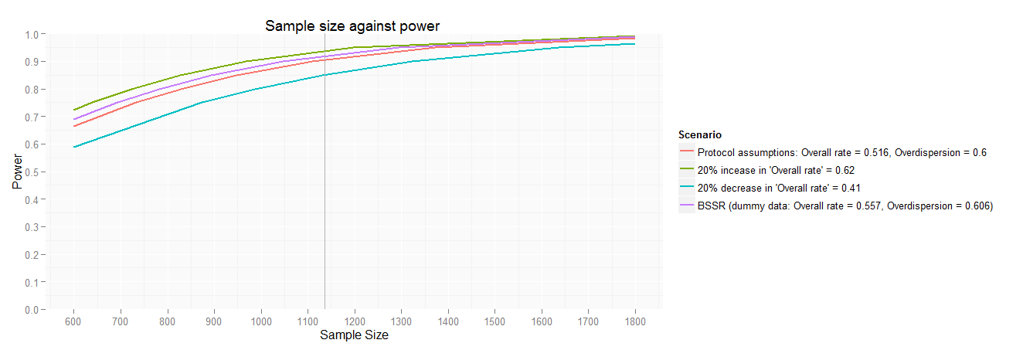
BSSR : Power (graphically) – template slide
N = 1136
Protocol estimates N=1136 patients with 90% power; Treatment effect 28% assumed to be constant
Notes:
Use Reference lines to explain various scenarios.

Slide 22
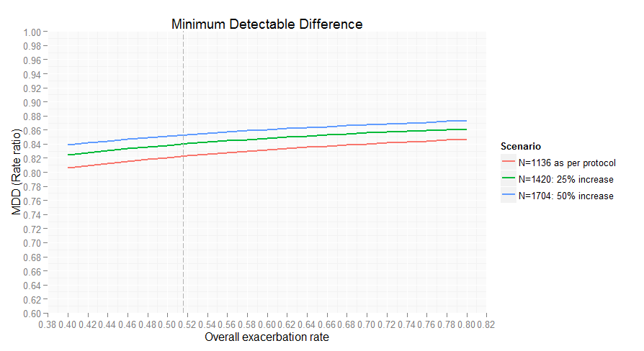
BSSR : MDD (graphically) – template slide
NOTE: overall exacerbation rates are 6-monthly, overdispersion parameter = 0.6 (protocol)
Notes:
Use Reference lines to explain various scenarios.

Slide 23
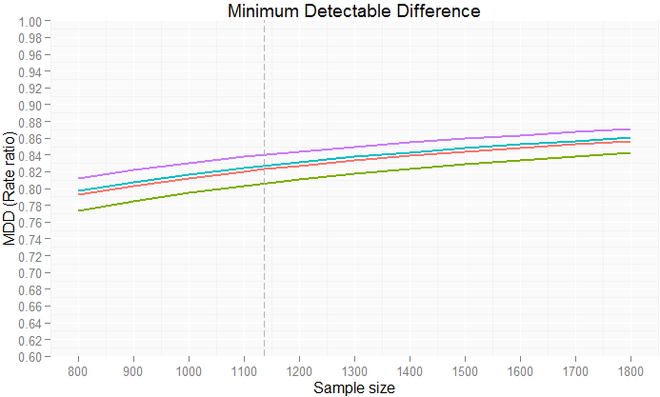
BSSR : MDD (graphically) – template slide
NOTE: overall exacerbation rates are 6-monthly, overdispersion parameter = 0.6 (protocol)
Notes:
Use Reference lines to explain various scenarios.

Slide 24
Template Graphs of results
Go slowly
Explain both axes
Use the moveable reference lines to explain how the scenarios work
Minimum Detectable Difference (rate ratio closest to 1 where p-value <0.05)
Explain carefully
Potentially better for decision making (‘red-face’ test)
Should relate to the clinically relevant difference
Should have been used when the initial sample size was chosen!
Key information from our US Medic:
“In terms of decision criteria, 20% reduction (i.e. rate ratio of 0.8) is the clinically relevant difference (One competitor has a value of 18% in their US label). Hence a MDD of 18% (i.e. 0.82) or less is fine. ”

Slide 25
BSSR calculation - Template Slide
 | Pilot BSSR – 31st Jan Data cleaned | Final BSSR
Number of exacerbations | n | n
Total follow-up (years) | nn | nn
‘Crude’ 6-monthly rate | nn | nn
Fit negative binomial model – as we will for the analysis but without treatment
Overall rate | 0.x
Over-dispersion parameter | 0.x
Exacerbation rate will be modelled using a negative binomial model including country/region, number of exacerbations in prior year and log follow-up time as offset variable

Slide 26
BSSR Results, 31st Jan - Template Slide
Power and sample size calculations given parameters obtained from BSSR
Exacerbation Rate | Over-dispersion Parameter | Sample Size | Power
x.xx | x.xx | 1136 | xxx
 |  | xxx | 90
 |  | xxx | 85
 |  | xxx | 80
 |  | xxx | 75

Slide 27
Template Tables of results
More Straightforward than graphs
Practical considerations of statistical model (Exacerbation rate will be modelled using a negative binomial model including country/region, number of exacerbations in prior year and log follow-up time as offset variable)
Ensure SAP is crystal clear on the model e.g.
country/region – what is the decision criteria – what is the definition of region
number of exacerbations in prior year - categorical or linear (categorical)
log follow-up time – base e or base 10 (e)
Practical considerations of defining follow-up time (time at risk for an exacerbation) for an ongoing trial

Slide 28
Team Recommendation - Template Slide
Blank

Slide 29
BSSR Pilot Results

Slide 30
BSSR Pilot
Miscommunication between DM and CRO Vendor meant that initial results were not on the (clean) data cut expected
New data required
2 week delay (2nd April to 16th April)
Statistical model used (Exacerbation rate will be modelled using a negative binomial model including country/region, number of exacerbations in prior year and log follow-up time as offset variable)
Only 42 exacerbations observed (in 31st Jan database)
country/region – region required for model to fit
number of exacerbations in prior year – linear would not fit (actually I’d assumed we would be fitting as a categorical variable)
Pilot clearly justified both in terms of team education and resolving above

Slide 31
Pilot BSSR : Recruitment – result slide
 | 31st January | 20th April (Most Recent data at the time)
Enrolled | 755 | 1366
Randomized | 344 | 612
Countries open (patients randomised) | Czech republic (22), Germany (36), Poland (41), South Africa (11) and USA (234). | Argentina (0), Bulgaria (52), Czech republic (41), Germany (58), Poland (80), South Africa (32), USA (343), Chile (4), Mexico (0), Spain (2).
Countries to open | Argentina, Chile, Mexico. Bulgaria had started enrolment but no randomized patients | All countries recruiting. Mexico and Argentina not yet randomized patients.
344 is less than a third of planned recruitment, 612 approx half

Slide 32
BSSR calculation - Result Slide
 | Pilot BSSR – 31st Jan Data cleaned
Number of exacerbations | 67
Total follow-up (years) | 46
‘Crude’ 6-monthly rate | 0.72
Negative binomial model fitted – as for the analysis but without treatment
Overall rate | 0.70
Over-dispersion parameter | 0
Exacerbation rate modelled using a negative binomial model including region, number of exacerbations in prior year and log follow-up time as offset variable

Slide 33
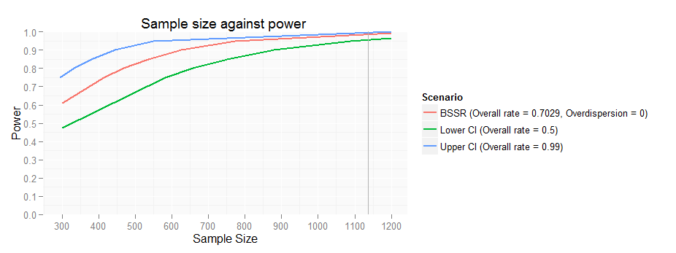
Pilot BSSR : Power (graphically) – result slide
Overall Exacerbation Rate 0.70, 95% CI (0.50; 0.99)
N=1136
Rates are 6-monthly

Slide 34
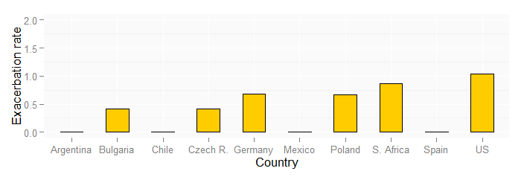
Pilot BSSR : Exacerbations – result slide
Country Level Information on 20 April (~ 3 months later)
Patient follow-up by country might be better – if available
Better with N on each country
41 11 NR 234 (31st JAN)

Slide 35
BSSR Pilot - Recommendations
Just regard as a test-run (as stated before)
Not for decision making
Too small a proportion of the final information (46 patient years of follow-up compared with ~518 patient years expected)
(not all) Countries yet recruiting
Exacerbation rate varies by country
(Season variation in exacerbation rate)
(over dispersion under estimated?)

Slide 36
Are you Awake? Slide
Which Audience should not see the Pilot results?
Your Study team
Your Project team
The ‘purse-strings’ holders
Fellow Statisticians
The ‘purse-strings’ holders only need know when making any decisions

Slide 37
Final BSSR Results

Slide 38
BSSR Final
Not done in isolation, regular additional information in the form of
Bi-Weekly Reports from CRO, mainly demographics and simple summaries, in particular:
Exacerbations observed
Time at Risk (definition not straightforward for ongoing trial)
‘crude’ exacerbation rate
Visualisation tool, demographics, patient and disease characteristics, exacerbations and AEs
Decision rule (now) agreed

Slide 39
Final BSSR : Decision Tree – (pre)result slide
BSSR2 June 23
ST Review June 24
STOP recruitment :
6 monthly exacerbation rate >0.5
Enough patients enrolled to reach 1136 randomized
> 90% power
Allow Clinical expectations, on exacerbation rate* in the rest of the study, to influence the decision whether to increase sample size or not:
6 monthly exacerbation rate between 0.41 – 0.5.
85%-90% power
Communicate new sample size and CONTINUE recruitment with full speed :
6 monthly exacerbation rate <0.41
< 85% power
The CSP text: ”If results of the blinded review indicate that the projected power falls to below 85%, the sample size will be increased to ensure a 90% projected power.”
Does not explicitly state that sample size may not be increased if power is between 85 and 90 %
*E.g. Influenza situation, seasonal variation and FEV1 in randomised patients during the rest of the study

Slide 40
BSSR calculation – Final result slide
 | BSSR 30th April - Data cleaned
Number of exacerbations | 176
Total follow-up (years) | 137
‘Crude’ 6-monthly rate | 0.65
Negative binomial model fitted – as for the analysis but without treatment
Overall rate | 0.6
Over-dispersion parameter | 0.03
Exacerbation rate modelled using a negative binomial model including region, number of exacerbations in prior year and log follow-up time as offset variable

Slide 41
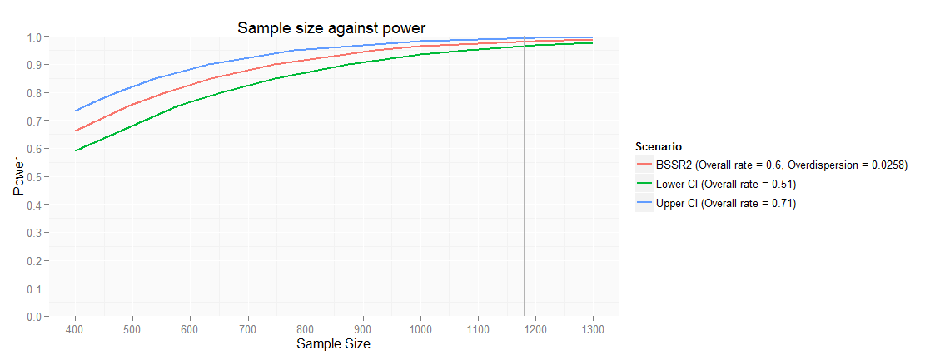
Final BSSR : Power (graphically) – result slide
Overall 6month Exacerbation Rate 0.6, 95% CI (0.51; 0.71)
N=1180
Rates are 6-monthly
Notes:
Key Slide, key point is to show the power for the observed parameter estimates.
Horizontal reference line at 90% power – note LCL is above this.
This slide shows uncertainty around the BSSR exacerbation rate estimate. Green line shows the power change as the sample size increases, when the overall exacerbation rate is 0.51 (lower confidence limit). Blue line shows the power change as the sample size increases when the overall rate is 0.71 (upper confidence limit).

Slide 42
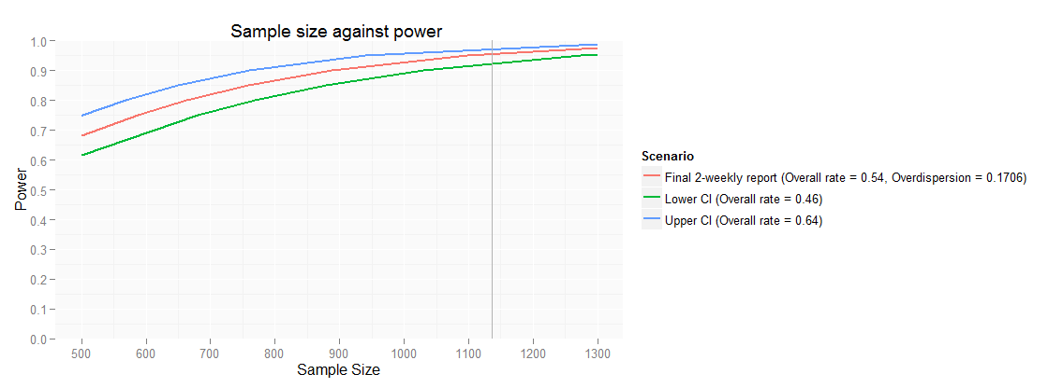
Final Biweekly : Power (graphically) – result slide
Overall 6month Exacerbation Rate 0.54, 95% CI (0.46; 0.64)
N=1136
Rates are 6-monthly
Notes:
Key Slide, key point is to show the power for the observed parameter estimates.
Horizontal reference line at 90% power – note LCL is above this.
This slide shows uncertainty around the BSSR exacerbation rate estimate. Green line shows the power change as the sample size increases, when the overall exacerbation rate is 0.51 (lower confidence limit). Blue line shows the power change as the sample size increases when the overall rate is 0.71 (upper confidence limit).

Slide 43
Final BSSR : Team Recommendations – result slide
Given the BSSR2 results (30th April on ‘clean’ data), current sample size gives >97% power to detect 28% difference (from protocol) between treatments
Given the 1st June Bi-weekly results, current sample size gives >95% power to detect 28% difference (from protocol) between treatments
BSSR2 and Bi-weekly results are consistent
Overdispersion parameter is lower than originally estimated, therefore the expected power is slightly higher
Therefore there is no need to increase the sample size, based on the present results
Please confirm that enrollment hold can be changed to a stop?

Slide 44
Are you Awake? Slide
Which Audience should see the Final results?
Your Study team
Your Project team
The ‘purse-strings’ holders
Fellow Statisticians
Everyone!
For (1) and (2) the previous slides are probably sufficient (plus demography)
(3) can probably manage with a quick email (2/3 slides max)
(4) may want to understand why the parameters change over time

Slide 45
Comparison of BSSR Results

Slide 46
AZ COPD Exacerbation Study : Comparison of BSSR results – result slide
Summary results | Pilot BSSR – 31st Jan Data cleaned | 16th March * | BSSR 30th April Data cleaned | 1st June *
Number of exacerbations | 67 | 100 | 176 | 201
Total follow-up (years) | 46 | 78 | 137 | 174
‘Crude’ 6-monthly exacerbation rate | 0.72 | 0.65 | 0.65 | 0.6
Model results
Overall rate | 0.70 | 0.61 | 0.6 | 0.54
Over-dispersion parameter | 0 | 0 | 0.03 | 0.2
* Data – not cleaned

Slide 47
AZ COPD Exacerbation Study : Comparison of BSSR results – result slide
Initial Scenarios (first 2 rows) / Results observed (final 3 rows) | Parameters | MDD 95%*
 |  | N = 1136 (protocol)
Protocol Assumptions | overall rate = 0.516, overdispersion = 0.6 | 0.82 (18%)
High exac. rate | overall rate = 0.7, overdispersion = 0.6 | 0.84 (16%)
BSSR1 – 31st Jan | overall rate=0.70 overdispersion = 0 | 0.86 (14%)
BSSR2 – 30th April | overall rate=0.60 overdispersion=0.03 | 0.85 (15%)
1st June Bi-Weekly | overall rate=0.54 overdispersion=0.2 | 0.84 (16%)
* MDD (95%) is calculated as the smallest difference (here a rate ratio) that would result in a p-value of 0.0499.
Notes:
Emphasise that MDD is closer to 1 (smaller rate ratio) since the over-dispersion is lower than the protocol assumption, and the exacerbation rate is higher.
“In terms of decision criteria, US Medic is clear that a 20% (i.e. rate ratio of 0.8) is the clinically relevant difference (One competitor has a value of 18% in the US label).
Hence a MDD of 18% or less is fine. “

Slide 48
AZ COPD Exacerbation Study : Overdispersion (over time)
Comparison with Cleaned BSSR1 & BSSR2 data
 | Protocol (assumptions) | Pilot BSSR | BSSR2 | Final (9th ) Biweekly* | Planned Stats Complete
DCO Date |  | Jan 31st | Apr 30th | June 1st
Randomised | 1136 | 337 | 664 | 791 | 1219
Time at Risk | ~510 | 46 | 137 | 174 | 558
Exacerbations | ~520 | 67 | 176 | 201 | 502
‘Crude’ Annual Exacerbation Rate | 1.04 | 1.4 | 1.3 | 1.2 | 0.9
Overdispersion | 0.6 | 0 | 0.03 | 0.2 | 0.49
Note: methods of calculating overdispersion in BSSR, BDR and Planned Stats Complete (PSC) are different. There is no treatment arm in the BSSR model used to obtain overdispersion, whilst there is a fake treatment arm used in BDR and the real treatment arm in PSC analyses. In addition, follow up time was converted into 6months in the BSSR, whilst in BDR it was 12 months. This may effect overdispersion.
* Data not cleaned
Notes:
Slight decrease to be expected given known seasonally variation
‘Crude’ COPD exacerbation rate, assessed up to last EXACD module entered date/last follow-up date
Study rate: All exacerbations in the study divided by total years of follow up (annualised)

Slide 49
Wrap-up

Slide 50
BSSR – points of discussion
Pilot BSSR – highly recommended:
Practice operational aspects (who is doing what, is the DCO applied correctly, data cleaned, etc)
Educational process for the study team (planning for the interpretation of BSSR results)
When to conduct a sample size estimation?
Too early – the rate and overdispersion estimates will be very unreliable
Too late – recruitment process needs to be managed, operational issues need to be considered
BSSR should be only conducted for one purpose only – estimate parameters for sample size estimation.
BSSR should only be used for increase, not decrease of the sample size.

Slide 51
BSSR – Key Messages
Remember the reason for doing a BSSR
Unsure of the variability assessment in your Sample Size Calculations
Agree Decision Rules beforehand
Do a Pilot BSSR
Planning
You need to know the results of your BSSR before you complete recruitment of the study
Keep it Simple (Statistically)
Graphs are (usually) better
Slides were presented to our Project team five (5) times – but worthwhile!
Twice as ‘template’ presentations, 3 times with results
Can over-dispersion be reliably estimated with less information (follow-up time)?
Use protocol estimate as well as BSSR estimate?
How best to explain over-dispersion to non-statisticians?

Slide 52
BSSR – Thank-you
Thanks to the various people who produced the slides used here
In particular Audrone Aksomaityte at Phastar for the graphs.
AZ product team

Slide 53
AZ COPD Exacerbation Study – Back-up Slides

Slide 54
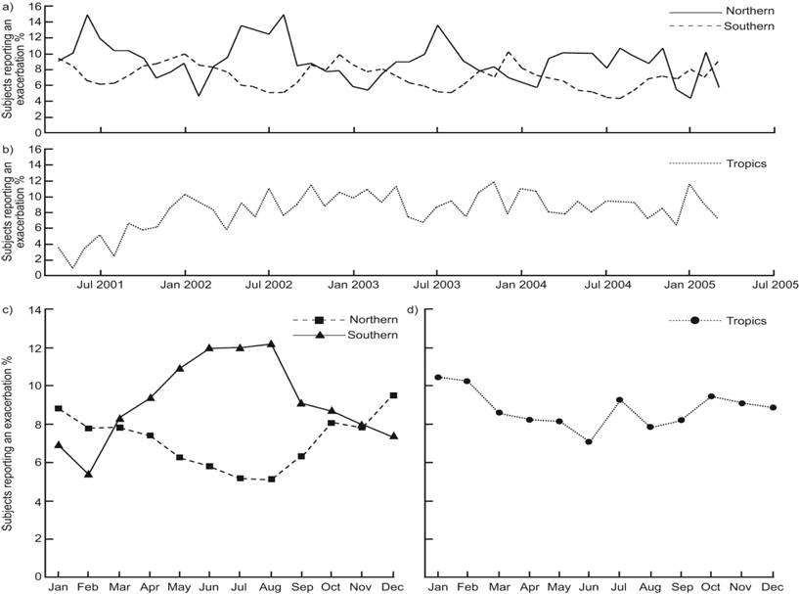
(Known) Seasonal Effects
Notes:
Add Reference

Slide 55
BSSR – Data management considerations
So for each patient we need to know the number of exacerbations and the follow-up we have (i.e. the time from randomisation to the last visit at which exacerbations were assessed)
Patients who do not have an exacerbation are important in this assessment. If we have less follow-up on patients who do not have an exacerbation then we will get a biased estimate of the rate (it will be too high)
We need to collect follow-up for patients who do not exacerbate – really need the date last assessed for exacerbation

Slide 56
Sample size determination formula – from BSSR plan Friede and Schmidli (2010)
θ - rate ratio under the alternative hypothesis
λ - overall observed exacerbation rate (per 26 weeks)
φ - is the estimated shape (overdispersion) parameter (normalized to 26 weeks) obtained in the analysis as described in SAP
Friede and Schmidli’s method assumes an equal follow-up in all patients of 1 unit of time; this will be approximately true at the end of the study insofar as nearly all patients have been followed up for 26 weeks. At the times of the BSSRs, some patients might have been followed up for shorter periods; however, since we could assume the exacerbation rate is constant over the study period, the true exacerbation rate could be approximated by the observed rate calculated using the negative binomial model with the patient-specific log(follow-up time) as the offset. Assuming approximately equal numbers of patients in both treatment arms, the sample size for both treatments combined is re-estimated blindly using Equation above.
Note: z_{a} is the a^{th} quantile of the standard normal distribution

Slide 57
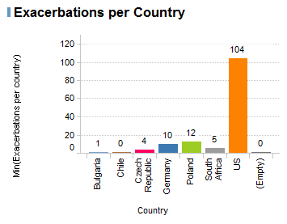
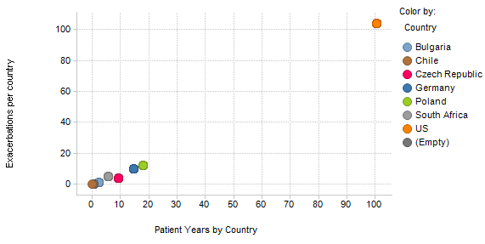
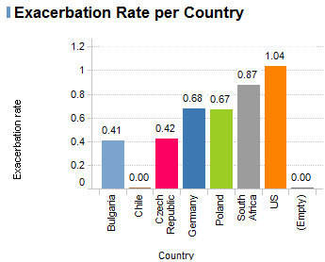
Pilot BSSR – Exacerbations by Country on 20 April
Exacerbations per country
Exacerbations vs Years of follow up by Country
Exacerbation rate per country

Slide 58
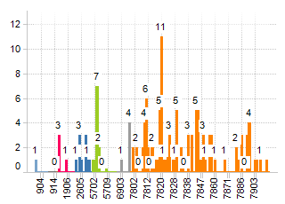
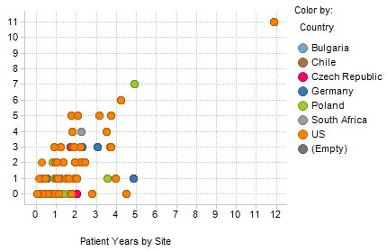
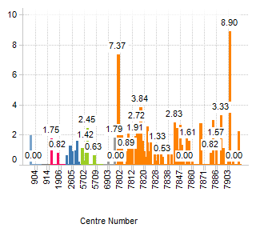
Pilot BSSR – Exacerbations by Site on 20 April

Slide 59
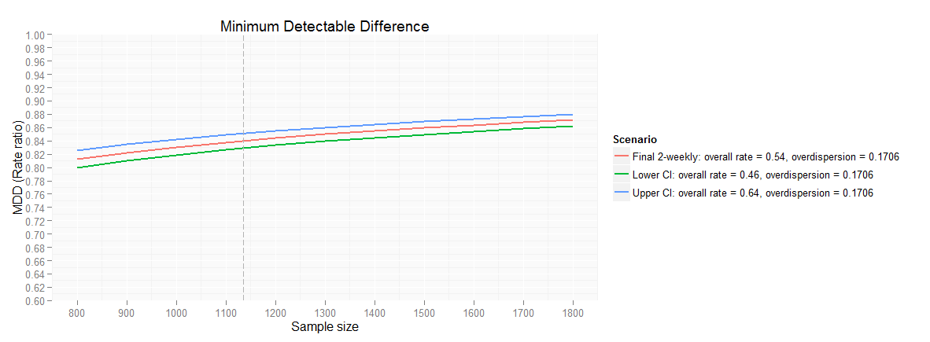
AZ COPD Exacerbation Study Final BiWeekly : MDD (graphically) – result slide
Overall 6month Exacerbation Rate 0.54, 95% CI (0.46; 0.64)
N=1136
NOTE: overall exacerbation rates are 6-monthly

