Slide 1
Quantitative assessment of adverse events in clinical trials: comparison of methods at interim and final analysis
Novartis QSE
V Jehl, in collaboration with N Hollaender, J Gonzalez-Maffe
Basel
October 29, 2019

Slide 2
Disclaimer
The views and opinions expressed in this presentation are those of the authors and do not necessarily reflect the official policy or position of Novartis or any of its officers.

Slide 3
Objective
Compare different methods to estimate the probability of occurrence of a selected adverse event (AE)
Particular focus
Early safety interim analysis (IA) for data monitoring committee (DMC) when limited knowledge about safety drug profile
Competing event (CE)

Slide 4
Setting
In clinical study reports (CSRs), AEs are commonly summarized using the incidence proportion (IP) (0 to 1)
or equivalently incidence frequency (0-100%)
To account for possible different follow-up time between patients, time-to-event methods are often employed:
one-minus-Kaplan-Meier (1-KM) is known to overestimate the AE probability in the presence of competing events
Non-parametric estimator of the cumulative incidence function (CIF) is therefore advocated
Do these methods reasonably estimate the AE probability at time of IA, when DMC needs to take decision on safety of the drug?
→ we investigate this via a case study and simulations

Slide 5
Adverse event & Competing event Definition
Adverse event (AE)
Any type of undesirable effect reported in context of clinical trial
“An event whose occurrence either precludes the occurrence of another event under examination or fundamentally alters the probability of this other event” Gooley et al. (1999)
Assumed well defined using MedDRA hierarchy (preferred term or grouping of preferred terms)
Denoted here as «AE», same principles apply to AE of particular severity or seriousness, vital sign or ECG finding
In most clinical trials, permanent drug discontinuation results in stopping the safety data collection
Thus the occurrence of permanent drug discontinuation prevents the observation of AE at a later timepoint → Permanent drug discontinuation (irrespective of cause, including death) treated as one combined CE
Competing Event (CE)

Slide 6
Methods compared & definitions
Incidence proportion at time t (IP) | $$\frac{d_{k}(t)}{N}$$ | $d_{k}$(t): #pat. experiencing the event k at any time before time t N: total #pat. at start of study
One minus Kaplan-Meier at time t (1-KM) | 1-$S_{k}(t)$ | $S_{k}\left(t\right):$ Kaplan-Meier estimator for event k at time t When event k is the AE, the AE is counted as an event, patients experiencing the CE (without prior AE) are censored
Cumulative incidence function (Aalen-Johansen estimator) at time t (CIF) | $$\sum_{{t_{j}≤t}_{ }}{S(t_{j−1})}\frac{d_{kj}}{n_{j}}$$ | S($t_{j−1}$): Kaplan-Meier estimator for the composite endpoint (AE or CE) at time $t_{j−1}$, 𝑑_{𝑘𝑗}: #pat. experiencing event k at time point 𝑡_{𝑗}, 𝑛_{𝑗}: #pat. under observation before timepoint 𝑡_{𝑗}
Parametric estimator based on the incidence density taking CE into account at time t (PCIF) | $\frac{{ID}_{k}}{{ID}_{all}}$ (1-exp(-t * ${ID}_{all}$)) | ${ID}_{k}$: incidence density for event k i.e. ${d_{k}}/{\sum{t_{i}}}$ $d_{k}$: #pat. experiencing event k $\sum{t_{i}}$: population time (person-time) at risk ${ID}_{all}$ = ${ID}_{AE}$ + ${ID}_{CE}$
Indexing by k, the event type k=AE or k=CE
#pat.= number of patients

Slide 7
Case study

Slide 8
Case study (1/5) a phase III study in breast cancer study
AE: most commonly observed AE - stomatitis
Stomatitis is defined as a Grouping of Preferred Terms in MedDRA
Mostly occurring within first 56 days of study treatment
At CSR, 321 patients out of 482 reported stomatitis (IPAE=0.67)
CE
Permanent discontinuation from study treatment including death
Per protocol, safety reported up to 28 days after last dose intake
At CSR, 117 patients out of 482 had a CE without prior AE (IPCE=0.24)
Follow-up time for study
Driven by primary efficacy endpoint (progression-free-survival): until sufficient number of PFS events to achieve pre-specified power i.e. irrespective of safety
Individual treatment duration: until disease progression, toxicity or cut-off date for primary analysis
Median exposure time 168 days (range: 7 to 703)

Slide 9
Case study (2/5) Final study results
At max follow-up (FU) time,
IP and CIF similar results
1-KM and PCIF provide a higher estimate than IP and CIF
Max FU time

Slide 10
Case study (3/5)
We now «introduce» an interim analysis (IA) 180 days after the first patient enrolled (i.e. Typical DMC situation)
What can the DMC say about the risk of stomatitis at that point in time?
Note: this IA did not exist in the considered study but was re-analyzed for the purpose of this investigational work

Slide 11
Case study (4/5) IA vs. Final study results
N=89 (#AE=67 #CE=4 #Cens=18)
N=482 (#AE=321 #CE=117 #Cens=44)

Slide 12
Case study (4/5) IA vs. Final study results
N=89 (#AE=67 #CE=4 #Cens=18)
N=482 (#AE=321 #CE=117 #Cens=44)
So what is «THE» probability of stomatitis?
How can a DMC take decisions on the safety profile?
What is the impact of CE distribution?
What is the impact of AE distribution?

Slide 13
Objective - revisited
Compare different methods to estimate the probability of occurrence of a selected adverse event (AE)
Particular focus
Early safety interim analysis (IA) for data monitoring committee (DMC) when limited knowledge about safety drug profile
Competing event (CE)
Investigate impact of AE and CE hazard function distribution
We model hazards using Weibull distributions

Slide 14
Simulation study

Slide 15
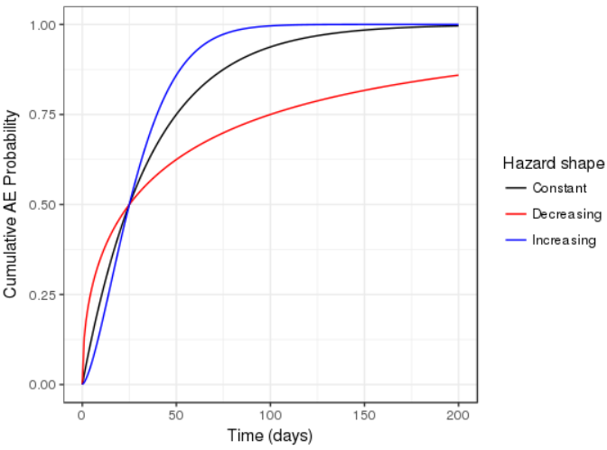
Investigate AE and CE hazard impact Illustration 1: AE only, no CE
AE cumulative probability (Weibull distribution - no CE)
AE distribution
Median=25 days
Hazard:
constant (shape=1);
decreasing (shape=0.5);
increasing (shape=1.5)

Slide 16
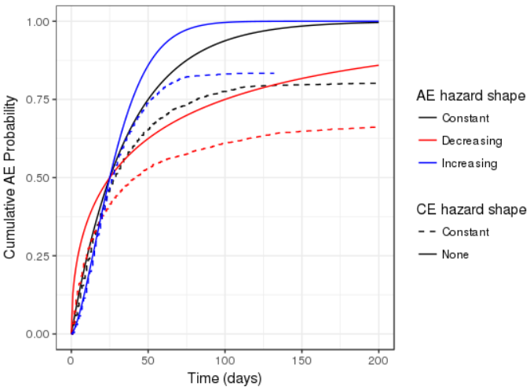
Investigate AE and CE hazard impact Illustration 2: AE and CE
AE cumulative probability (Weibull distribution) adding CE
AE distribution
Median=25 days
Hazard:
constant (shape=1);
decreasing (shape=0.5);
increasing (shape=1.5)
CE distribution
Median=100 days
Hazard:
constant (shape=1);

Slide 17
Investigate AE and CE hazard impact
More complex situations depending on the combination AE vs. CE distributions
We try to understand the impact on the estimation methods of
AE early vs. late
CE early vs. late
AE and CE relative frequency
Increasing, decreasing hazard

Slide 18
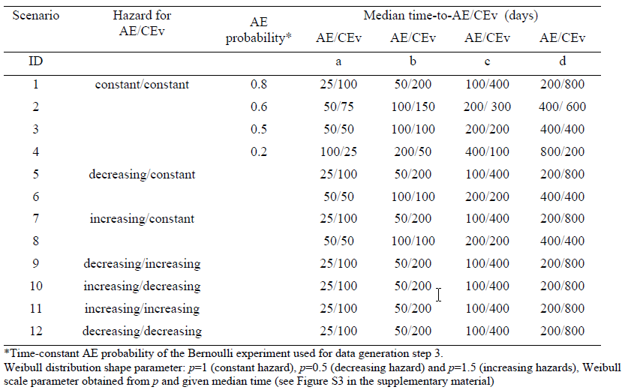
Investigation plan
We investigated the following scenarios and assess impact of
Constant hazard
1. Relative frequency
2. Timing
Early vs. Late event
Non-constant hazard
3. Different
distribution

Slide 19
Simulation set up & scenarios
AE and CE time simulation (Beyersmann et al. 2009)
Specify cause specific hazard function for AE and CE: h_{AE}(t) and h_{CE}(t)
We took Weibull distributions
Simulate time T with all cause hazard h_{AE}(t) + h_{CE}(t)
Attribute event as AE with probability h_{AE}(t) /(h_{AE}(t) + h_{CE}(t))
Simulate accrual time A
Determine calendar time of event CT=T+A
Prepare data for 3 analyses
«COMP»: complete data i.e. as simulated. In this set, each patient has the AE or the CE
«FINAL» (i.e. CSR): 540 days after first accrual (censoring events beyond day 540);
«IA»: 180 days after first accrual (censoring events beyond day 180)
We simulate N=300 patients and perform 1’000 simulations

Slide 20
Assessment method
For each analysis (COMP, FINAL or IA), the AE probability will be estimated at the maximum observed time (AE, CE or censoring): t_{max}
Note t_{max} differs between analysis
We take our reference or «truth», P_{true}, as the mean CIF at t_{max} over all simulations for the COMP data i.e. the complete data as simulated where all patients have AE or CE
When the hazards for AE and CE are constant, P_{true} can be obtained analytically
For each method we assess
$\hat{P_{j}}$ is the estimated probability at t_{max} ,
R is the number of simulations

Slide 21
Results Constant hazard
COMP= as simulated
FINAL=day 540
IA=day 180
Method
AE proba=0.6 Median time-to-AE/Median time-to-CE (days)
50/75 | 100/150 | 200/300 | 400/600
P_{true}
AE probability

Slide 22
Results Constant hazard
COMP= as simulated
FINAL=day 540
IA=day 180
Method
AE proba=0.6 Median time-to-AE/Median time-to-CE (days)
50/75 | 100/150 | 200/300 | 400/600
P_{true}
AE probability
At COMP: 1-KM overestimates the risk, other methods perform similarly
At FINAL: when AE is early compared to analysis time, CIF, IP and PCIF perform similarly. The later the event, the bigger the bias; using IP underestimates the risk.
At IA: AE probability well estimated only for early events with high bias for later events.

Slide 23
Results Non-constant hazard
COMP= as simulated
FINAL=day 540
IA=day 180
Method
Decreasing hazard for AE and CE Median time-to-AE/Median time-to-CE (days)
25/100 | 50/200 | 100/400 | 200/800
P_{true}
AE probability

Slide 24
Results Non-constant hazard
COMP= as simulated
FINAL=day 540
IA=day 180
Method
Decreasing hazard for AE and CE Median time-to-AE/Median time-to-CE (days)
25/100 | 50/200 | 100/400 | 200/800
P_{true}
AE probability
At COMP: 1-KM overestimates the risk, other methods perform similarly
At FINAL: when AE is early compared to analysis time, CIF, IP and PCIF perform similarly. The later the event, the bigger the bias; PCIF no longer performs as CIF
At IA: bias can be high, not consistent PCIF positioning compared to other methods

Slide 25
Conclusion (1/2)
Methods ordering
As expected, 1-KM always provided the highest probability while IP provided the lowest
The relative positioning of PCIF compared to the other methods was not systematic, sometimes underestimated, sometimes overestimated the risk
For FINAL,
when the AE occured early compared to the time of analysis (e.g. median AE time 25, 50, 100 days vs. analysis cutoff day 540 or «mature data»), all methods, expect 1-KM, performed similarly
CIF generally out performed the other methods
For IA
Except when the event occured early compared to the analysis time (e.g. median AE time 25, 50 days vs. analysis cutoff day 180), the estimates obtained at IA generally underestimated the risk (except with 1-KM)

Slide 26
Conclusion (2/2) Back to initial question
”Do these methods reasonably estimate the AE probability at time of IA, when DMC needs to take decision on safety of the drug?”
Based on current simulated scenarios, answer clearly «NO»
Recommendations
use of CIF
Over-performed compared to the other methods in a range of scenario also at FINAL
Allows comparisons between analysis (i.e. CIF at 6 months can be estimated at the IA and the FINAL) and external source if patients characteristics remain unchanged over the accrual period. This could be of particular interest for DMCs.
use of the estimand framework also for safety
Clarify question
What time horizon is studied (e.g. 6 months, 12 months)?
What is the intercurrent event i.e. how is the CE defined?

Slide 27
References
Allignol A., Beyersmann J., Schmoor C. (2016). Statistical issues in the analysis of adverse events in time-to-event data. Pharmaceutical Statistics 15, 297-305.
Beyersmann J., Allignol A., Schumacher M. (2012). Competing risks and multistate models with R Springer: New York.
Unkel S., Amiri M., Benda N., et al. (2018). On estimands and the analysis of adverse events in the presence of varying follow-up times within the benefit assessment of therapies. Pharmaceutical Statistics, 1-18.

