Slide 1



Registered Student Summary
19th November 2025

Slide 2
158 students have registered for the 2025/26 PSI Medical Statistics Careers Event

Slide 3
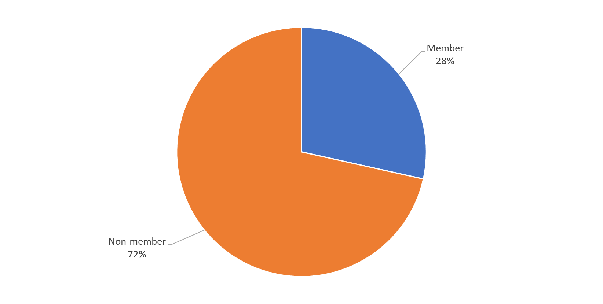
Majority of registered students are non-members…

Slide 4
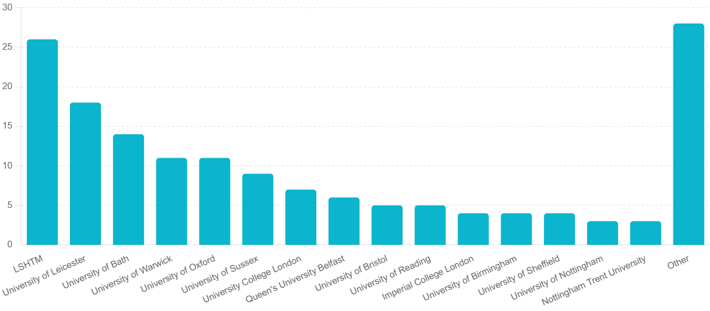
University of Registered Students
Other includes: Lancaster University, Durham University, University of Cambridge, Aston University, University of Greenwich, Nottingham Trent University, Hohenam, Oxford Brookes University, Cardiff University, University of Sciences, Techniques and Technologies of Bamako, Banaras Hindu University, Queen Mary University of London, University of Strathclyde, University of Essex, King’s College London, Hasselt University, University of Liverpool, Keele University, University of Edinburgh, University of London, and University of St Andrews.

Slide 5
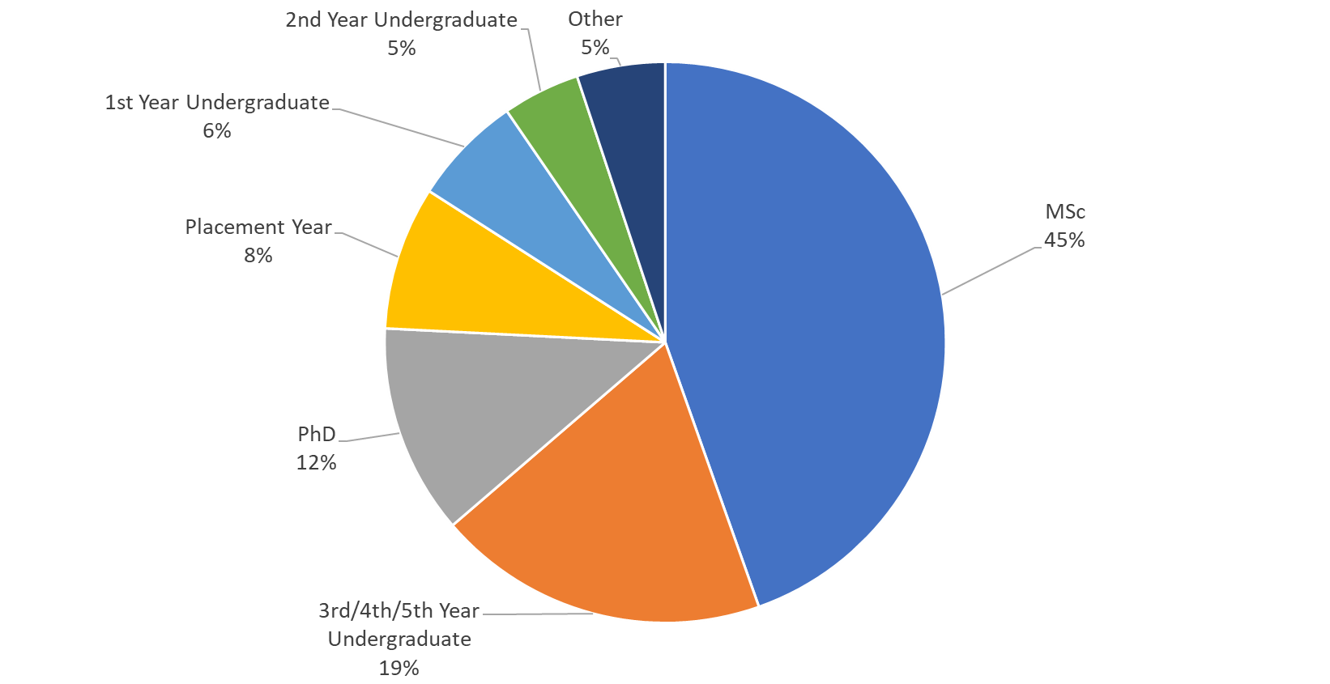
Year of Study for Registered Students

Slide 6
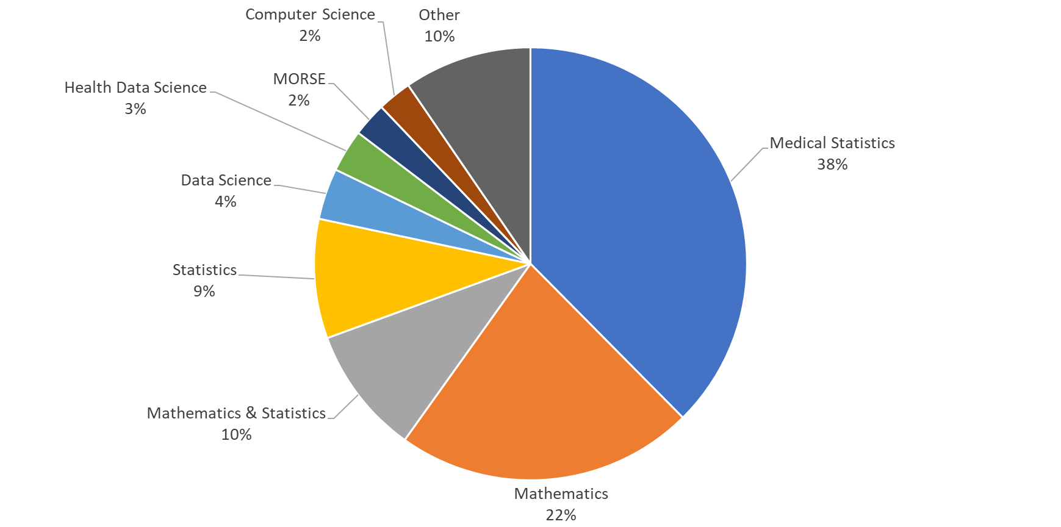
Courses Studied by Registered Students

Slide 7
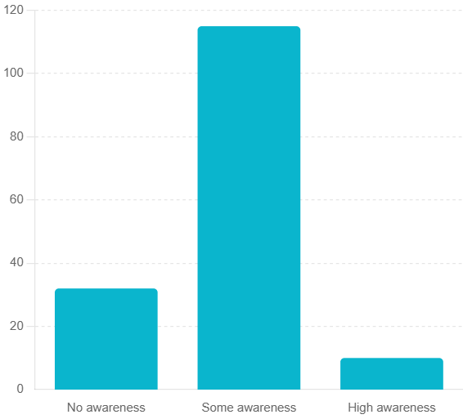
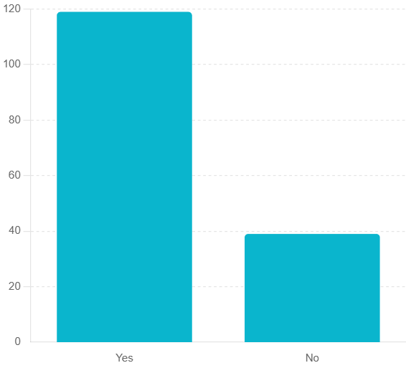
Majority of students have some awareness of opportunities in medical statistics, and would like to opt in to receive further communications from sponsors/exhibitors…
What is your current level of awareness of opportunities available in medical statistics?
I would like to opt-in to receive further communication from the Careers Fair Sponsors/Exhibitors

Slide 8
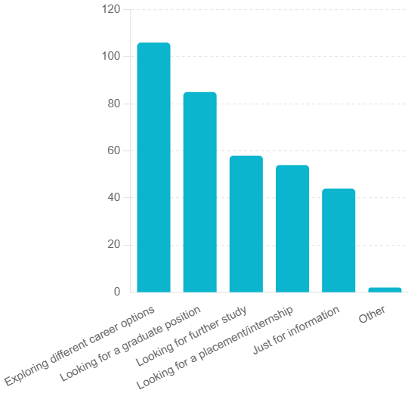
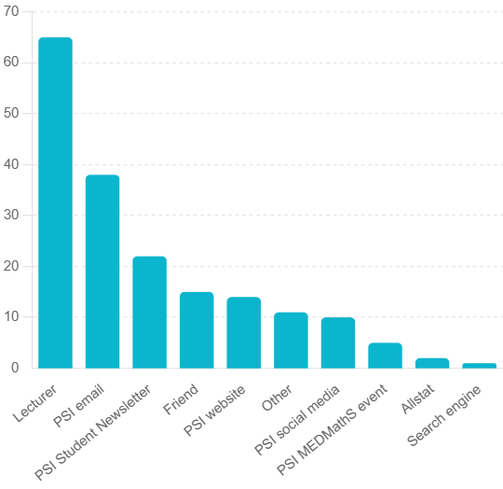
Attending students are looking for a variety of future opportunities, and many heard about the event from their lecturer…
What is your reason for attending?
How did you hear about the event?

