Slide 1
Registered Student Summary
21st November 2023

Slide 2
144 students have registered for the 2023/24 PSI Medical Statistics Careers Event

Slide 3
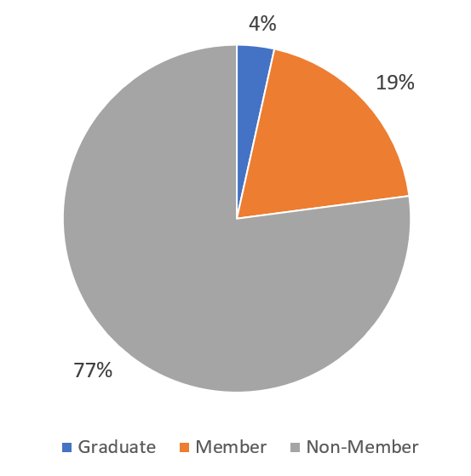
Majority of registered students are non-members

Slide 4
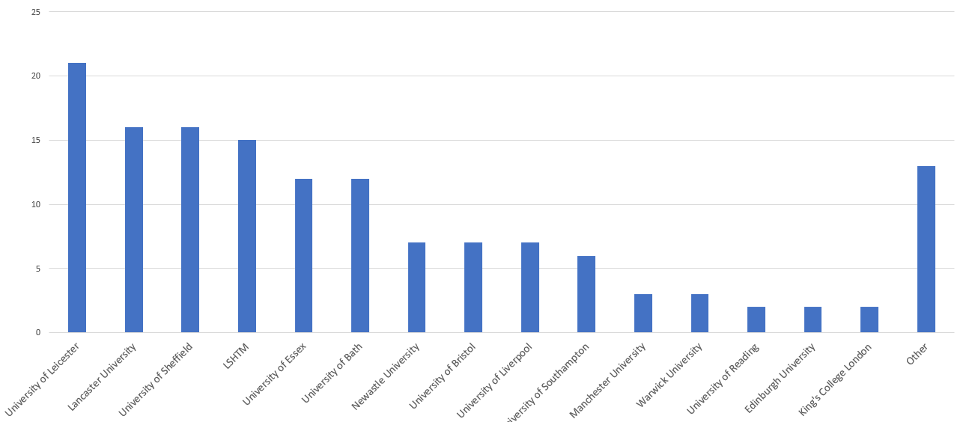
University of registered students/graduates
Other: UCL, Oxford, Open University, Keele, Salford, Cardiff, Aberystwyth, Exeter, Cambridge, Greenwich, Chester, Birmingham, Queen Mary University of London (1 attendee each)

Slide 5
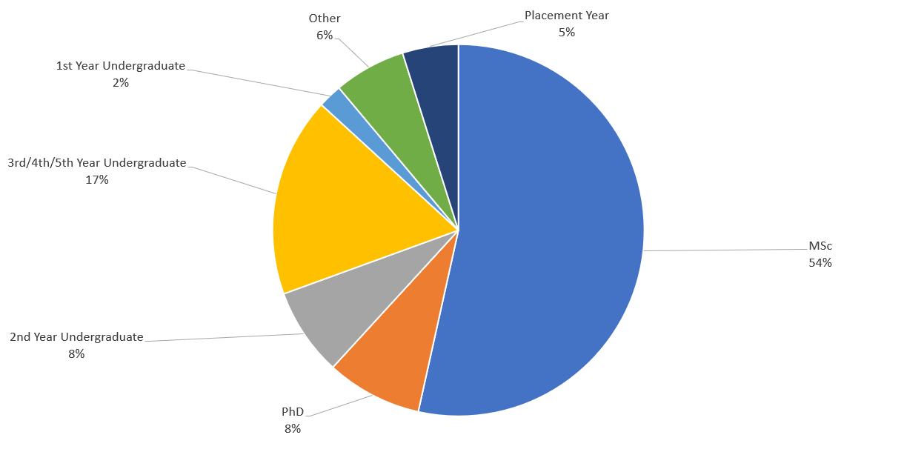
Year of Study for registered students

Slide 6
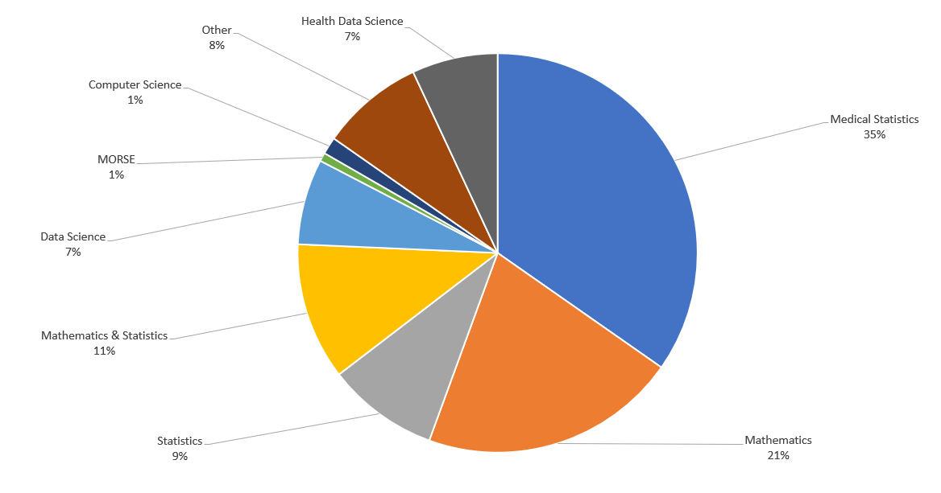
Courses studied by registered students

Slide 7
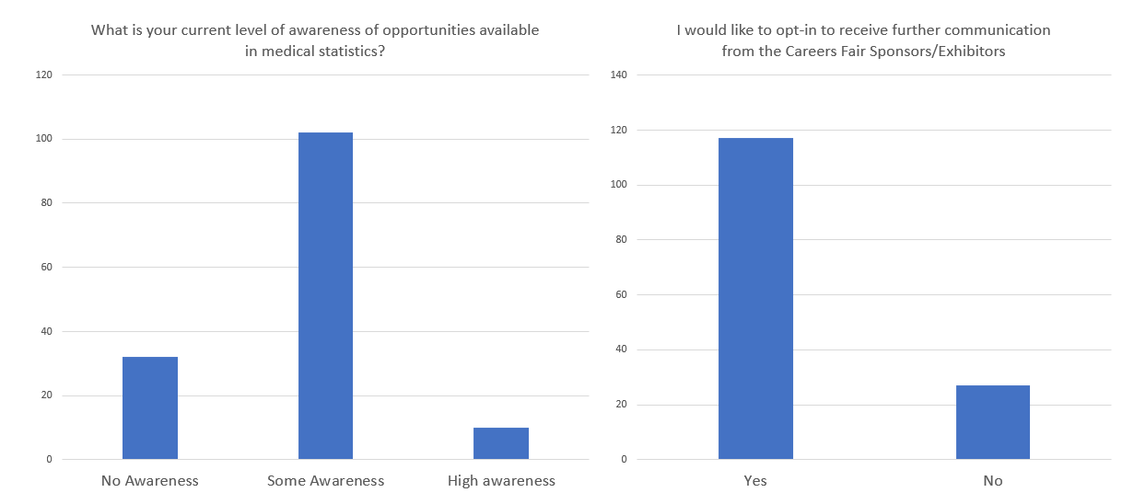
Majority of students have some awareness of opportunities in medical statistics, and would like to opt in to receive further communications from sponsors/exhibitors

Slide 8
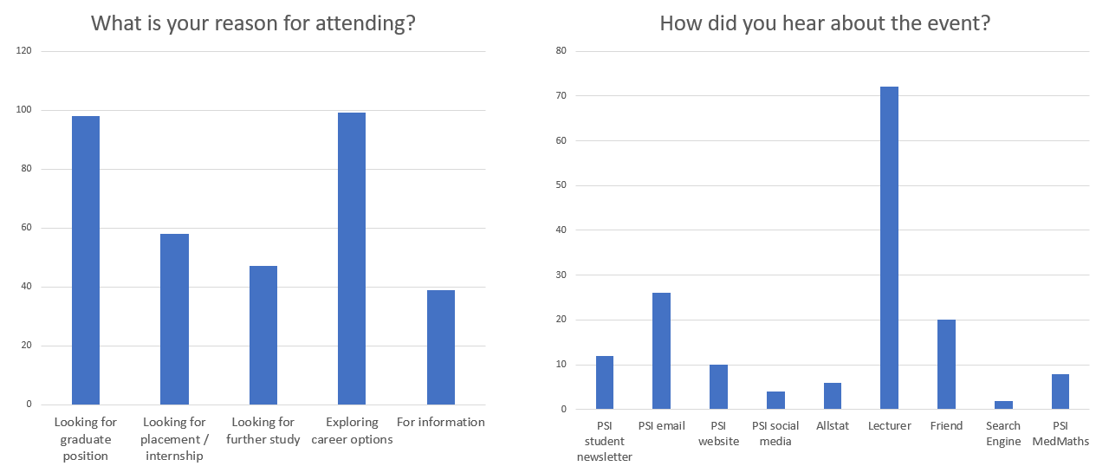
Attending students looking for a variety of future opportunities, and many heard about the event from their lecturer

